Slide 1
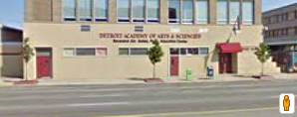
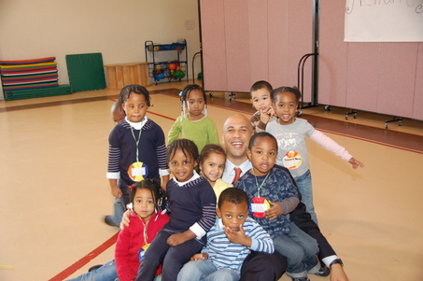
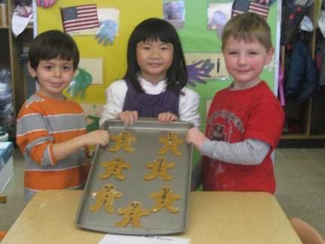
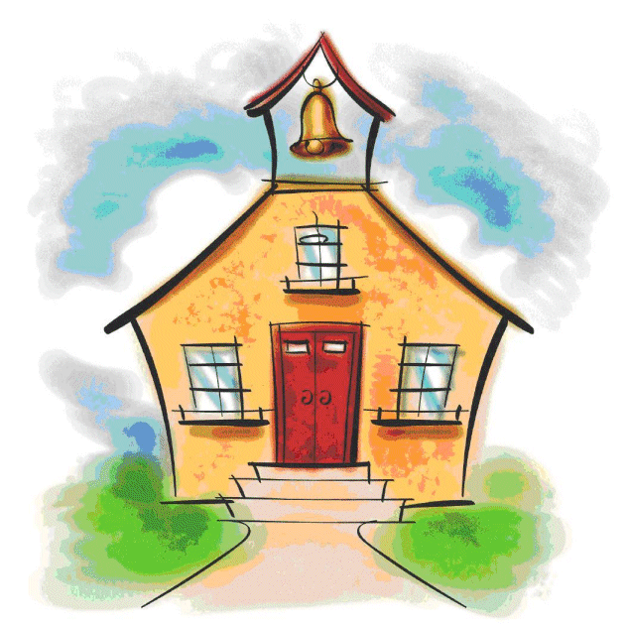
Education Use
There are 8 Elementary Schools within 1.5 miles of the site.
  2 Private
  1 Charter
  5 Public (1 is a Magnet)
  Only 1 has an “A” Rating (Magnet)
Poor performance of Public and Charter Schools is a deterrent
Very few children in CBD (<8% Hh)
Demographics don’t support School
Preschool in the CBD is a more viable option. Ages 3,4,5
Market: downtown workers and residents with young children
Existing schools near our site

