Slide 1
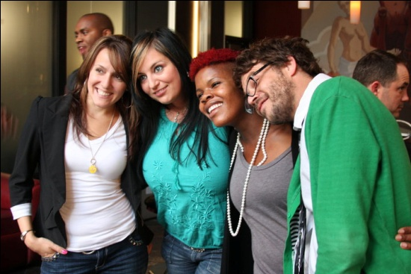
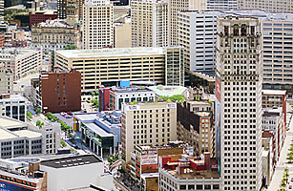
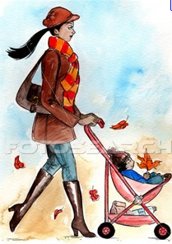
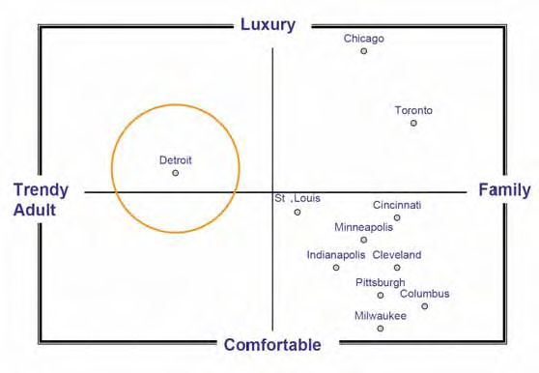
Sociographic Information
‘Hipsters’ like to live downtown (60% age 25-39)
2/3 work in city, tend to be professionals who work long hours, relatively high salaries
Enjoy the restaurants, nightlife & excitement
Typical resident has not started a family.
  Families with very young children are underserved in the CBD.
  Those with older children move out of downtowns
Many in this group desire safer environment in the CBD - and want access to Groceries
< 6000 live but 80,000 People work in CBD
New Jobs in CBD are on the Rise!
  New employers describe employees as youthful, internet-based,& excited to be in Detroit.
Source: Adapted from Strategic Marketing & Research, Inc. 2006 for Detroit Metro Visitors and Convention Bureau

