Slide 1
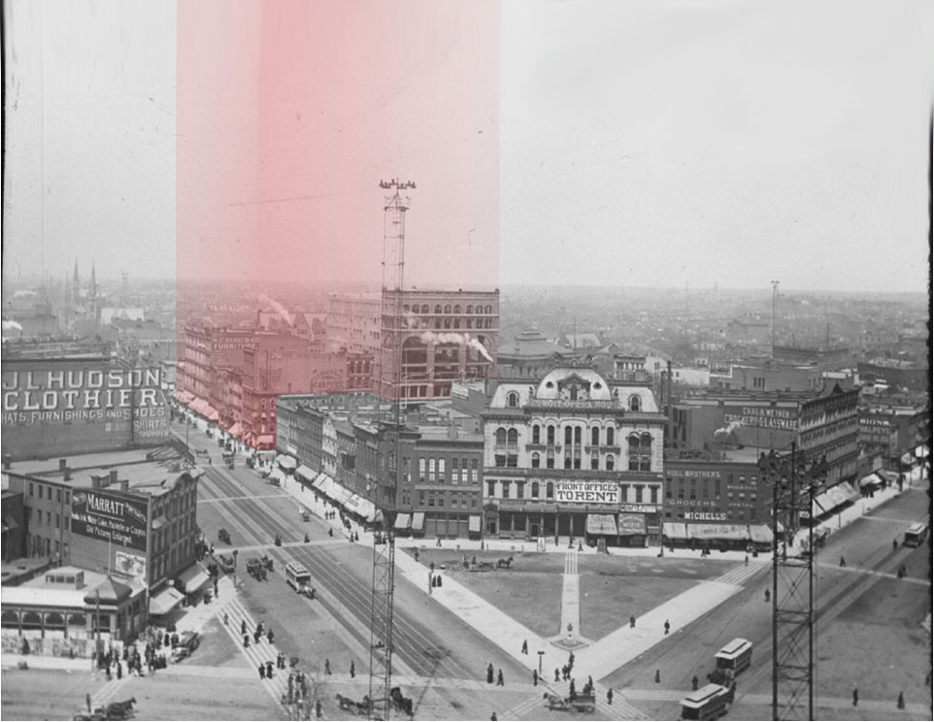
Hudson’s Site
Connie Rizzolo Brown
Mary Cay Lancaster
Lesa Rozmarek
Ryan Grabow

Slide 2
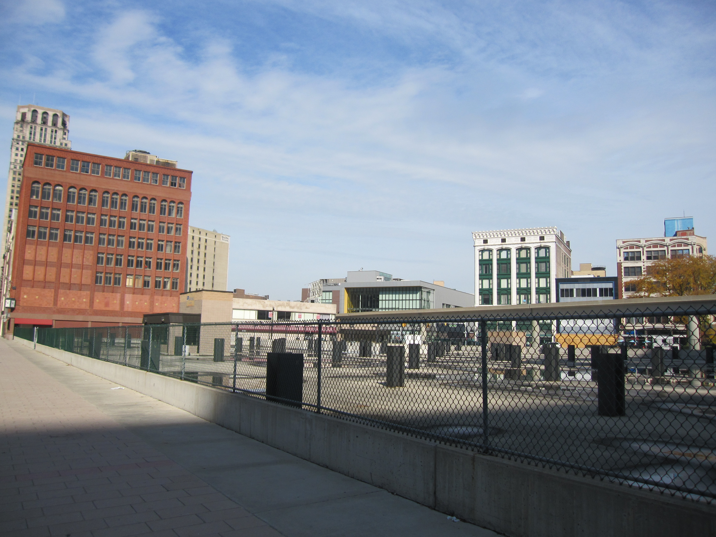
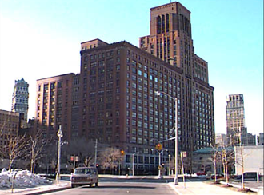
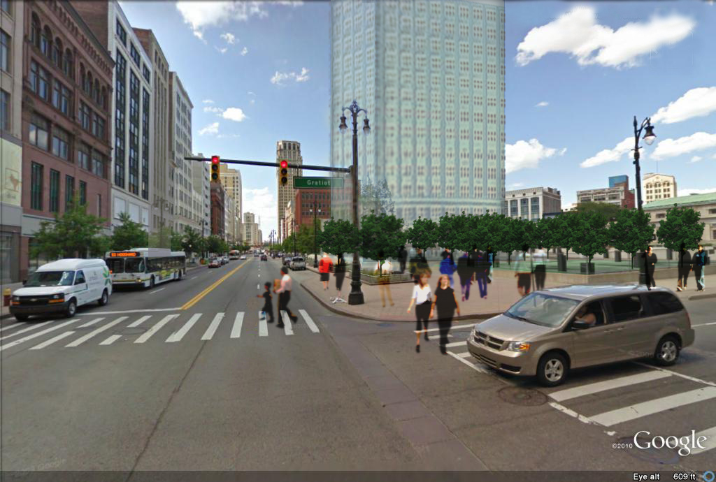
Objectives
Site
Previous presentation
Sociographics
New uses
Development Proposal
Economics / Pro-forma

Slide 3
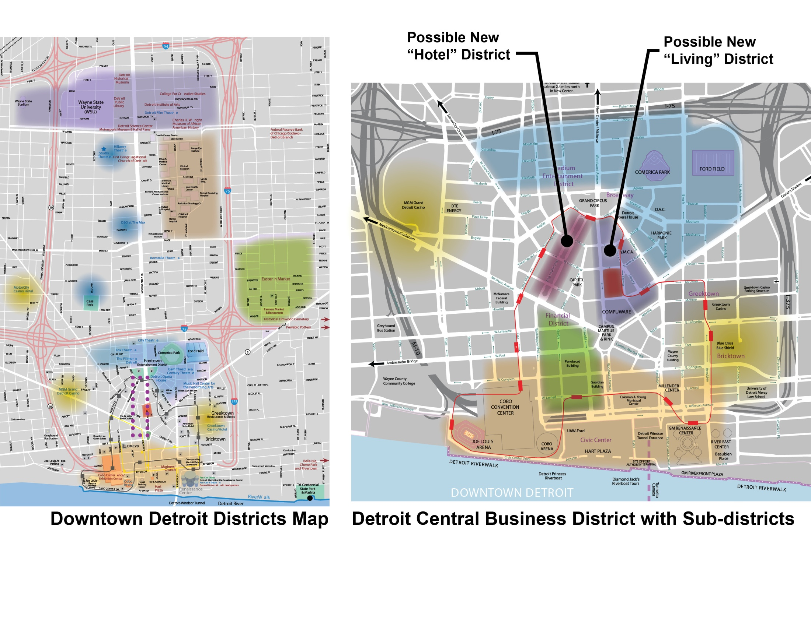
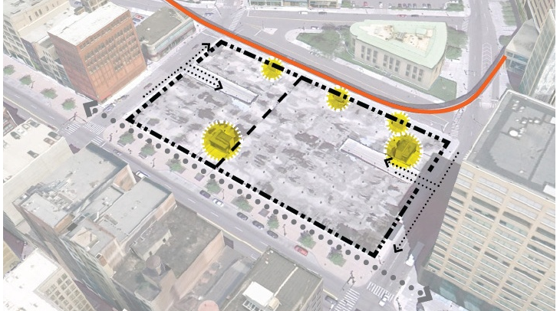
Downtown Detroit
Heart of the CBD.
Higher residential density desired.
Large proportion of office commuters.
Potential connection to People Mover.

Slide 4
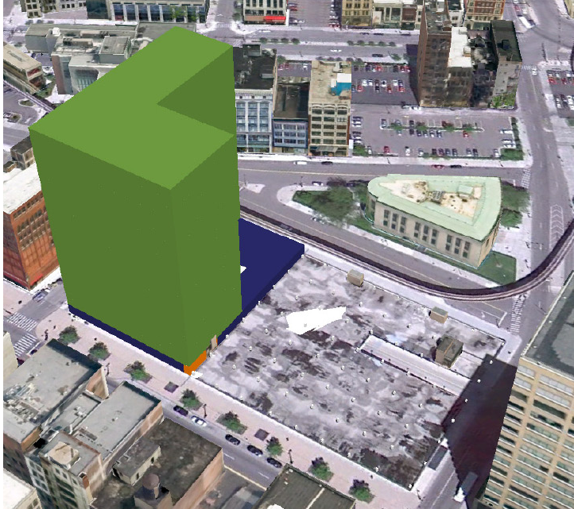
Previous Presentation
Proposed:
Grocery
Residential
Phased approach
Feedback to Consider:
Sociographic data
Educational Use
Market Saturation
Growth Trends & Expectations

Slide 5

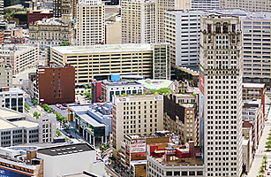

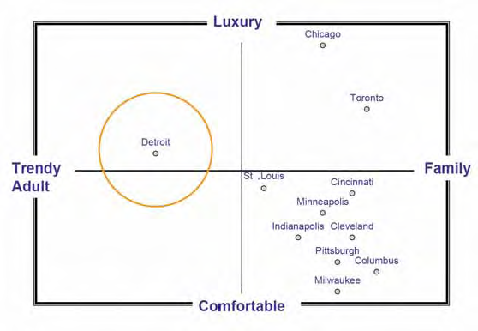
Sociographic Information
Sociographic Information
‘Hipsters’ like to live downtown (age 25-39)
Many in this group desire safer environment than the CBD currently offers
Residents work long hours (2/3 work in city)
Residents want access to groceries
Typical resident has not started a family.
  Families with very young children are underserved in the CBD.
  Families with older children tend to move out of downtowns
80,000 People work in the CBD
New Jobs in CBD are on the Rise!
  New employers describe employees as youthful, internet-based,& excited to be in Detroit.
Source: Adapted from Strategic Marketing & Research, Inc. 2006 for Detroit Metro Visitors and Convention Bureau

Slide 6



Education Use
Very few children in CBD (<8% Hh)
There are 7 Elementary Schools within 1.5 miles of the site.
  2 Private
  1 Charter
  4 Public (1 is a Magnet)
  Only 1 has an “A” Rating (Magnet)
Poor performance of Public and Charter Schools is a deterrent
Demographics don’t support School
Preschool in the CBD is a more viable option. Ages 3,4,5
Market: downtown workers and residents with young children
Existing schools near our site

Slide 7
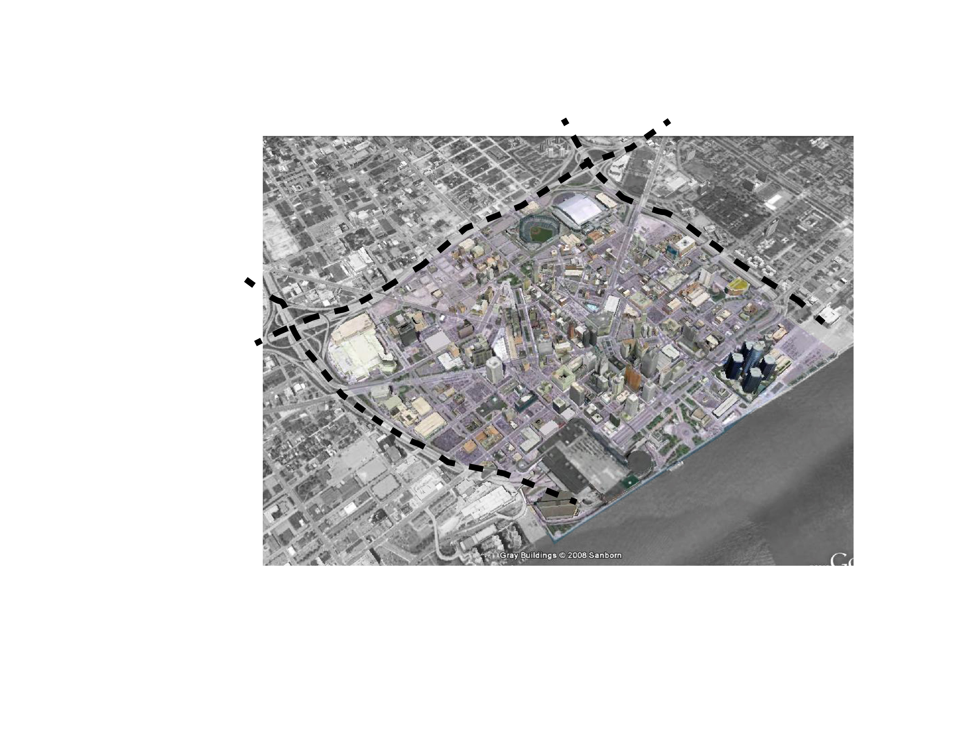


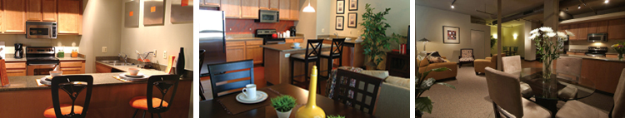
The Residences at 1200 Woodward
Urban formula: Density = City = Add Density to the CBD
Two-Phase Strategy
  First Phase: Grocery at Street Level with Residential Tower above and Urban Park at Phase 2 site
  Second Phase: Retail and Lobbies at Street Level, Possible Private Elementary School at mid-levels, with Residential Tower above

Slide 8
Effect of Site Rent
Annual values indicated.
Construction cost assumed at $160 per square foot.
0% down, 5-10% Interest, 30 years.
Assumes every square foot is leasable.
Actual income lower.
Taubman Retail
Retail
Office
Single floor construction leaves no profit after site rent and construction expenses.
10+ story office works, but lacks market.
Grocery-Educational-Residential has profit potential once loan is paid; however, the land is leased not owned.
Grocery
Residential
Educational

Slide 9
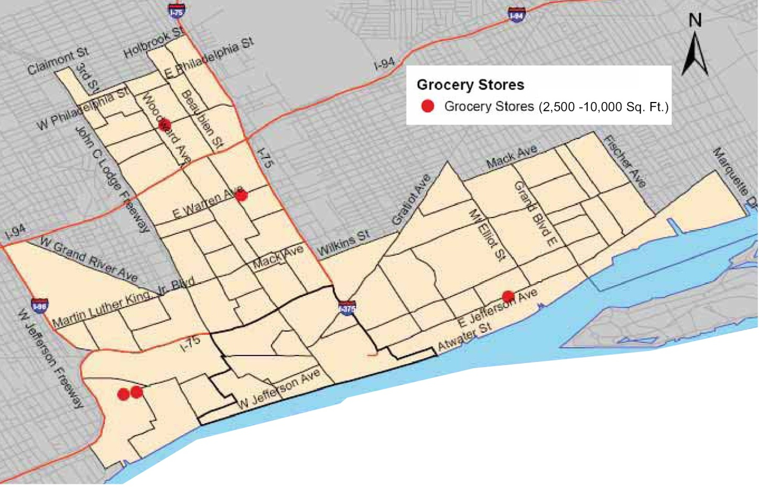
Grocery Economics
Description | Value
Weekly Sales per Sq.Ft. | $ 11.77
Annual Sales per Sq.Ft. | $ 612.04
Rent as percent of Sales | 3.18%
Annual Sq.Ft. rental (Avg) | $ 19.46
Annual Sq. Ft. Site Rent | $ 25.00
An average performing single floor grocery store would not be sufficient to cover site rental costs.
Grocery may be a strong component in a Mixed-use strategy.
Area of influence

Slide 10
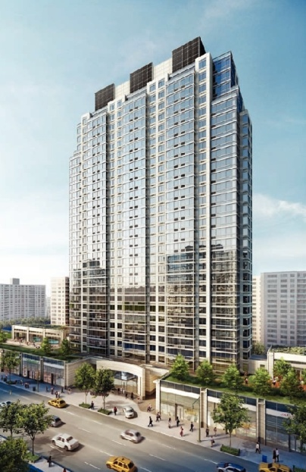
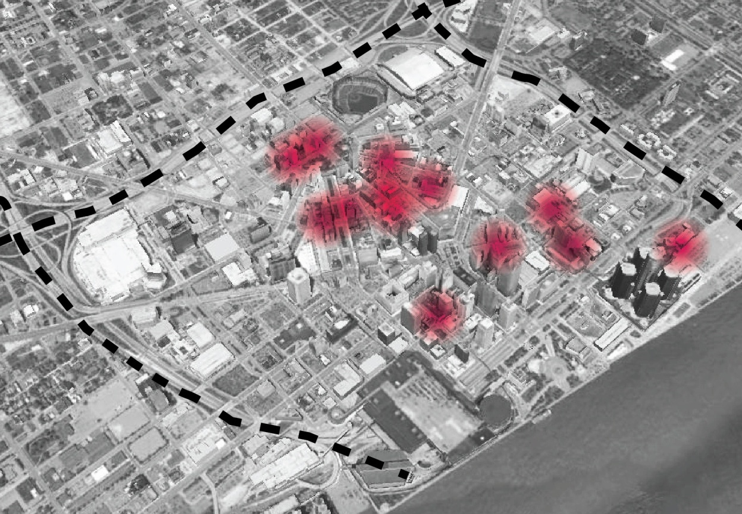
Residential Economics
MARC RIZZOLO:
Lesa
MARC RIZZOLO:
Lesa
Existing Vacancy Rate >4% in CBD
Soft loft design desired by residents
Higher levels have better views and improves rent values.
Residential is a secondary use necessary to be profitable
New construction housing is “Unique” in CBD
A variety of rental and for sale units requires:
  Variety of housing stock to appeal to a mixed market
  Good local education
  Safe local recreation facilities
  Nearby services
Phase 1 would bring 658 people to the CBD
http://npaper-wehaa.com/pub-files/12284050704937f94e5d725/pub/New-York-Family-March-2010/lib/12670559344b85bd3e9cd82.jpg
http://www.loftsofmerchantsrow.com/
Description | Value
Estimated 3% Growth per Year | +122 Units 1st Year
Leveling Off Point (site rent vs. Construction costs) | 20 to 25 floors
Est. Floor plate 21,000 sq.ft. | 32 floors
Avg. 14 Units Per Floor | 448 Units
Est. Construction Costs | $106, 000,000
Market Rate for One Bedroom in MRD | $1.20 - $1.30 sq. ft.
Est. Yearly Rental Income | $10, 400,000
Est. Yearly Mortgage (20 Year) | $8,000,000

Slide 11
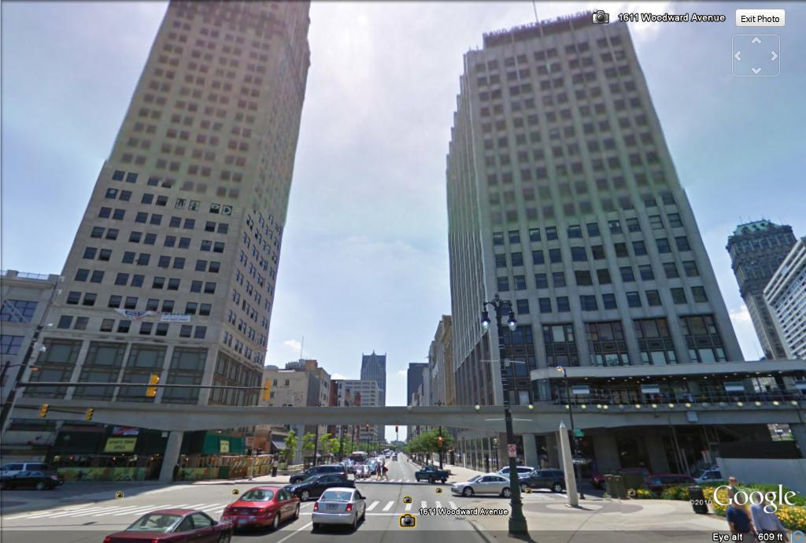
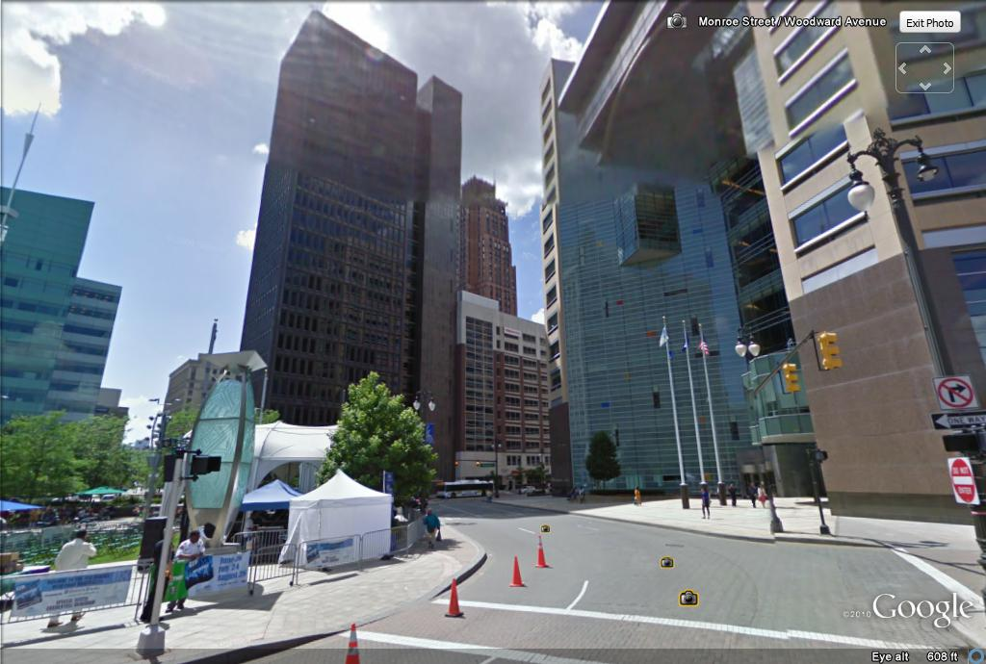
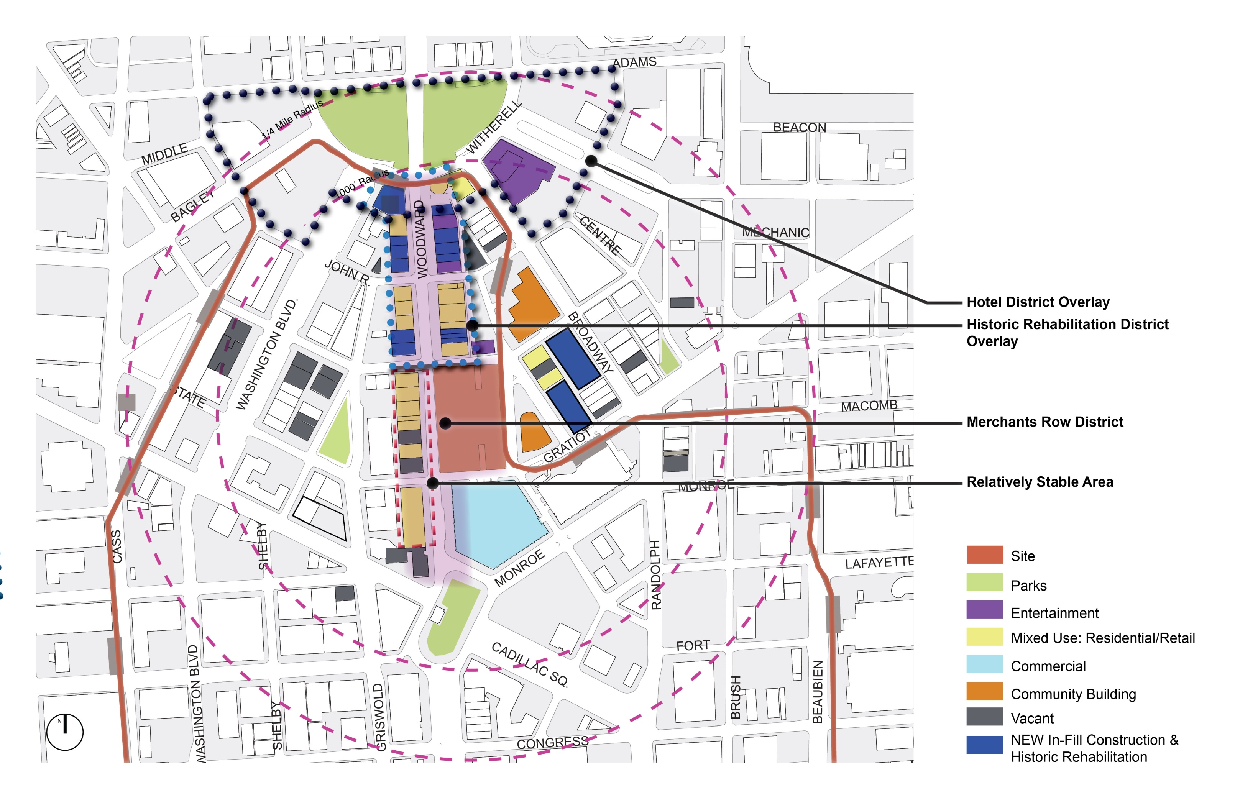
Creating the 100% Location
MARC RIZZOLO:
lesa
MARC RIZZOLO:
lesa
Remove Threshold Resistance at Grand Circus Park Gateway
  Rehabilitation of Existing Structures provides estimated 700 additional Residential Units
  Location of District centrally located within CBD
Phase 1 & 2 provides substantial density to Merchant’s Row District
Larger name brand grocery benefits from both onsite residences and draws from a substantial region
High quality educational component can grow from pre-school/daycare for area workers to full elementary school
Lower level commercial supports both residences and city goals

Slide 12
Space Allocation & Cash Flow

Slide 13
Pro Forma
Description | Value
Gross Income (90% of potential) | $ 4,862,250
Operations % of Gross Income | 45%
Operations Expense | $ (2,188,012)
Site Rent | $ (925,000)
Net Income | $ 1,749,237
Construction Cost | $ 56,560,000
Capitalization Rate | 3.1%
Years to payback w/o financing | 32.3
Construction Payments
Profitability
Time

Slide 14

The Residences at 1200 Woodward

Slide 15
Citations
http://forum.skyscraperpage.com/showthread.php?t=178249
http://www.fotosearch.com/IMZ259/rco0052/
http://www.businessleadersformichigan.com/node/258
http://www.thetransportpolitic.com/2009/03/16/bringing-rapid-transit-to-detroit/
http://www.thekraemeredge.com/
http://www.nytimes.com/1987/06/07/realestate/perspectives-vertical-shopping-malls-plugging-in-an-anchor-at-the-gimbels-site.html
http://detnews.com/article/20101006/BIZ/10060387/Winners--losers-emerge-among-Detroit’s-hotels
http://www.forbes.com/forbes/2010/1108/focus-dave-bing-motown-autos-detroit-must-shrink.html
http://michpics.wordpress.com/2008/12/06/the-demolition-of-the-jl-hudson-building-in-detroit/
http://www.degc.org/
http://www.metromodemedia.com/devnews/cadillacctre5108.aspx
http:www.expedia.com
http://detroitcommunitydevelopment.org/
http://datadrivendetroit.org/data-mapping/
http://onedscorecard.org/
http://socialcompact.org/index.php/site/research/category/food_access/
http://www.naahq.org/SiteCollectionDocuments/Industry%20Resources/2010%20Income%20and%20Expenses%20Survey.pdf
http://i46.tinypic.com/1zd14ra.jpg
Detroit Zoning Ordinance (01 Apr 2010)
http://www.city-data.com/
http://www.downtowndetroit.org/ddp/housing-lease.htm
http://www.michiganhousinglocator.rentlinx.com
http://www.motorcityapartments.rentlinx.com
http://www.showmetherent.rentlinx.com/Listings.aspx?Location=48226&Within=2&StartAt=40
http://units.realtydatatrust.com/unittype.aspx?ils=3&propid=32836
http://www.simplyhired.com/a/local-jobs/city/l-Detroit,+MI
www.detroitprogress.com
http://www.computerworld.com/s/article/102711/Quicken_Loans
http://www.danmulhern.com/wordpress/2007/03/quicken-loans-how-employees-matter/
http://www.computerworld.com/s/article/102711/Quicken_Loans
http://www.metromode.com
http://www.bridging96.com/article/20101026/FREE/101029901/1060/mobile&template=mobile
http://wwj.cbslocal.com/2010/09/29/galaxe-expands-commitment-at-1001-woodward-work-hiring-increases/
http://www.crainsdetroit.com/article/20101117/FREE/101119866/500-new-jobs-on-way-aided-by-tax-credits#
http://www.wxyz.com/dpp/news/local_news/governor-granholm-talks-jobs-at-mega-meeting
http://pics.city-data.com/zraces/15388.jpg
http://www.forbes.com/2010/06/04/migration-moving-wealthy-interactive-counties-map.html
http://www.brookings.edu/es/urban/census/whygrowth.pdf
http://www.fmi.org/facts_figs/?fuseaction=superfact
http://www.bizstats.com/reports/rent-sales-ratio.php
http://www.nps.gov/history/hps/tps/tax/download/HPTI_brochure.pdf
http://www.detroitmi.gov/
Google Earth

Slide 17
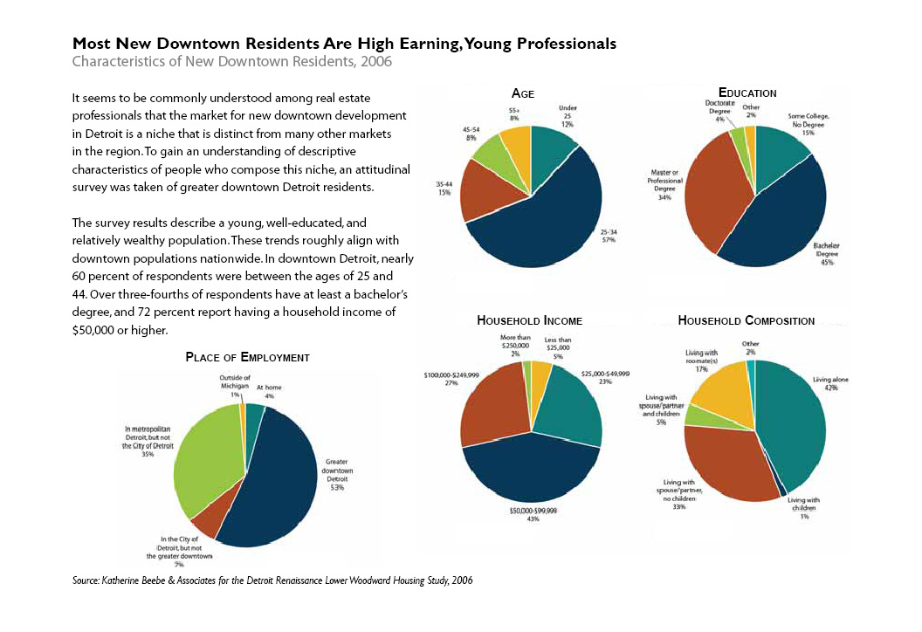

Slide 18
