Slide 1
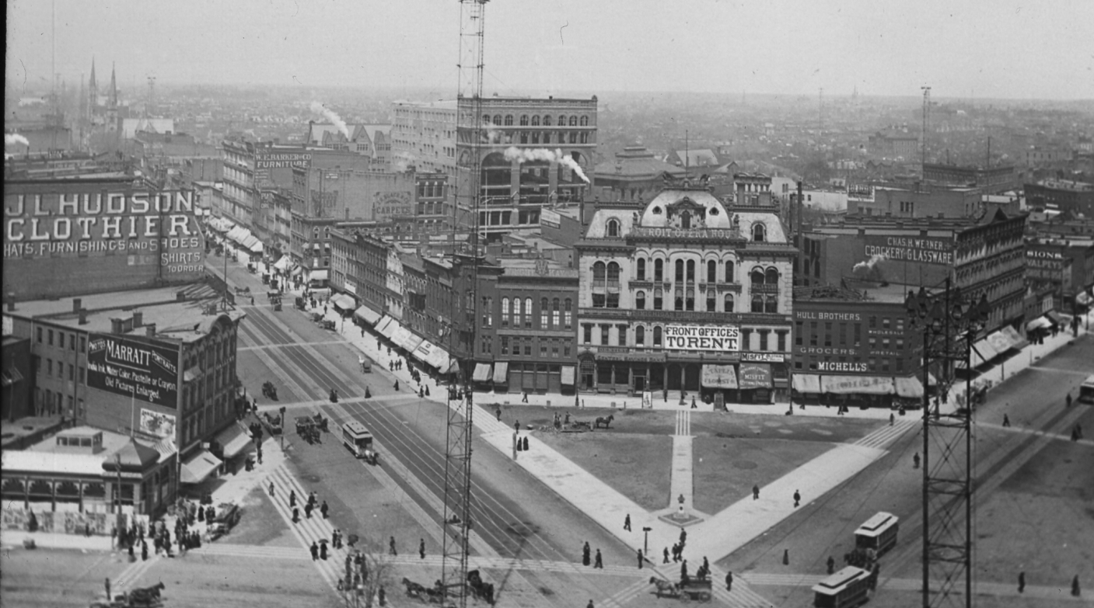
Hudson’s Site
Connie Rizzolo Brown
Mary Cay Lancaster
Lesa Rozmarek
Ryan Grabow

Slide 2
Objectives
Site
Previous presentation
New uses
Sociographics
Economics / Proforma

Slide 3
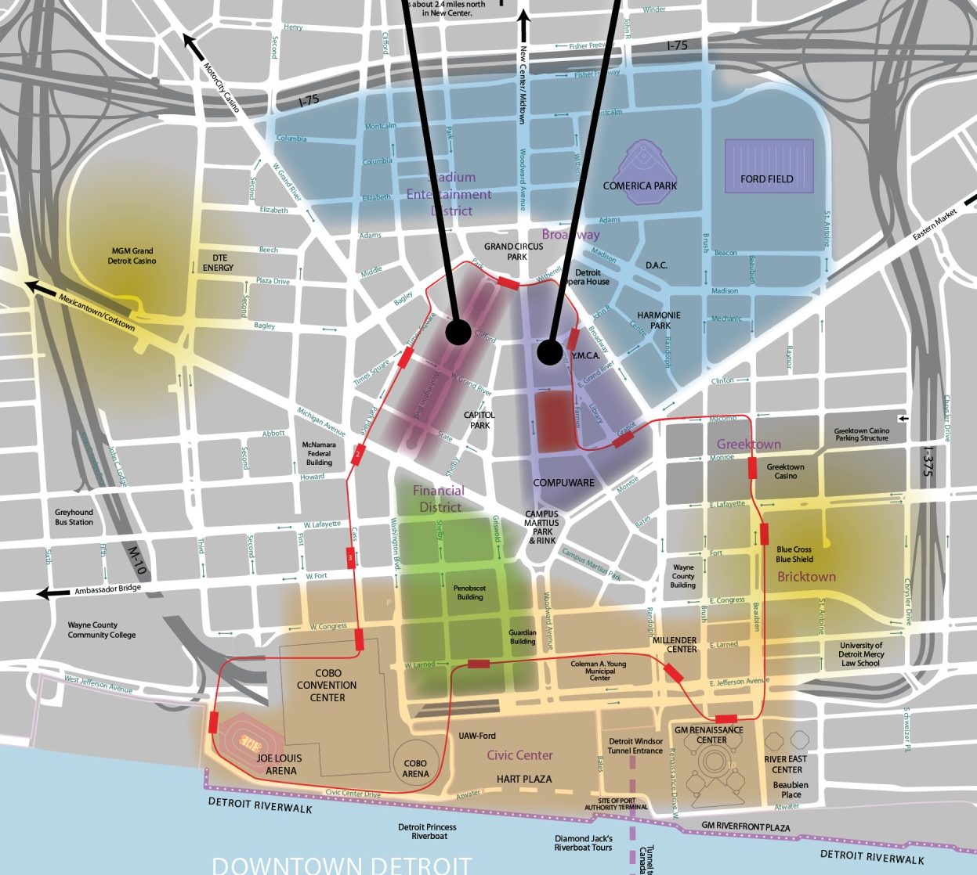
Downtown Detroit
Heart of the CBD.
Higher residential density desired.
Large proportion of office commuters.
Potential connection to People Mover.

Slide 4
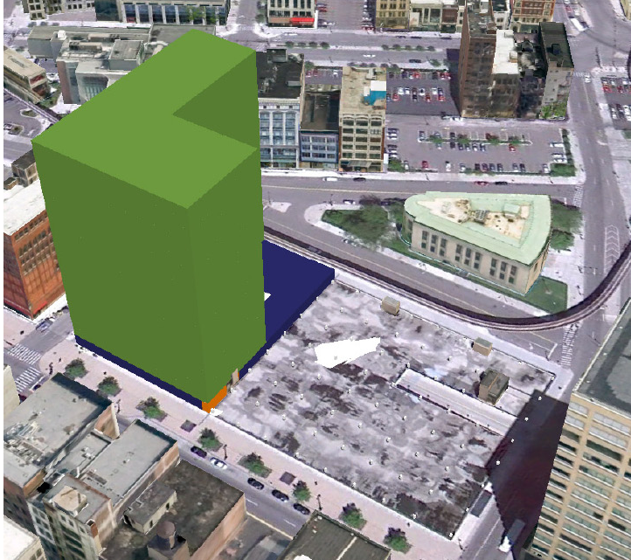
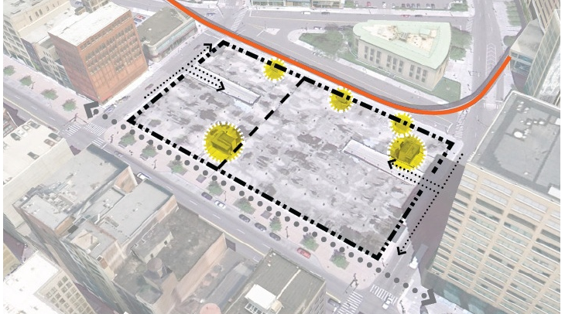
Previous Presentation
Grocery
Residential
Phased approach

Slide 5
Feedback
Consider:
  Sociographic data
  Educational use
  Careful of market saturation

Slide 6
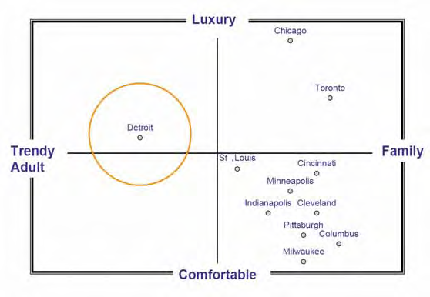
Sociographic Information
Existing market perceived as trendy adults.
Next life stage is starting a family.
Mainstream market deterred by lack of supporting services.
Underserved market in Detroit.
Provide downtown option to suburbs.
Source: Adapted from Strategic Marketing & Research, Inc. 2006 for Detroit Metro Visitors and Convention Bureau

Slide 7
Education Use

Slide 8
Grocery Economics
Description | Value
Weekly Sales per Sq. Ft. | $ 11.77
Annual Sales per Sq. Ft. | $ 612.04
Rent as percent of Sales | 3.18%
Annual Sq.Ft. Rental (Avg.) | $ 19.46
Annual Sq. Ft. Site Rent | $ 25.00
A stand alone single floor grocery store would not be sufficient to cover site rental costs.
Security issues and inefficient loading are anticipated challenges.
Grocery is likely to be a strong component in a mixed-use strategy.
http://www.fmi.org/facts_figs/?fuseaction=superfact

Slide 9
Education Economics
Description | Value
Public (State $ per student) | $ 7,475 (Wayne Co.)
Private (Tuition $ per student) | $ 4,000-15,000
Rent as percent of “Sales” | 5.45%
Rent per Student | $ 407.00
Sq. Ft. per Student | 70-150 (100)
Annual Rent per Sq. Ft. | $ 4.07
Annual Sq. Ft. Site Rent | $ 25.00
Construction is frequently funded separately from operations.
After school programming can provide additional revenue.
Tenant volunteering and teacher apartment accommodations can help reduce costs.

Slide 10
Residential Economics
Description | Value
Monthly rent per Sq. Ft. | $ 0.80 – 1.40
Annual rent per Sq. Ft. | $ 9 - 17
Annual Sq.Ft. Rental (Avg.) | $ 19.46
Annual Sq. Ft. Site Rent | $ 25.00
Placing residential above improves:
  Higher views improves rent values.
    100 feet is above most adjacent buildings.
    240 feet are skyline views above Compuware.
  Security
  Differentiation

Slide 11
Effect of Site Rent
Annual values indicated.
Construction cost assumed at $160 per square foot.
0% down, 5-10% Interest, 30 years.
Assumes every square foot is leasable.
Actual income lower.
Taubman Retail
Retail
Office
Single floor construction leaves no profit after site rent and construction expenses.
10+ story office works, but lacks market.
Grocery-Educational-Residential has profit potential once loan is paid; however, the land is leased not owned.
Grocery
Residential
Educational

Slide 12
Synergistic Uses
Simultaneous development of market, amenities, and demand.
Grocery benefits from both onsite residences and parent pick-up of children.
Grocery and quality schools are required to attract more mainstream and luxury tenants.
Grocery
Educational
Residential

