Slide 1
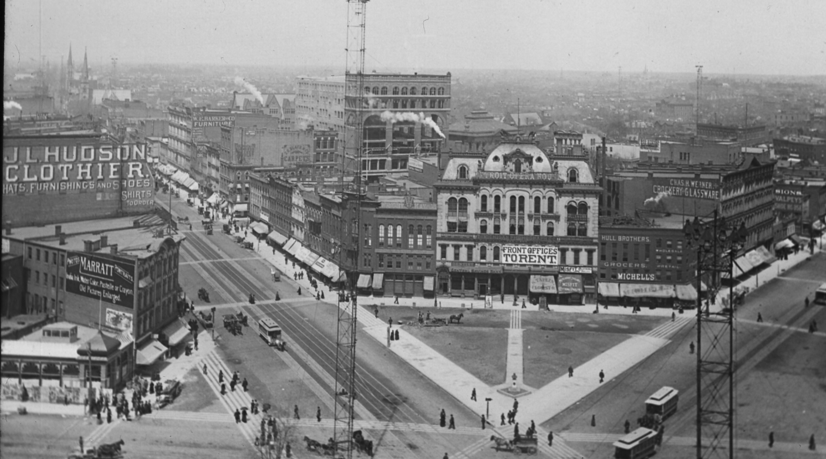
Hudson’s Site
Connie Rizzolo Brown
Mary Cay Lancaster
Lesa Rozmarek
Ryan Grabow

Slide 2
Objectives
Site
Previous presentation
New uses
Sociographics
Economics / Proforma

Slide 3
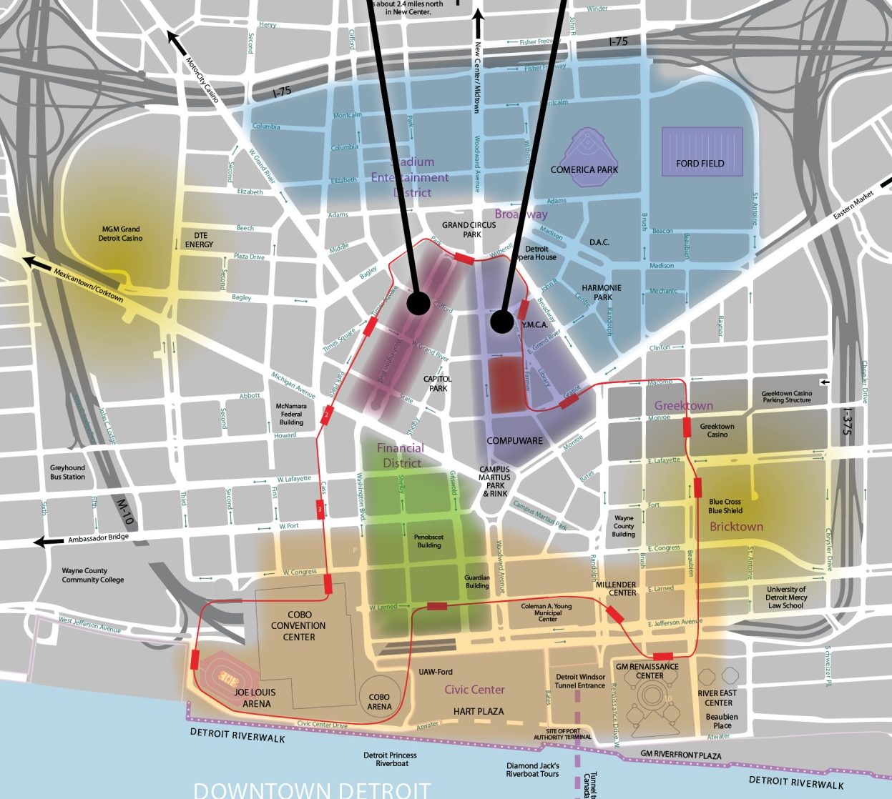
Downtown Detroit
Heart of the CBD.
Higher residential density desired.
Large proportion of office commuters.
Potential connection to People Mover.

Slide 4
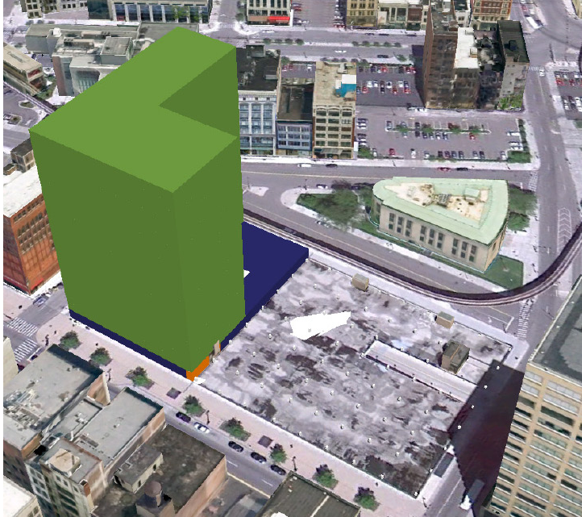
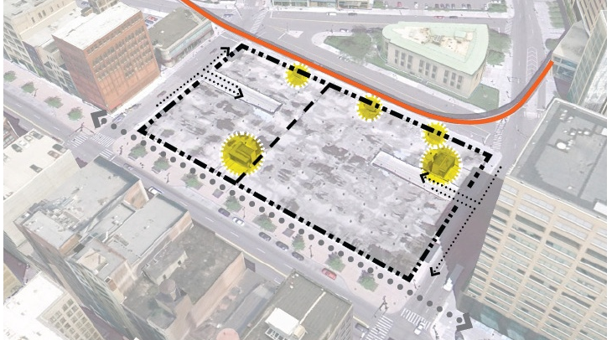
Previous Presentation
Grocery
Residential
Phased approach

Slide 5
Feedback
Consider:
  Sociographic data
  Educational use
  Careful of market saturation

Slide 6
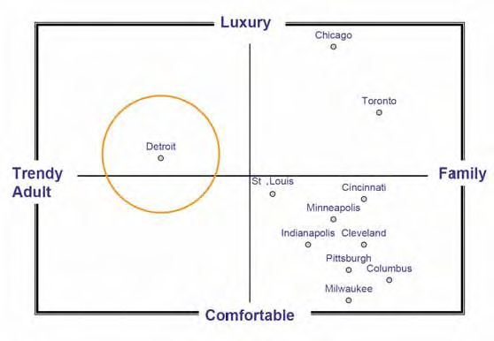
Sociographic Information
Existing market aimed at trendy adults.
Next life stage is starting a family.
Underserved market in Detroit.
Provide downtown option to suburbs.
Source: Adapted from Strategic Marketing & Research, Inc. 2006 for Detroit Metro Visitors and Convention Bureau

Slide 7
Education Use

Slide 8
Grocery Economics
Description | Value
Weekly Sales per Sq.Ft. | $ 11.77
Annual Sales per Sq.Ft. | $ 612.04
Rent as percent of Sales | 3.18%
Annual Sq.Ft. rental (Avg) | $ 19.46
Annual Sq. Ft. Site Rent | $ 25.00
An average performing single floor grocery store would not be sufficient to cover site rental costs.
Security and a poor loading condition
Grocery may be a strong component in a Mixed-use strategy.

Slide 9
Education Economics

Slide 10
Residential Economics

