Slide 1
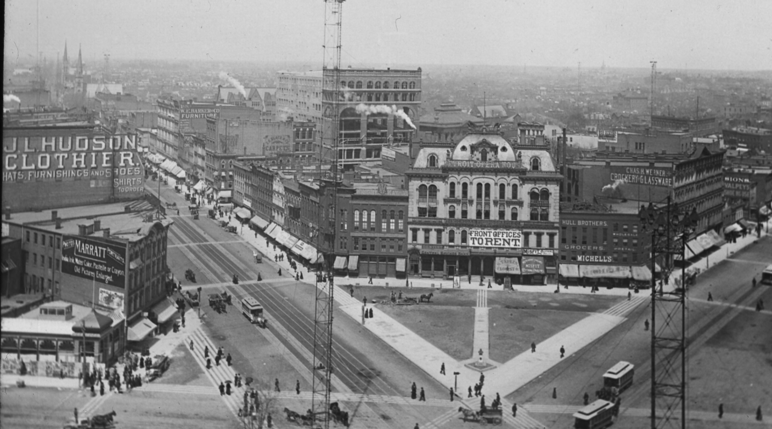
Hudson’s Site
Connie Rizzolo Brown
Mary Cay Lancaster
Lesa Rozmarek
Ryan Grabow

Slide 2
Objectives
Site
Previous presentation
New uses
Sociographics
Economics / Proforma

Slide 3
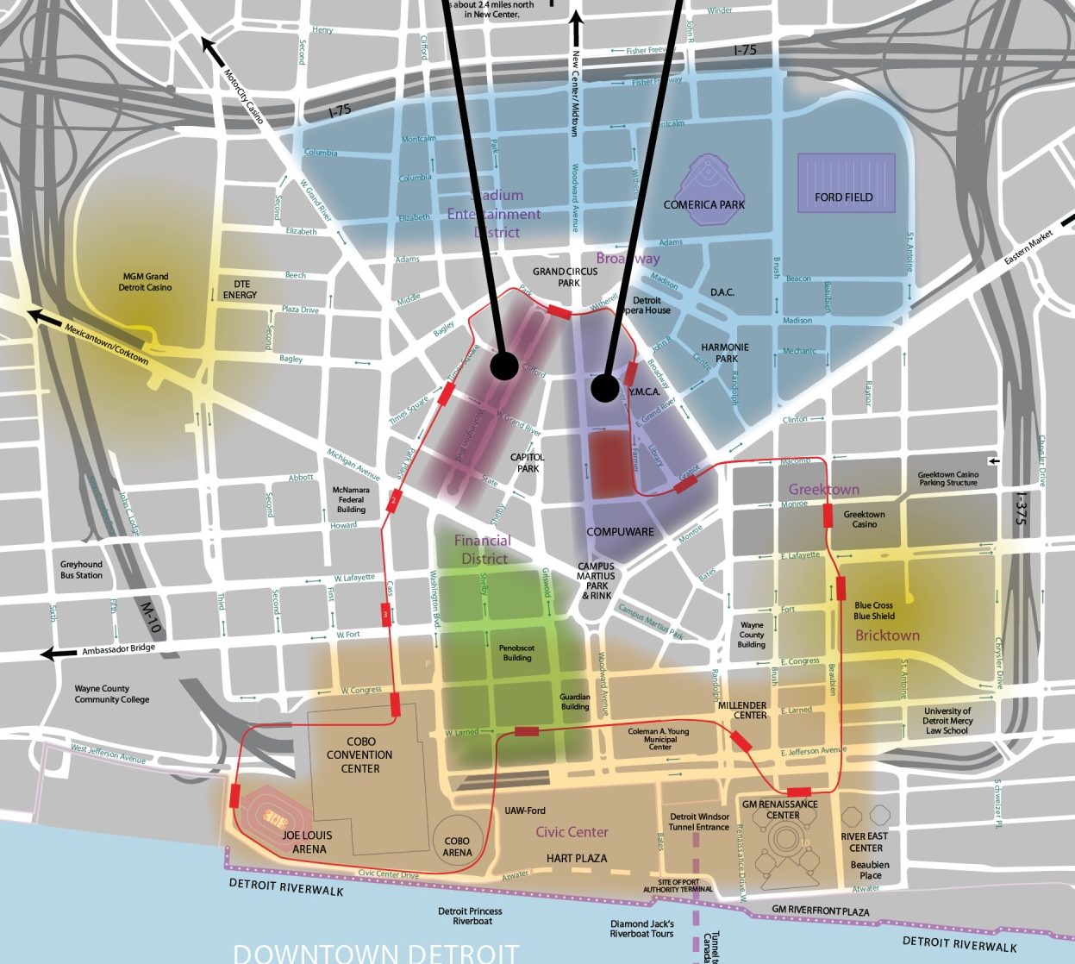
Downtown Detroit
Heart of the CBD.
Higher residential density desired.
Large proportion of office commuters.
Potential connection to People Mover.

Slide 4
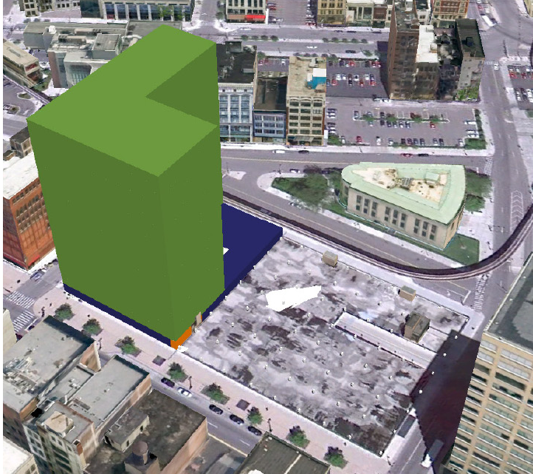
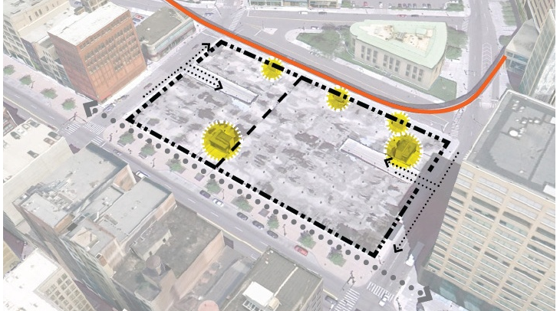
Previous Presentation
Grocery
Residential
Phased approach

Slide 5
Feedback
Consider:
  Sociographic data
  Educational use
  Careful of market saturation

Slide 6
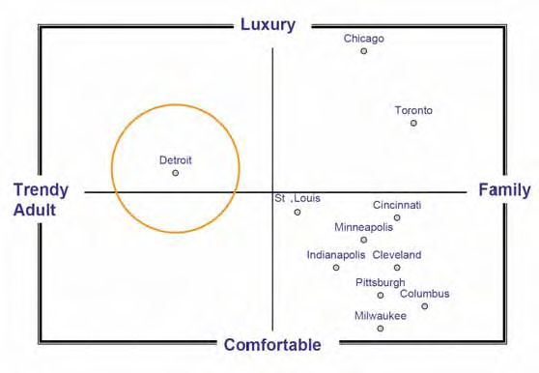
Sociographic Information
Existing market aimed at trendy adults.
Next life stage is starting a family.
Underserved market in Detroit.
Provide downtown option to suburbs.
Source: Adapted from Strategic Marketing & Research, Inc. 2006 for Detroit Metro Visitors and Convention Bureau

Slide 7
Education Use

Slide 8
Grocery Economics
Description | Value
Weekly Sales per Sq.Ft. | $ 11.77
Annual Sales per Sq.Ft. | $ 612.04
Rent as percent of Sales | 3.18%
Annual Sq.Ft. rental (Avg) | $ 19.46
Annual Sq. Ft. Site Rent | $ 25.00
An average performing single floor grocery store would not be sufficient to cover site rental costs.
Security issues and a poor loading conditions trend toward less than average profitability.
Grocery may be a strong component in a Mixed-use strategy.

Slide 9
Education Economics

Slide 10
Residential Economics
Higher levels have better views and improves rent values.
  Above 100 feet has views above most adjacent buildings.
  Above 240 feet has skyline views above the Compuware building.
Placing residential above improves:
  Views / Rent values
  Security

Slide 11
Synergistic Uses
Simultaneous development of market and demand.
Grocery benefits from both onsite residences and

