Slide 1
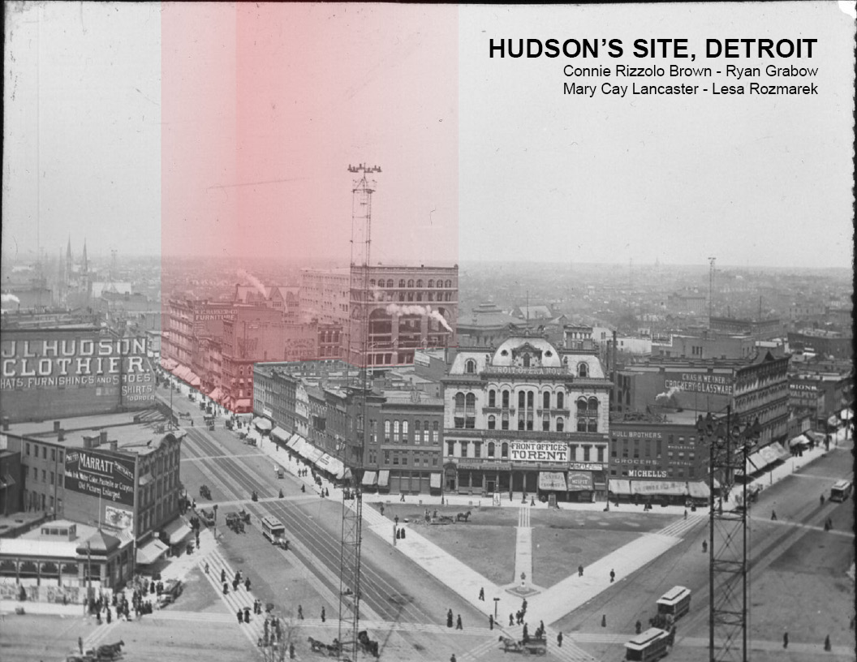

Slide 2
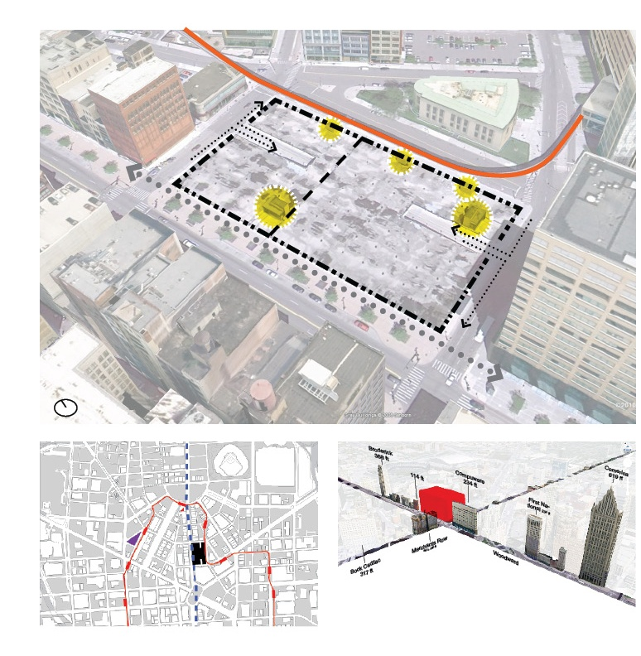
^{Size}
^{2 Acres, 92000 sf}
^{420 ft x 220 ft}
^{Existing Structure}
4 floors underground parking: for 1,100 cars
^{Column grid ~ 35’}
Ramps, elevators, and ventilation.
Designed for division, approximately 40/60 (N/S)
^{Adjacent Structures}
^{People Mover Track (E)}
^{Public Library (E)}
^{Compuware Building (S)}
^{Lofts at Merchant Row (W)}
^{Elliot Building (N)}
^{YMCA (NE)}
^{Zoning}
Zone B5 in Central Buisiness District
Max. height: 3x widest street = 360 ft

Slide 3

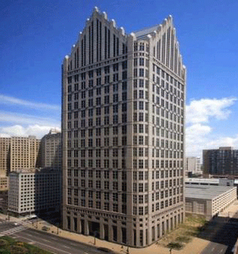
http://3.bp.blogspot.com/_n3lEKqDKTSA/TEwoMjE6rtI/AAAAAAAAHu8/9jUo8x4_qoY/s320/one+detroit+center.png
Previous Analysis….
Highest & Best Use
Retail
Hospitality
Requires a critical mass to be successful and therefore drives the program to a vertical mall
Existing Retail space stock is very high.
A vertical mall is difficult to make successful
City requires First Floor Retail.
A mixed use is probably necessary to help offset expenses (include hotel or housing)
To compete locally – luxury hotel required = Higher construction costs
Low occupancy rates do not support the income needed to sustain the project
Increased tourism could improve occupancy but that is not in the developers control
Though not incompatible, it is not the strongest use
Commercial
High vacancy rate and excess Class A space does not support a demand for this use.
Class B office stock has lower costs, but would be useless in the current and foreseeable market.
Due to infrastructure in Financial District: The best long-term development strategy is to work with the districts the city has in place

Slide 4


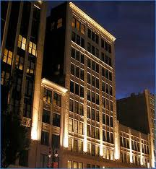
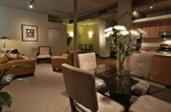
Highest and Best Use: Residential Apartment Rentals
Residential potentially offers the highest and best use
Detroit is full, very little vacancy, and there is the desire to live downtown by young, working professionals
These young professionals who favor soft loft type living. Simple finishes and open spaces are the appropriate design and can be more affordable to build
All of the housing currently available are older renovated buildings. Nothing currently offers the choice of a new space with more modern features designed for today’s lifestyle
80,000 people work in downtown Detroit so there are potential future tenants. Currently only 6000 people live in downtown Detroit
Despite the economy the occupancy rate has continued to grow until full

Slide 5
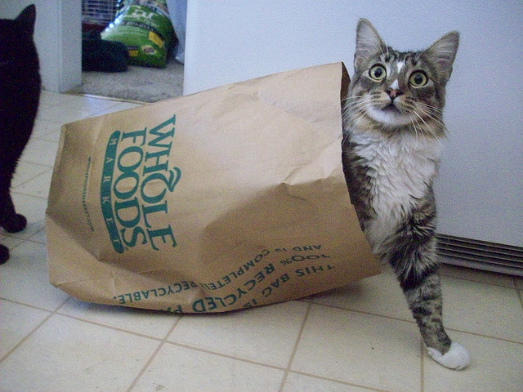
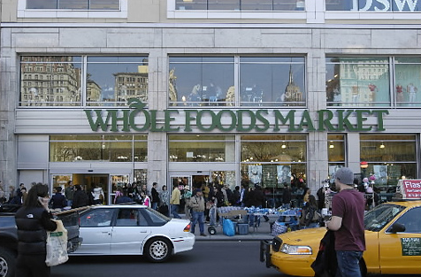
Highest and Best Use: Retail - Grocery
Grocery potentially offers the highest and best use
Downtown Detroit is highly underserved and demand is high.
This use works well in conjunction with the surrounding residential and commercial yet can function independently in this location, by also drawing users who are downtown oriented.
The demand of 125,000 sqft translates to roughly $38,000,000 in sales
Major chain can add vitality to the site and increase site value
The cost of developing a grocery store is substantially less than a luxury tower.
http://farm5.static.flickr.com/4074/4765979423_9d9cb314ac.jpg
http://farm4.static.flickr.com/3502/3730424763_836a8ba0fb_z.jpg

Slide 6
New Perspective…….
Look at socio-graphics, not just demographics
Averages don’t mean a lot
100% current usage, does not mean there is more demand
Re-charted course……
Mixed housing models to include other groups-families, work/live, etc.
Education facility to draw families
Grocery model could be strong

Slide 9
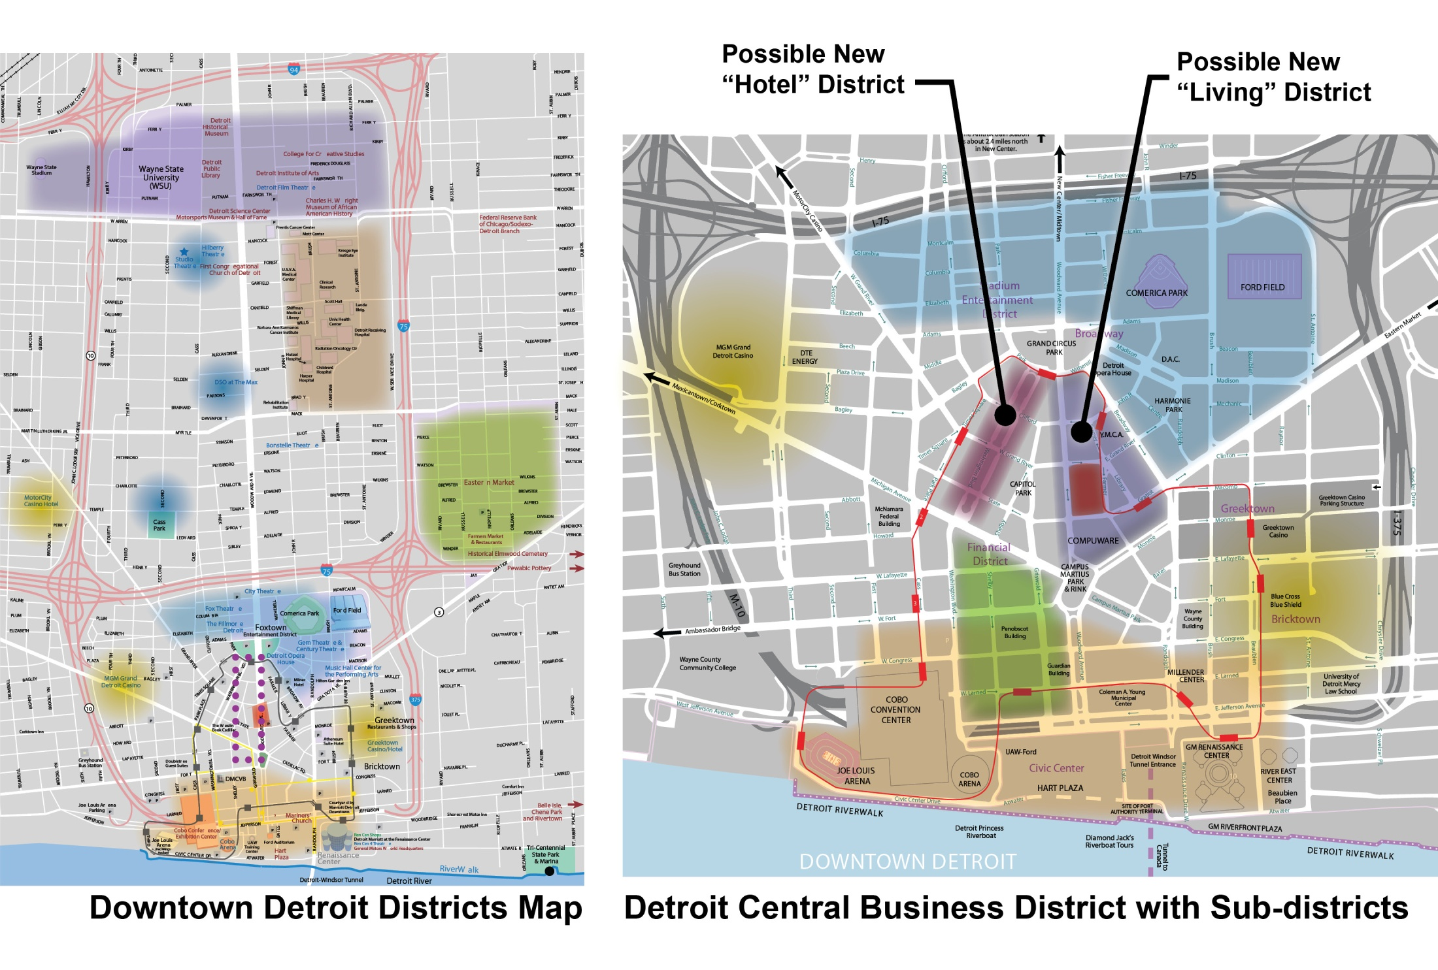

Slide 10
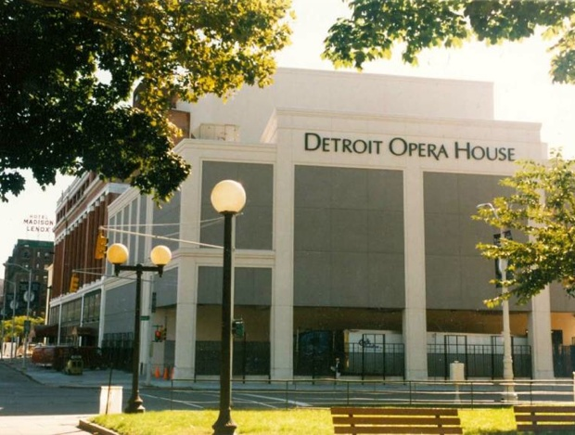
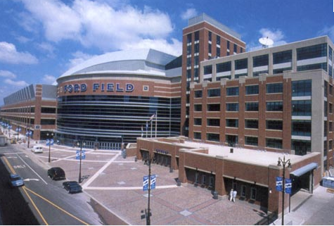
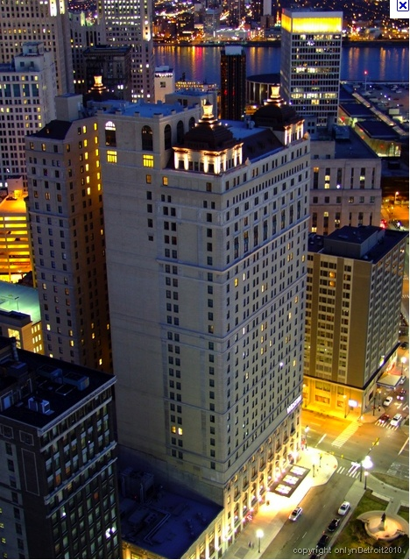
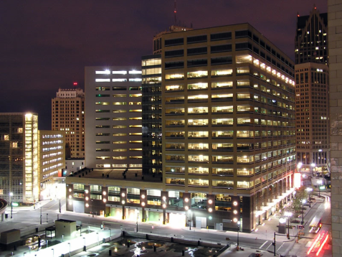
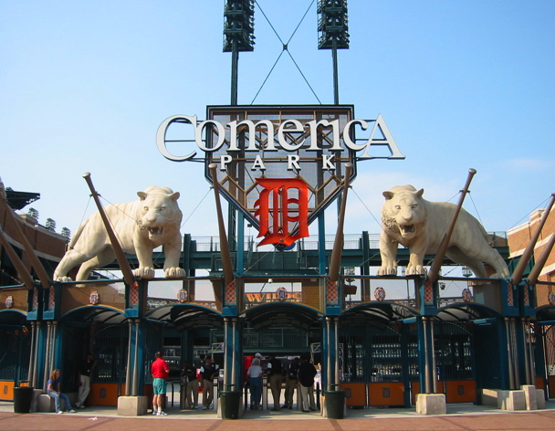
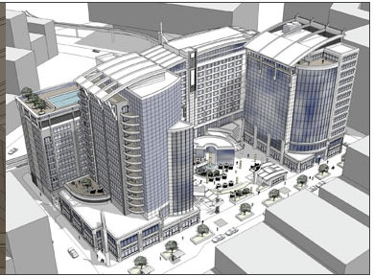
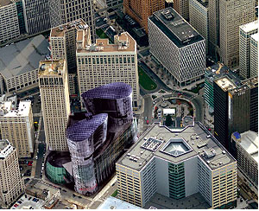
Ford Field
Detroit Opera House
Compuware
Book Cadillac Hotel
Comerica Park
Recent & Proposed Developments

Slide 11
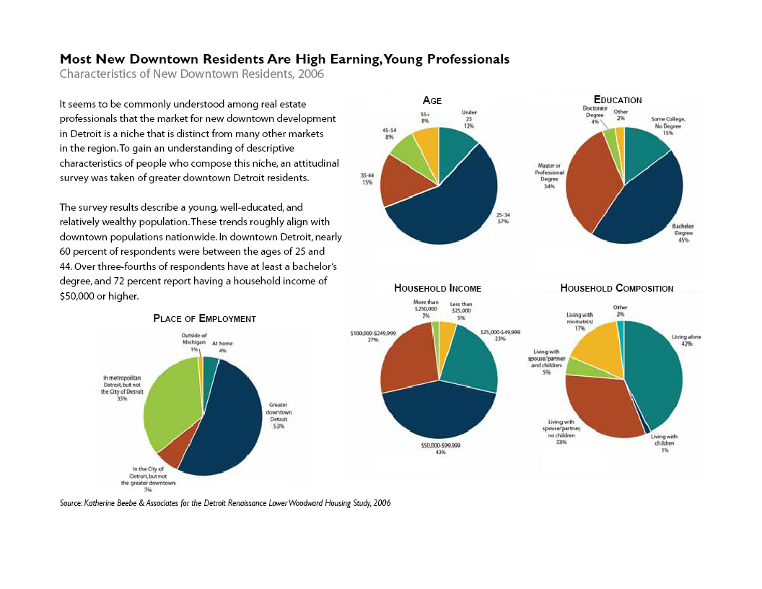

Slide 12
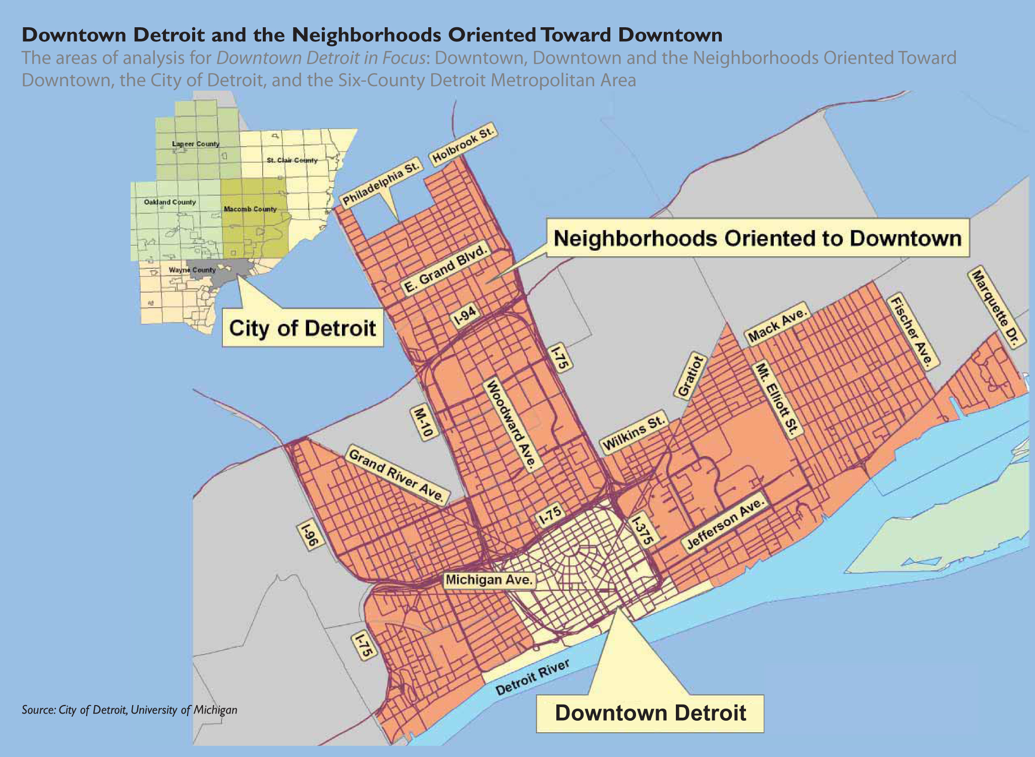

Slide 13
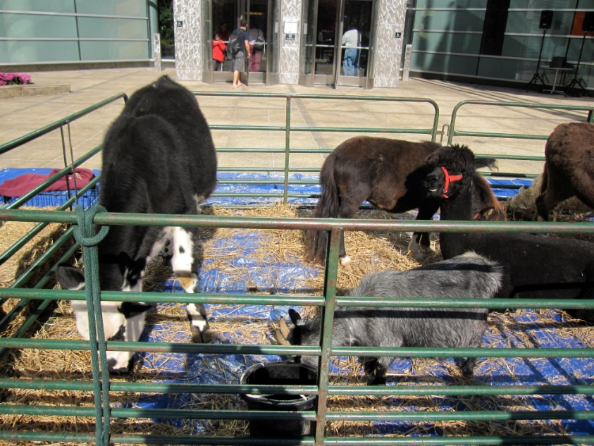
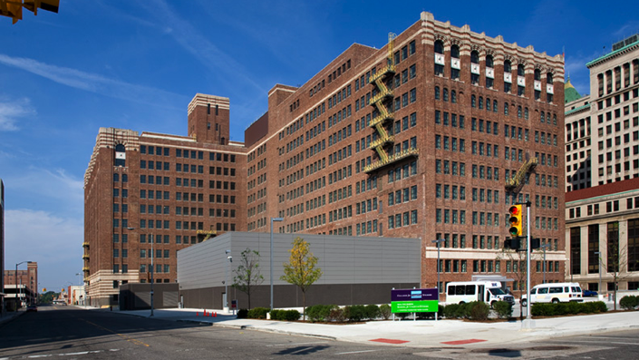
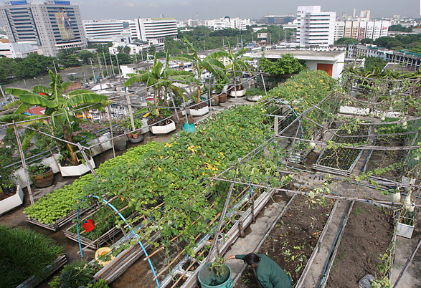
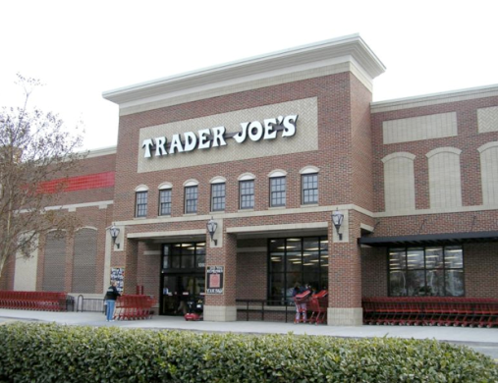

What Makes A Downtown, A Downtown?
Grazing ≠ Density
Institutional ≠ Stable Density
And in an informal survey…
Agriculture ≠ Density

Slide 14
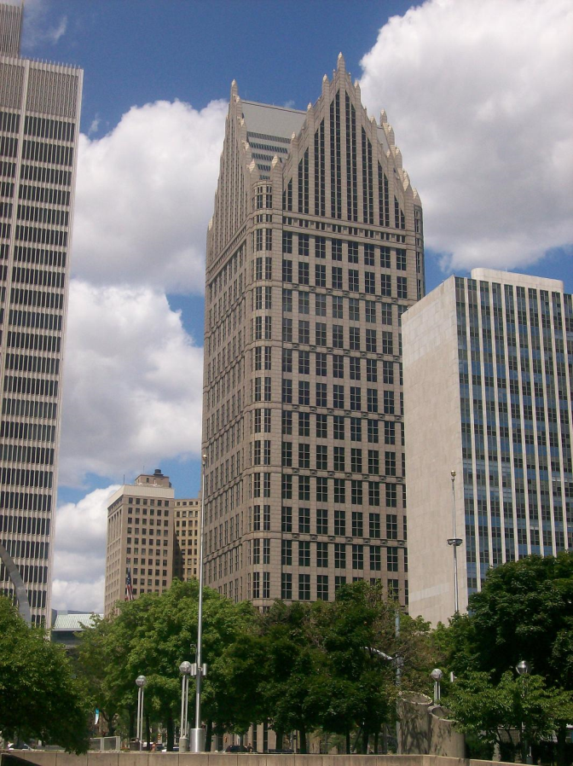
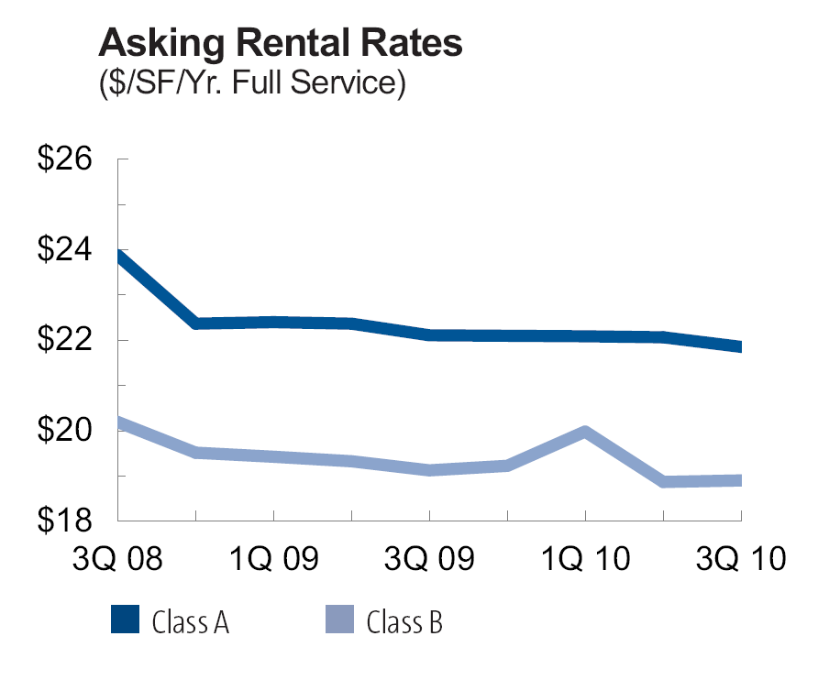
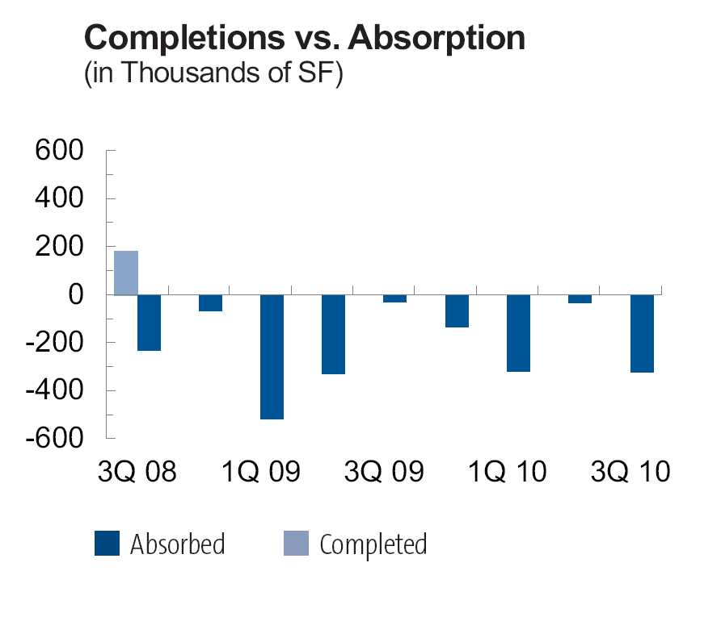
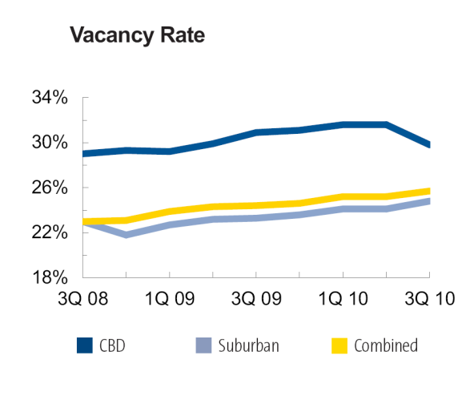
Office
Use compatible with surrounding neighborhood
Many vacant buildings and upper level spaces. Easier to convert to offices at a reasonable cost, Possible tax incentives.
Compuware has had commercial success
Due to high vacancy rates, speculative building would be risky.
A large tenant who wants a signature building may be viable
Current occupancy rate in inhabited buildings is 65%
Easily accessed through freeways and people mover
Office

Slide 15
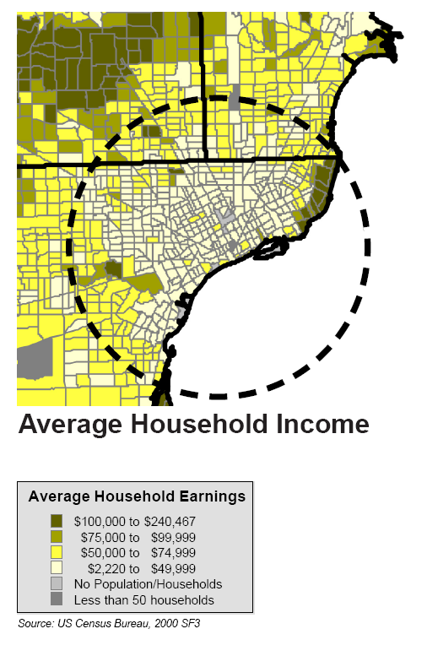
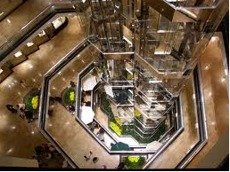
Retail
•Use is compatible
•Retail takes a critical mass to be successful.
This would drive a vertical mall, typically need other use,
such as a hotel. Success of vertical malls is mixed.
•Very little retail currently
and it is scattered throughout the area
•Consumer base to support a quantity of retail is
not within walking distance. It is within driving distance,
but would require switching from their current shopping area

Slide 16
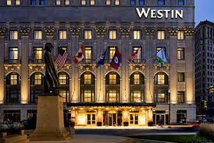
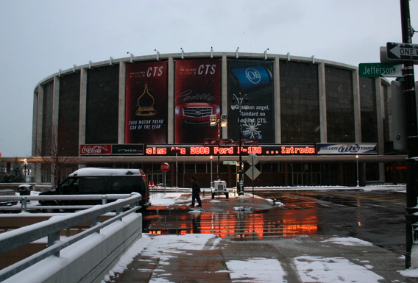
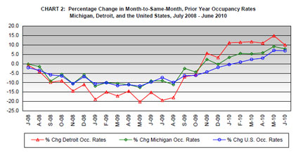
Many successful venues in the area. Many unsuccessful.
1,000,000 sf convention & conference space in downtown
3000 existing hotels rooms in the conference centers
The Book Cadillac and MGM Grand Casino - high-end lodging, condos and concierge services.
Industry standard for a successful hotel is 70% occupancy rate.
Overall hotel occupancy for all hotels in downtown Detroit is marginal at 65%. (greatly improved w/MGM and Book Cadillac)
Use is compatible with the area
Hospitality

Slide 17
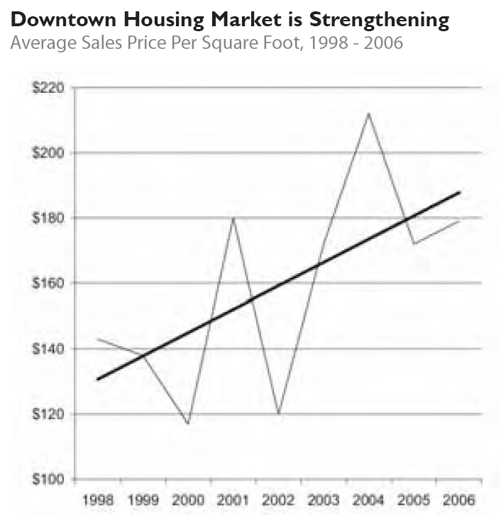
•There are numerous residential developments and improvements such as the Lofts at Merchant Row & Lofts at Woodward Center.
•Rental occupancy is 96% in downtown Detroit
•Many older buildings are empty, redevelopment potential with tax incentives.
•Downtown has a workforce of 80,000 people
•Residents who live downtown like it
Residential contributes to stable density downtown, can drive other development
•Rent is reasonable, yet competitive with other major Midwest and coastal cities
Residential

Slide 18
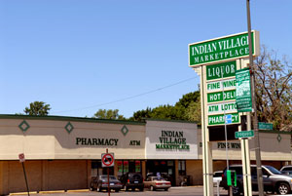
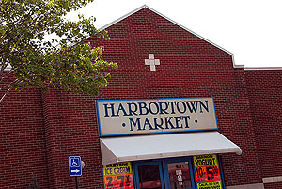
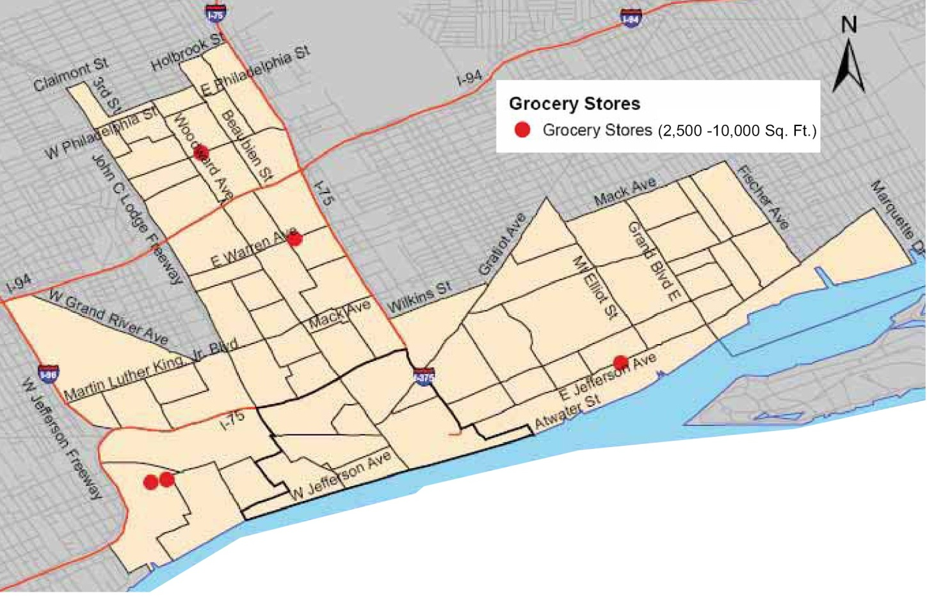
•Detroit is underserved & demand exists for 125,000 sf of grocery
•67 groceries in the vicinity, only 31 are over 2500 sqft & none are over 10,000 sf. And no major brands or chains.
•Grocery can draw the downtown and the near downtown
•Grocery can revitalize a community in the following ways:
The introduction of new neighborhood grocery stores increases property values, expands the city’s tax base and creates jobs.
Full-line food stores are high-value magnets that attract complementary stores and services, creating opportunities for additional private sector investment.
•New stores contribute to the physical revitalization of communities.
Grocery

Slide 19
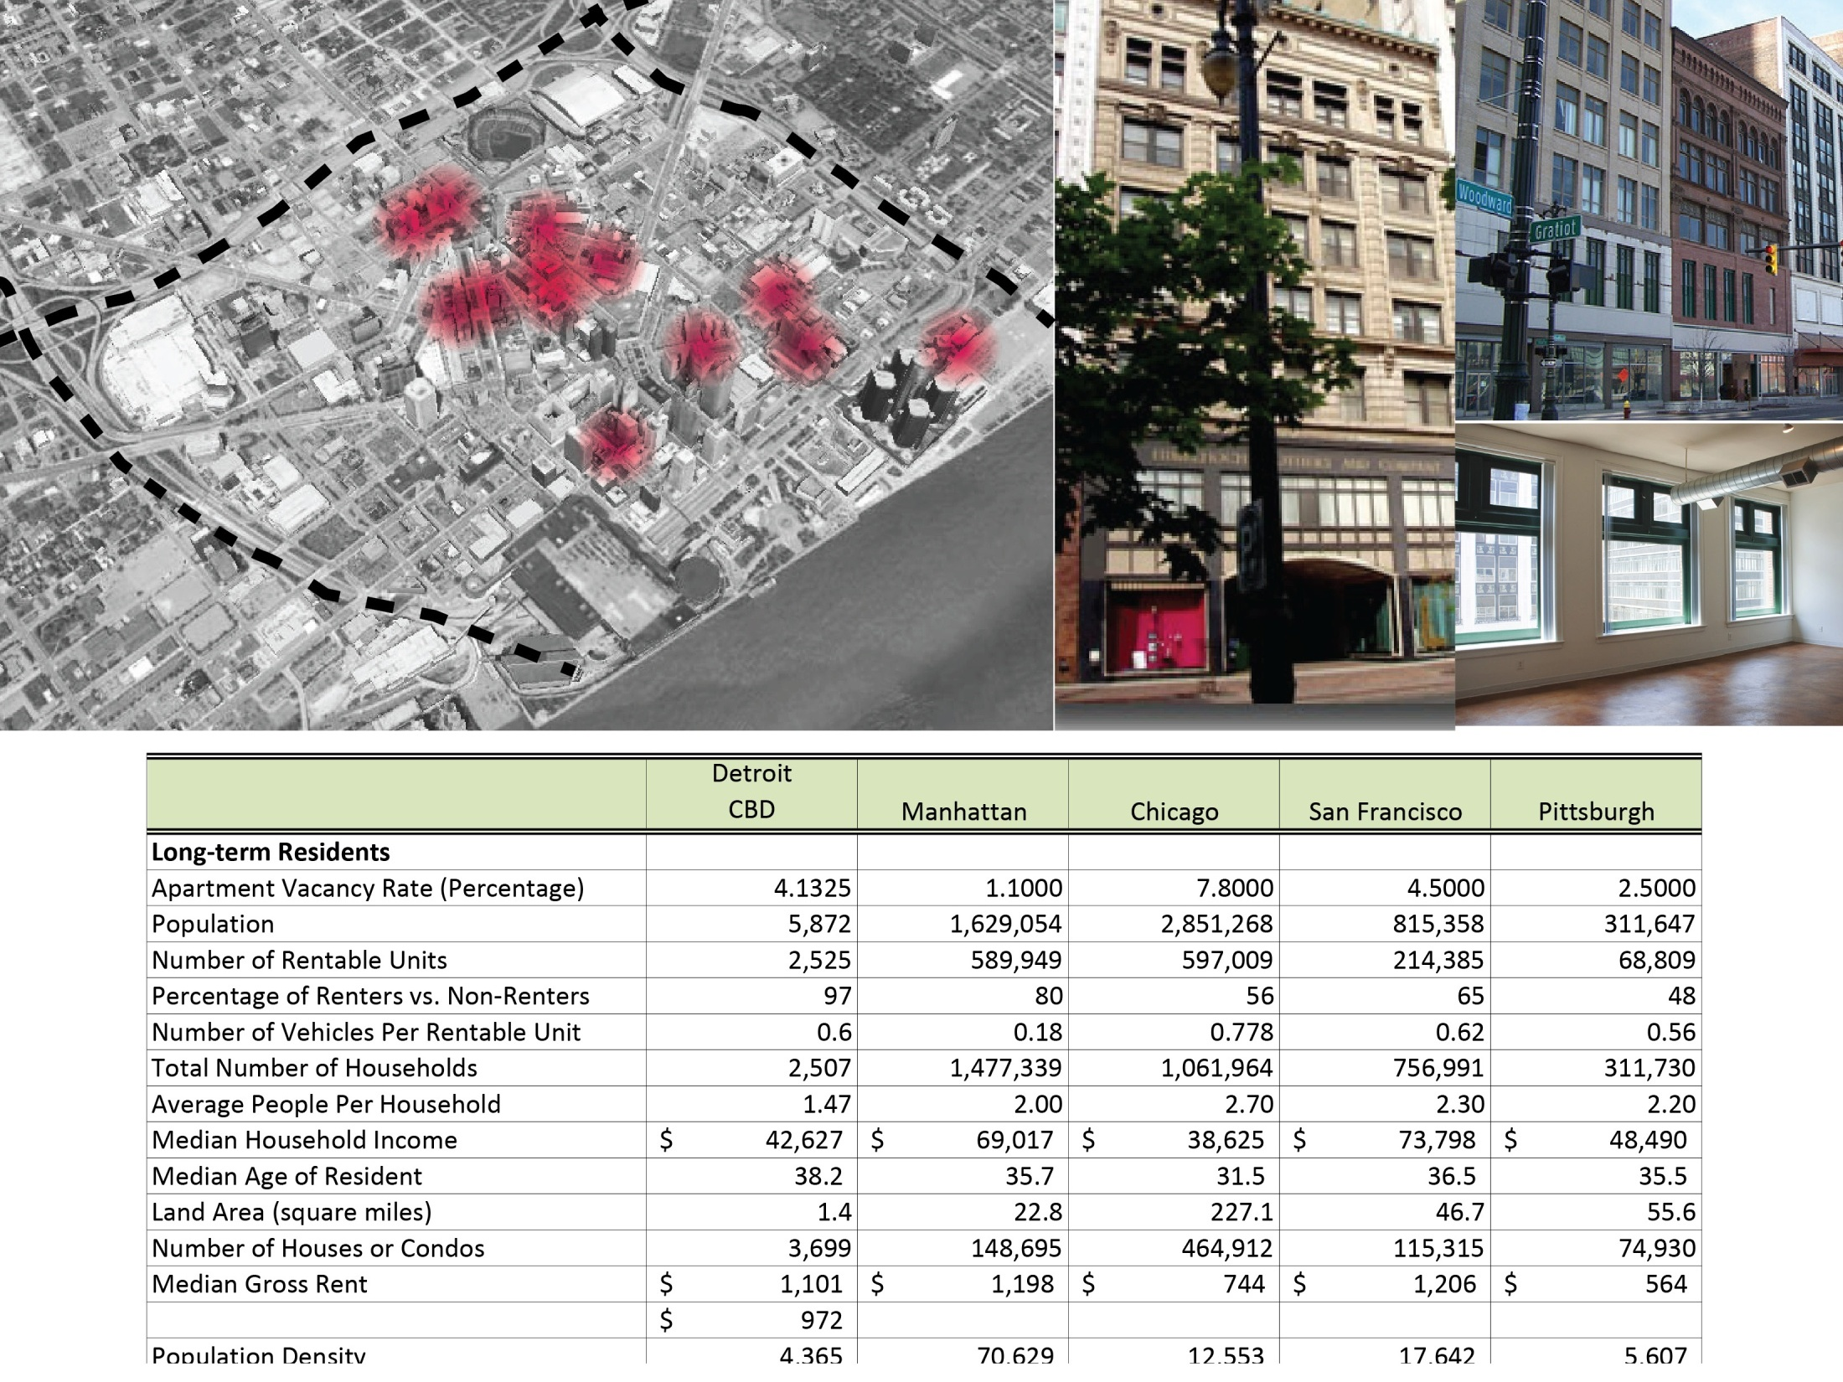
Housing - Rentals

Slide 20
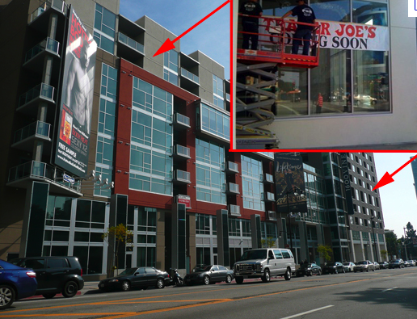
Right: Integrate Hipster friendly chain grocers to re-establish main-stream shopping into the City.
Economic Development Benefits of Supermarkets
The introduction of new neighborhood grocery stores increases property values, expands the city’s tax base and creates jobs
Full-line food stores are high-value magnets that attract complementary stores and services, creating opportunities for additional private sector investment.
New stores contribute to the physical revitalization of communities
In addition, could support Detroit’s Fresh Food Access Initiative
Above: Closest Grocery Store to Site: Harbortown Market
Retail - Grocery
http://www.nyc.gov/html/dcp/html/supermarket/index.shtml

Slide 21
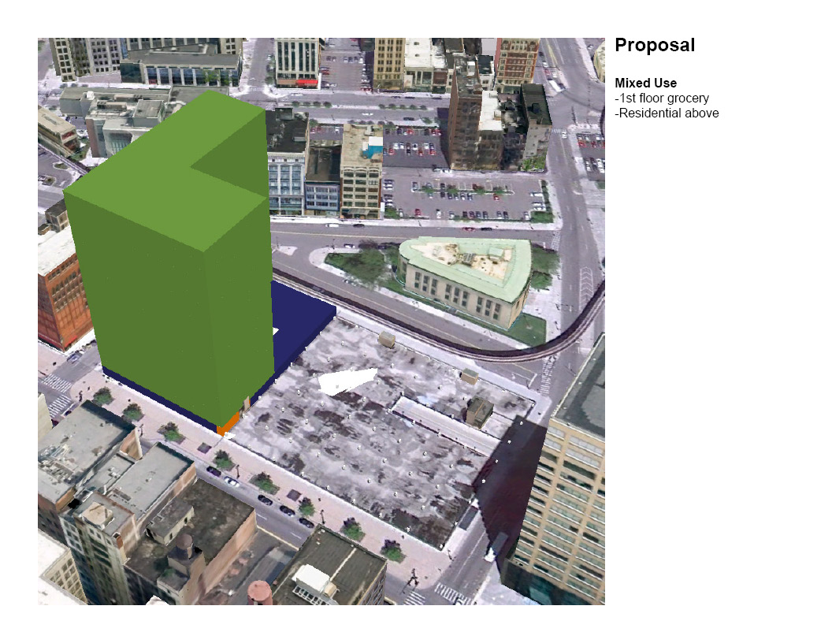

Slide 22
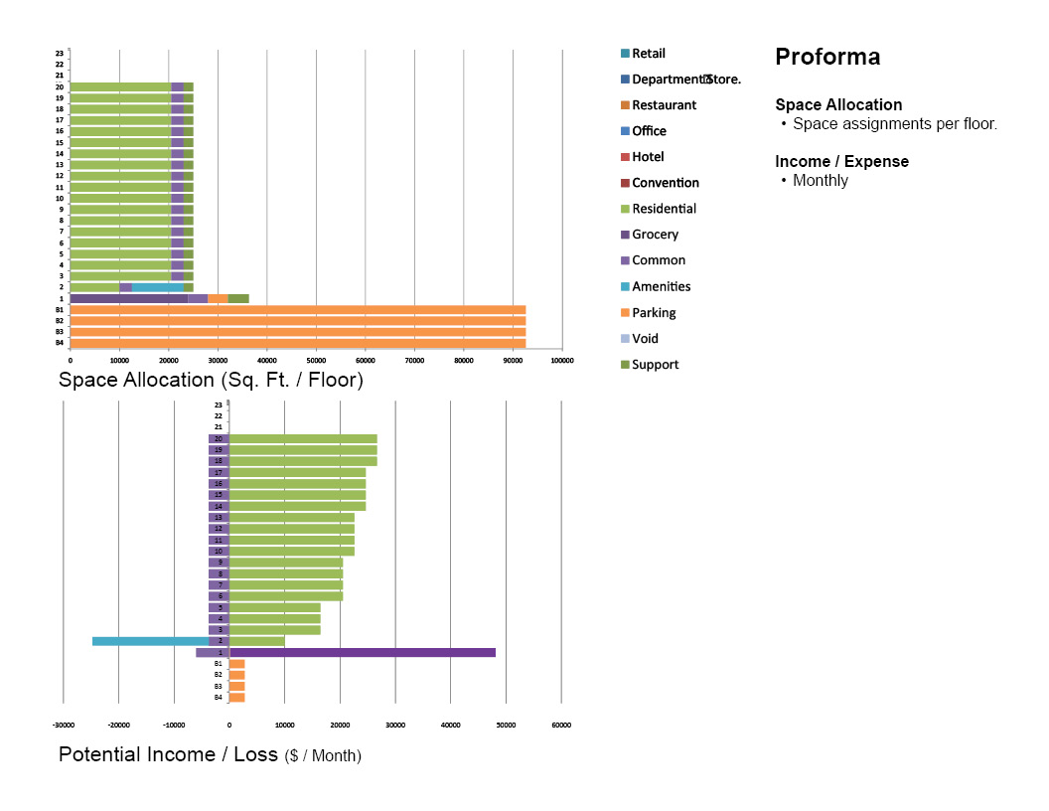

Slide 23
Category | Potential Income | Unrealized Income | Occupancy | Monthly Total | Annual Total
Residential | 409,750 | (81,950) | 80% | 218,975 | 2,627,700
Amenities | (21,000)
Common | (77,250)
Support | (10,575)
Grocery | 48,000 | (2,400) | 95% | 45,600 | 547,200
Parking | 120
Proforma
Annual Income
Values anticipated to be high. Additional operations and maintenance costs are expected.
Construction Cost
R.S. Means. Square foot costs. (Includes Arch. Fee)
Return on investment
Residential does not justify its expense.
Grocery costs are in the high teens and warrants further development.
Category | SF | Base Cost/SF | Additions /SF | Location Factor | Construction Cost (Includes Arch) | Net Income | Annual Income / Construction
Residential | 487,300 | 162 | 10 | 1.03 | $ 86,330,068.00 | 2,627,700 | 3%
Grocery | 24,000 | 114 | 10 | 1.03 | $ 3,065,280.00 | 547,200 | 18%

