Slide 1
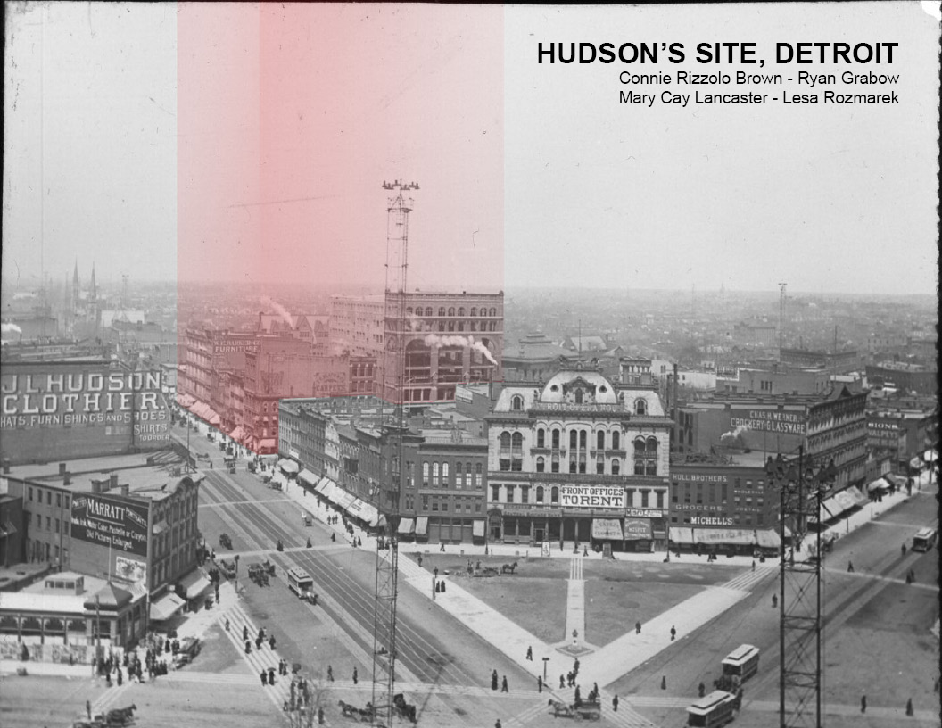

Slide 2
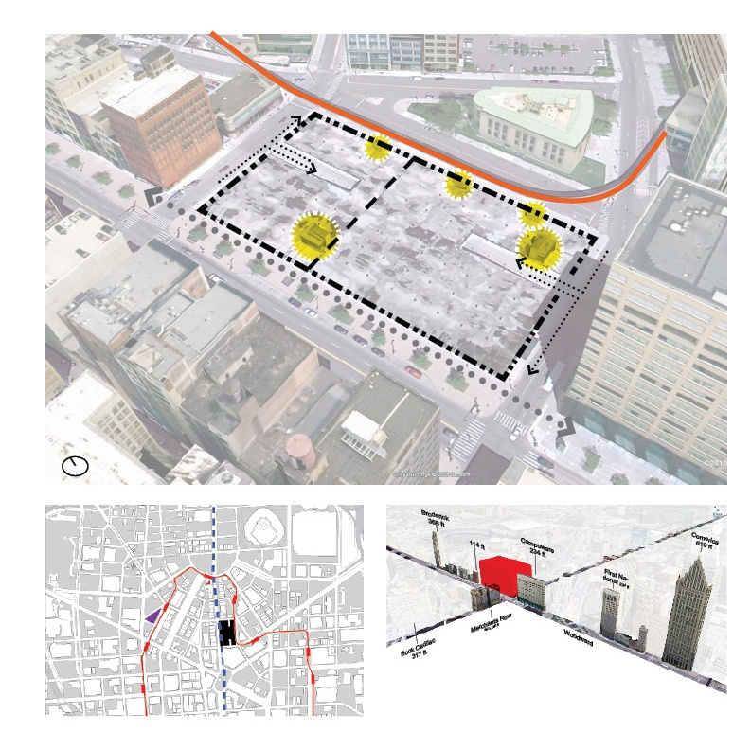
^{Size}
^{2 Acres, 92000 sf}
^{420 ft x 220 ft}
^{Existing Structure}
4 floors underground parking: for 1,100 cars
^{Column grid ~ 35’}
Ramps, elevators, and ventilation.
Designed for division, approximately 40/60 (N/S)
^{Adjacent Structures}
^{People Mover Track (E)}
^{Public Library (E)}
^{Compuware Building (S)}
^{Lofts at Merchant Row (W)}
^{Elliot Building (N)}
^{YMCA (NE)}
^{Zoning}
Zone B5 in Central Buisiness District
Max. height: 3x widest street = 360 ft

Slide 3
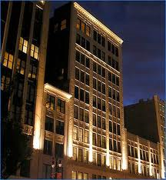
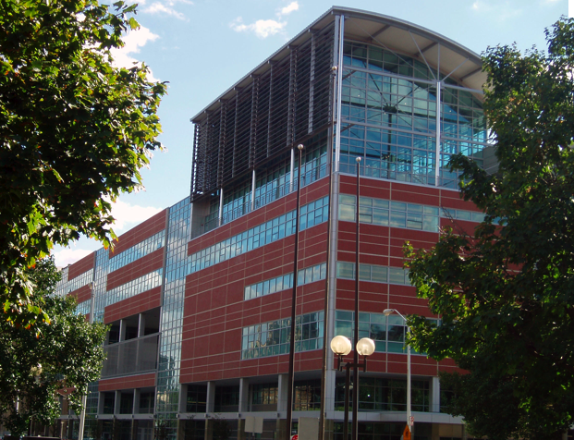
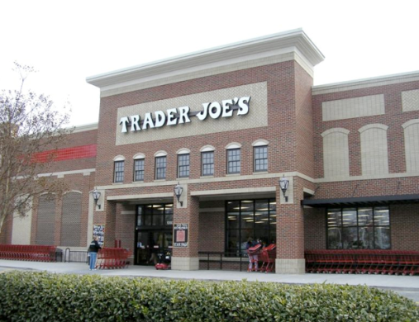

Slide 4
Educational Facilities
Look at socio-graphics, not just demographics
Averages don’t mean a lot
100% current usage, does not mean there is more demand
Re-charted course……
Mixed housing models to include other groups-families, work/live, etc.
Education facility to draw families
Grocery model could be strong
Mary Cay slides 1-3

Slide 5
Growth Trends
Jobs: in CBD 5600 new jobs next year
Downtown CBD living: current residents 5600
80,000 work in detroit
Most cities growing at 8.7%
Detroit is growing at a rate of 3.2%
Detroit Charter Schools: graduation rate same as detroit public
Density in Chicago 12,500 per sqmi, Detroit CBD is 4200
Need a population of 17,500 in the cbd for that density

Slide 6
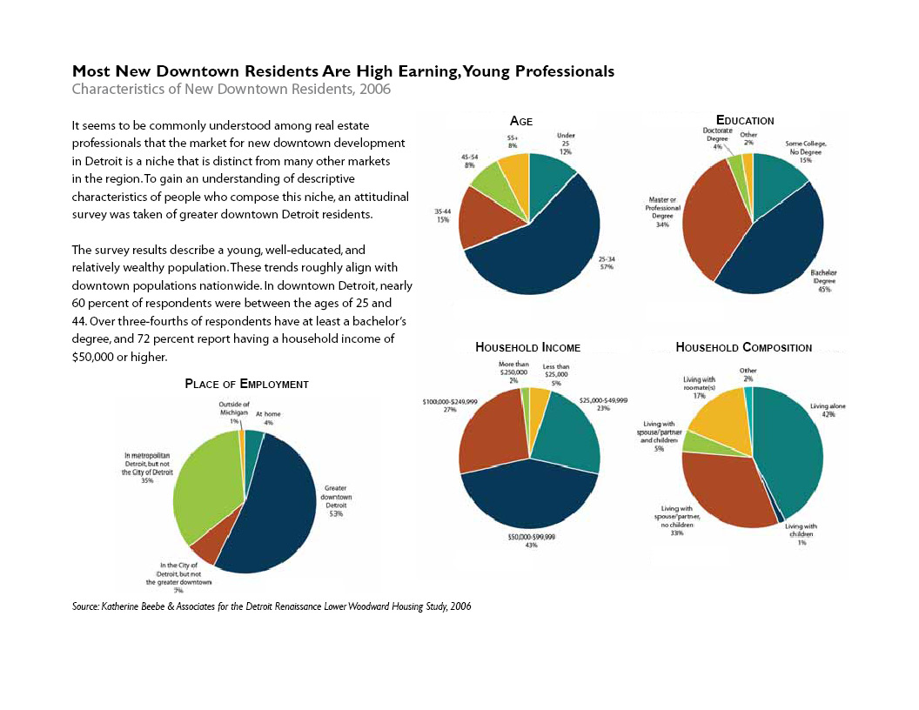

Slide 7
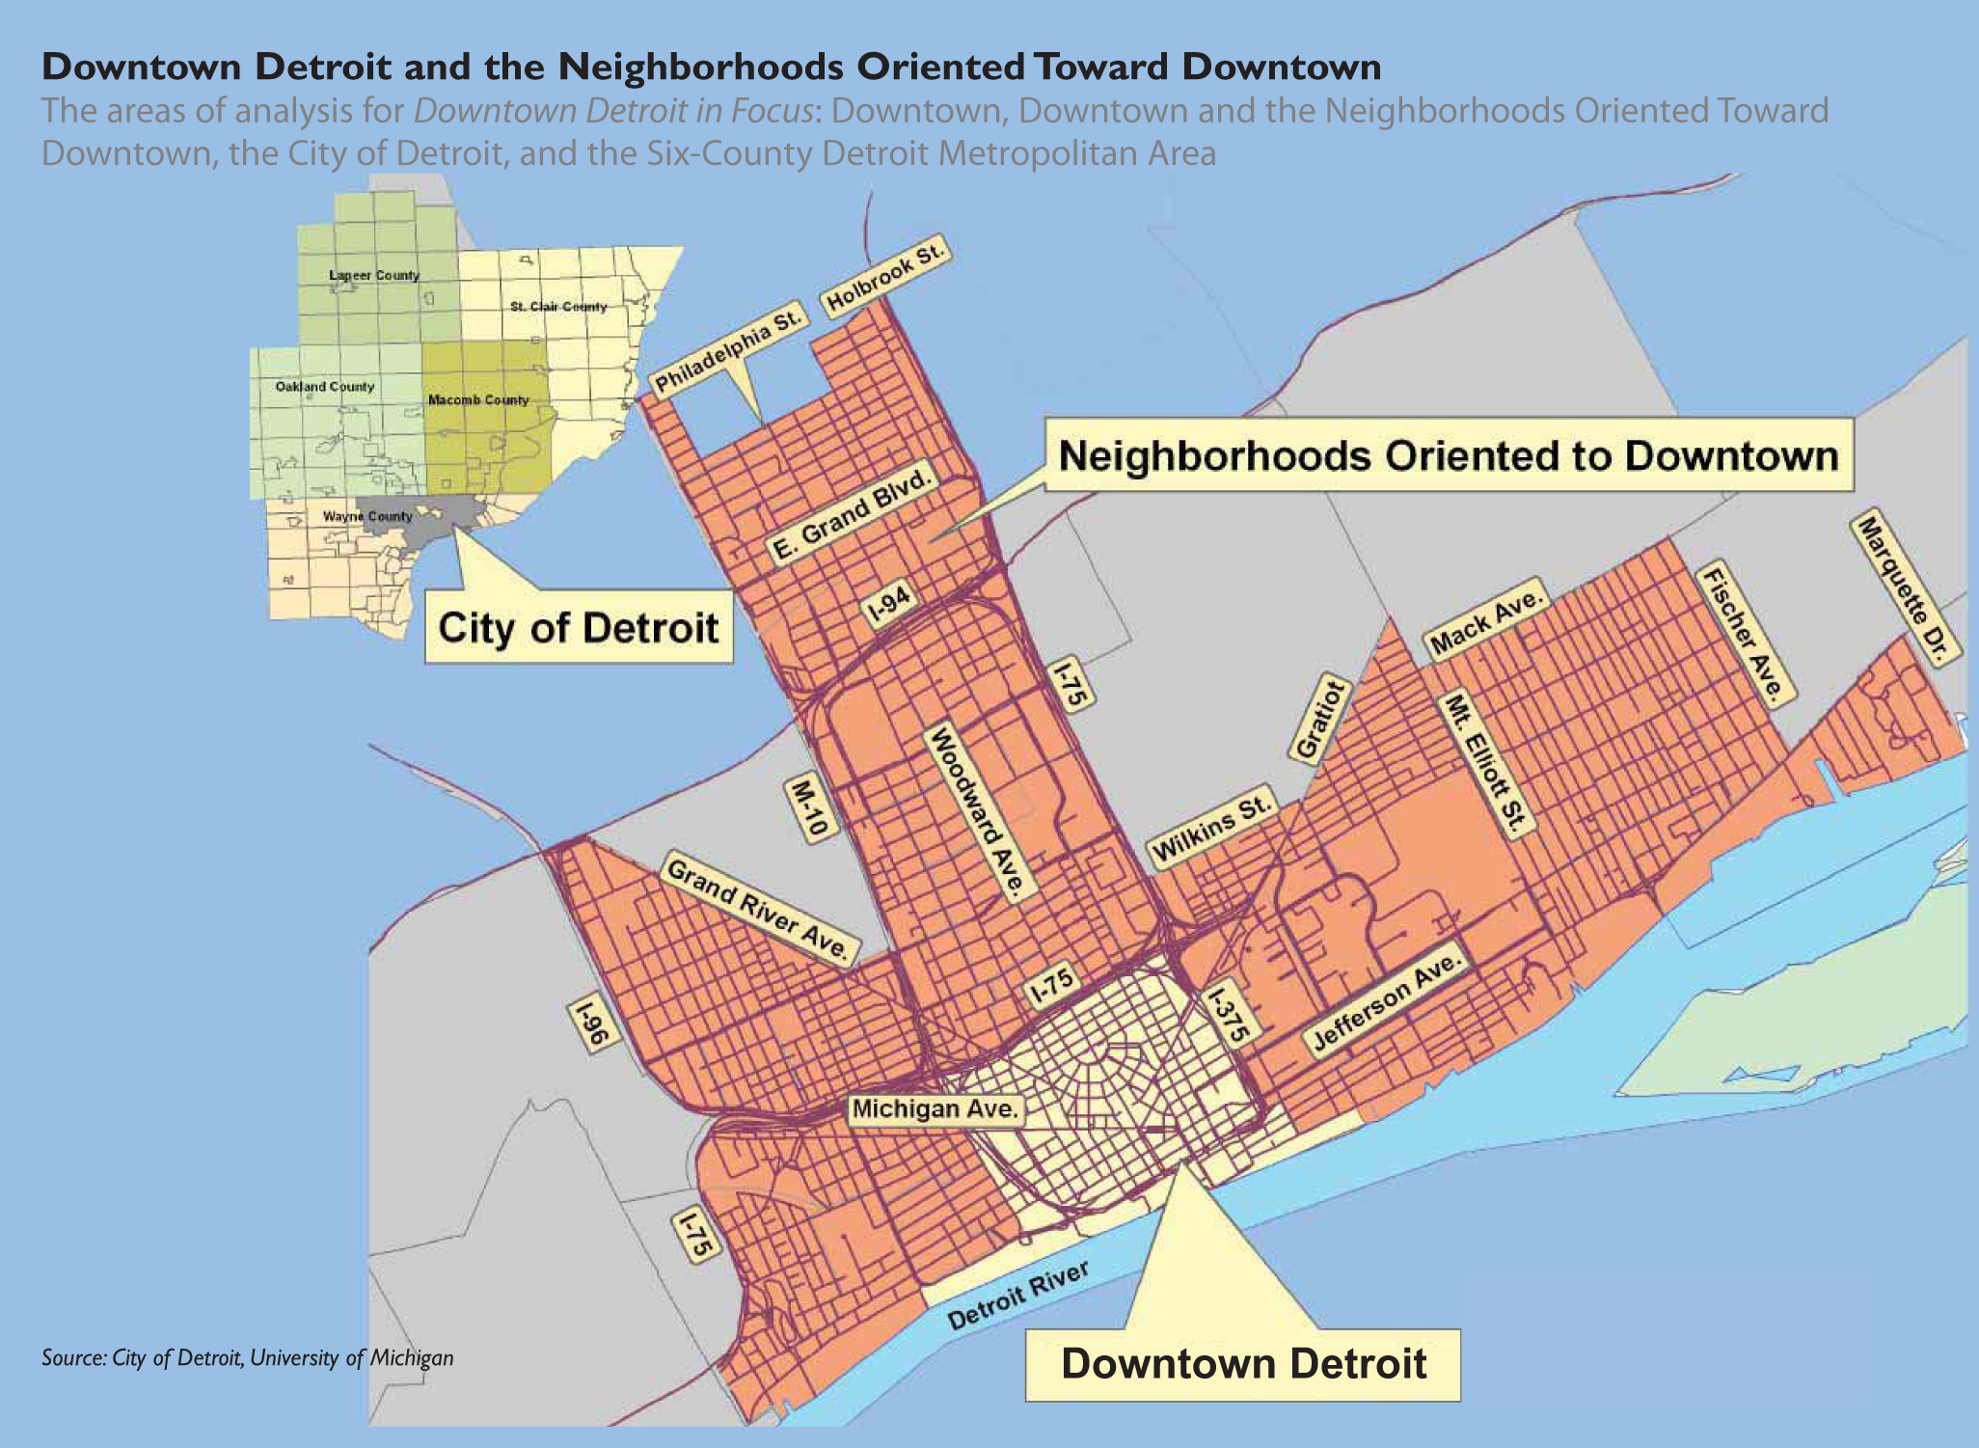

Slide 8
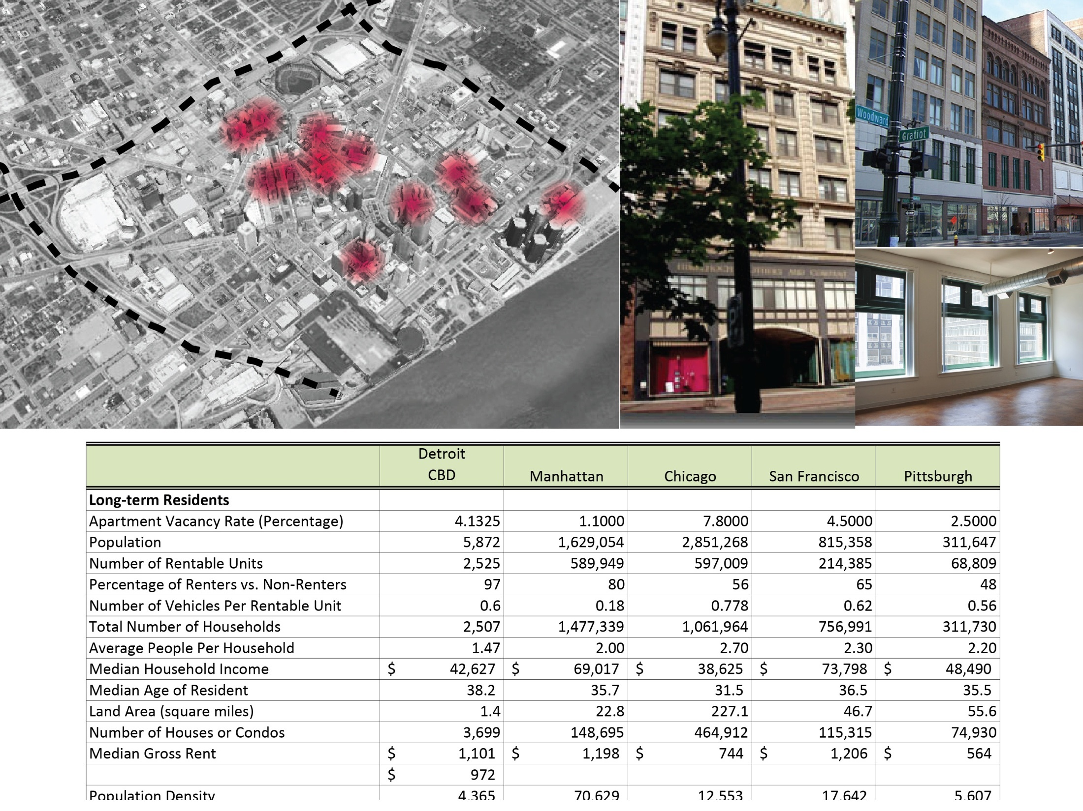
Housing - Rentals

Slide 9
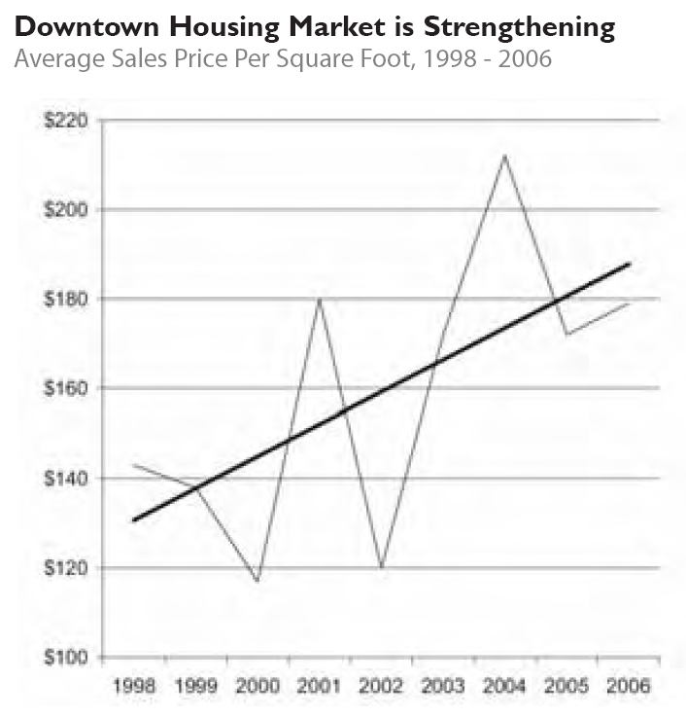
•There are numerous residential developments and improvements such as the Lofts at Merchant Row & Lofts at Woodward Center.
•Rental occupancy is 96% in downtown Detroit
•Many older buildings are empty, redevelopment potential with tax incentives.
•Downtown has a workforce of 80,000 people
•Residents who live downtown like it
Residential contributes to stable density downtown, can drive other development
•Rent is reasonable, yet competitive with other major Midwest and coastal cities
Residential

Slide 10


Mixed-Type Residential Apartments
Residential potentially offers the highest and best use
Detroit is full, very little vacancy, and there is the desire to live downtown by young, working professionals
These young professionals who favor soft loft type living. Simple finishes and open spaces are the appropriate design and can be more affordable to build
All of the housing currently available are older renovated buildings. Nothing currently offers the choice of a new space with more modern features designed for today’s lifestyle
80,000 people work in downtown Detroit so there are potential future tenants. Currently only 6000 people live in downtown Detroit
Despite the economy the occupancy rate has continued to grow until full

Slide 11
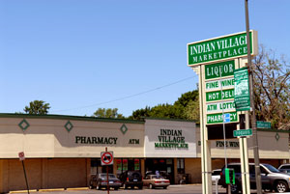
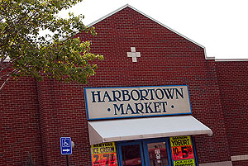
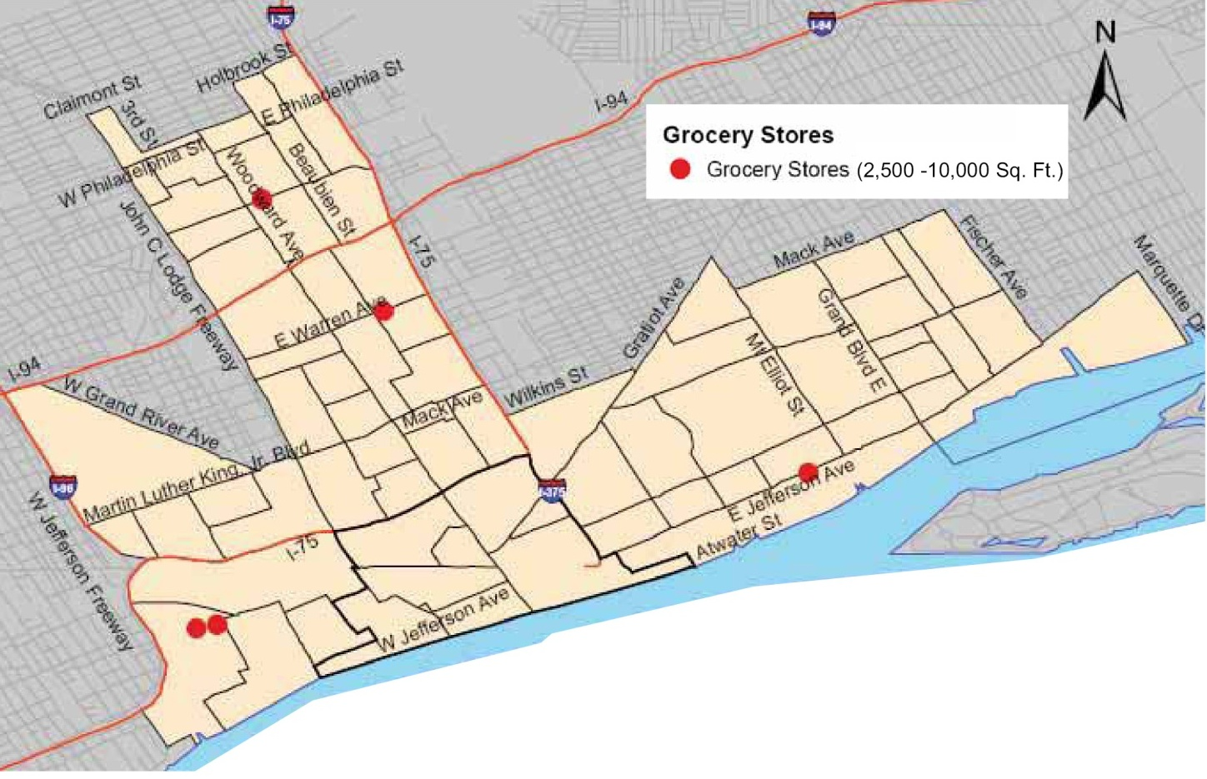
•Detroit is underserved & demand exists for 125,000 sf of grocery
•67 groceries in the vicinity, only 31 are over 2500 sqft & none are over 10,000 sf. And no major brands or chains.
•Grocery can draw the downtown and the near downtown
•Grocery can revitalize a community in the following ways:
The introduction of new neighborhood grocery stores increases property values, expands the city’s tax base and creates jobs.
Full-line food stores are high-value magnets that attract complementary stores and services, creating opportunities for additional private sector investment.
•New stores contribute to the physical revitalization of communities.
Grocery

Slide 12


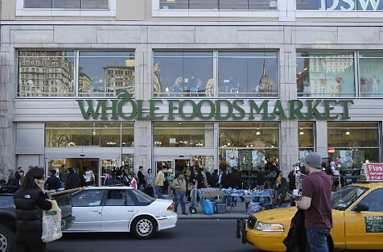
Highest and Best Use: Retail - Grocery
Grocery potentially offers the highest and best use
Downtown Detroit is highly underserved and demand is high.
This use works well in conjunction with the surrounding residential and commercial yet can function independently in this location, by also drawing users who are downtown oriented.
The demand of 125,000 sqft translates to roughly $38,000,000 in sales
Major chain can add vitality to the site and increase site value
The cost of developing a grocery store is substantially less than a luxury tower.
http://farm5.static.flickr.com/4074/4765979423_9d9cb314ac.jpg
http://farm4.static.flickr.com/3502/3730424763_836a8ba0fb_z.jpg

Slide 13
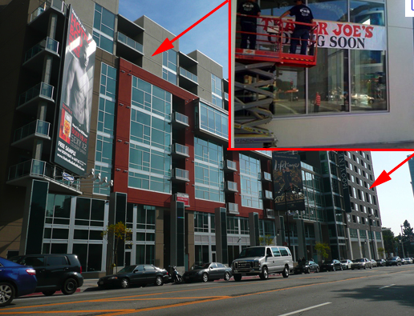
Right: Integrate Hipster friendly chain grocers to re-establish main-stream shopping into the City.
Economic Development Benefits of Supermarkets
The introduction of new neighborhood grocery stores increases property values, expands the city’s tax base and creates jobs
Full-line food stores are high-value magnets that attract complementary stores and services, creating opportunities for additional private sector investment.
New stores contribute to the physical revitalization of communities
In addition, could support Detroit’s Fresh Food Access Initiative
Above: Closest Grocery Store to Site: Harbortown Market
Retail - Grocery
http://www.nyc.gov/html/dcp/html/supermarket/index.shtml

Slide 14
Ryan and connie
Talk about numbers analysis and what it drives us to do

Slide 15
Ryan and connie
Talk about numbers analysis and what it drives us to do

Slide 16
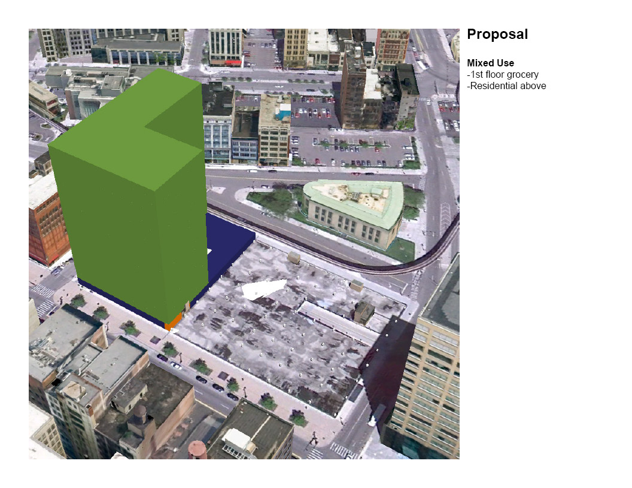
Ryan and connie redo

Slide 17
Proforma
Annual Income
Values anticipated to be high. Additional operations and maintenance costs are expected.
Construction Cost
R.S. Means. Square foot costs. (Includes Arch. Fee)
Return on investment
Residential does not justify its expense.
Grocery costs are in the high teens and warrants further development.
Category | Potential Income | Unrealized Income | Occupancy | Monthly Total | Annual Total
Residential | 409,750 | (81,950) | 80% | 218,975 | 2,627,700
Amenities | (21,000)
Common | (77,250)
Support | (10,575)
Grocery | 48,000 | (2,400) | 95% | 45,600 | 547,200
Parking | 120
Category | SF | Base Cost/SF | Additions /SF | Location Factor | Construction Cost (Includes Arch) | Net Income | Annual Income / Construction
Residential | 487,300 | 162 | 10 | 1.03 | $ 86,330,068.00 | 2,627,700 | 3%
Grocery | 24,000 | 114 | 10 | 1.03 | $ 3,065,280.00 | 547,200 | 18%
Ryan and connie redo

