Slide 3
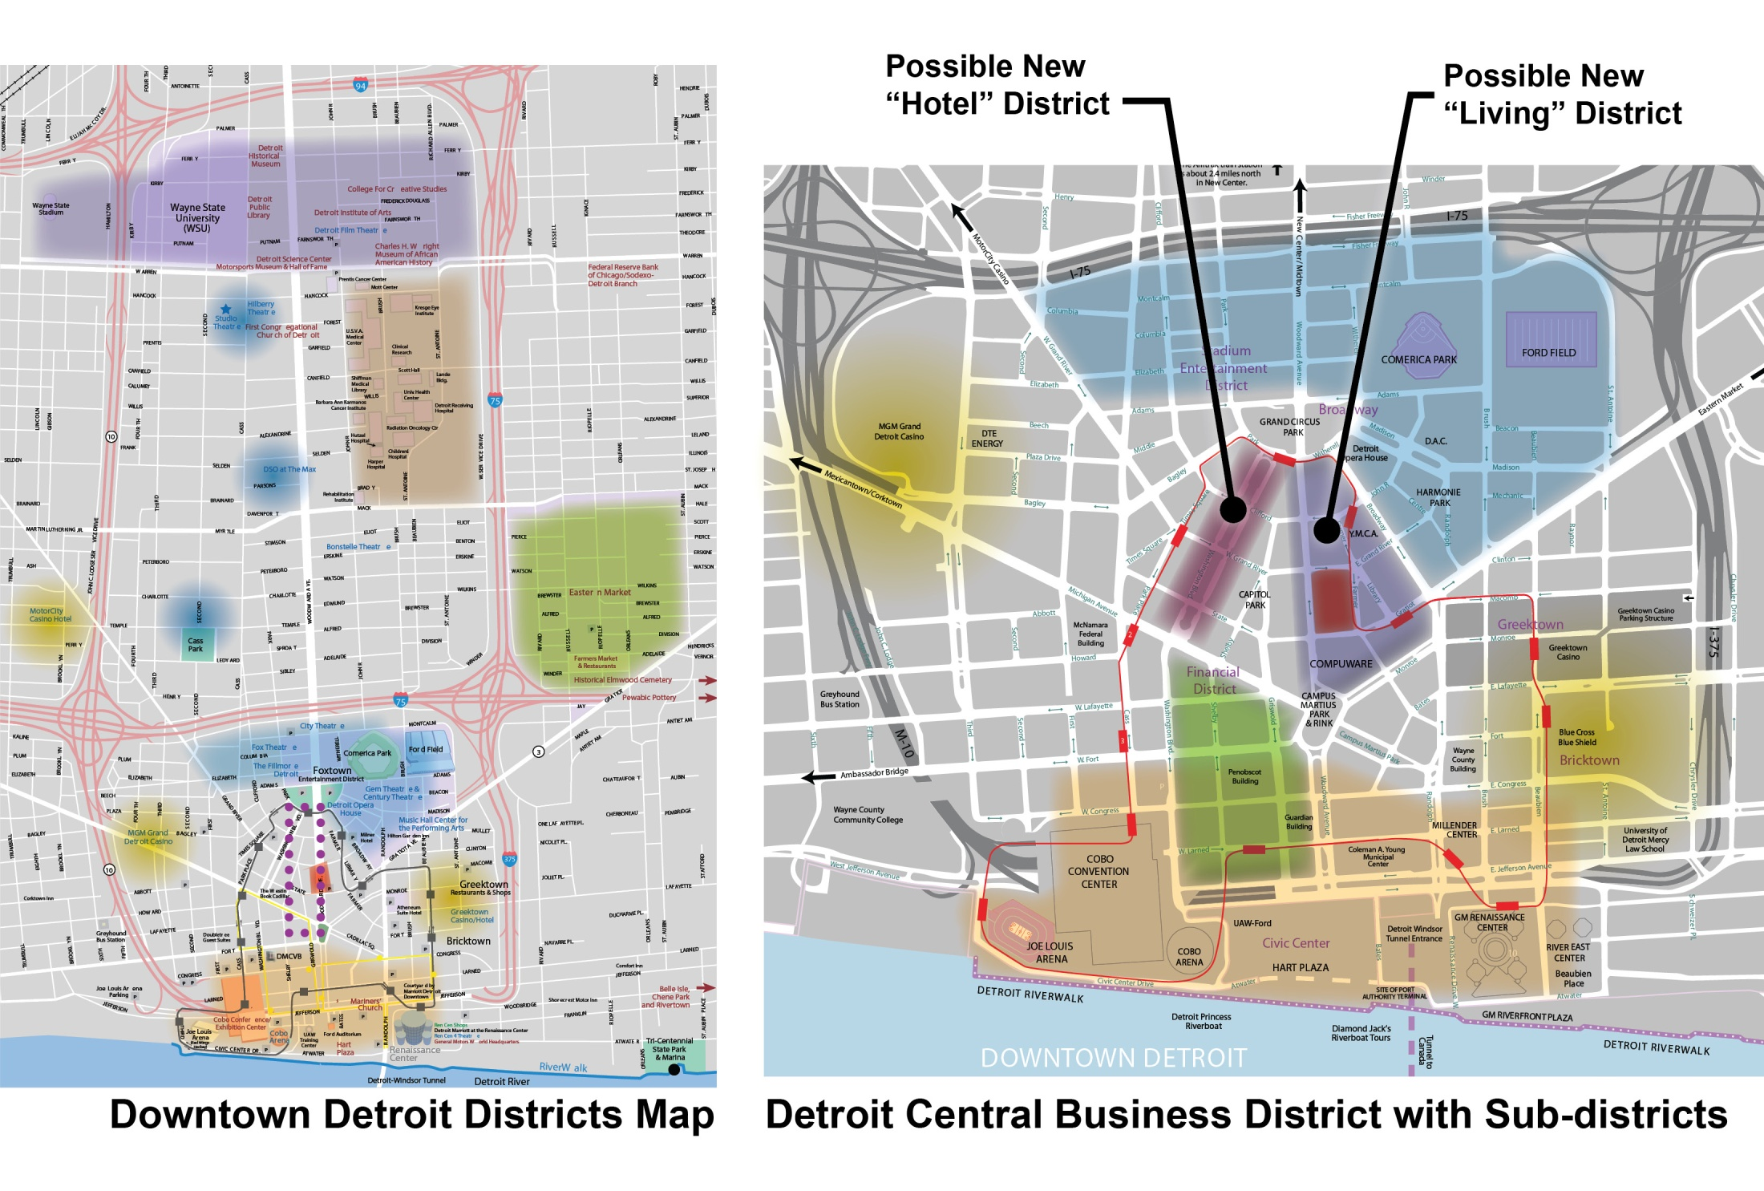

Slide 8

Highest and Best Use
Retail is not the highest and best use
Requires a critical mass to be successful and therefore drives the program to a vertical mall, such as Water Tower Place in Chicago
A vertical mall is difficult to make successful due to the principles of serial vision and 100% locations discussed in seminar. Retail on the first level is in keeping with the city’s vision and districting that is currently in place.
A mixed use is probably necessary to help offset expenses (include hotel or housing)
Office is not the highest and best use
High vacancy rate and excess quality space does not support a demand for this use. Mid-grade office stock has lower costs, but would be useless in the current and foreseeable market.
A headquarters store may be a successful endeavor as the developer could negotiate the deal up front.
The best long-term development strategy is to work with the districts the city has in place
Hospitality is not the highest and best use
The quality of the hotel would need to be high to compete, driving the cost of construction up.
Low occupancy rates do not support the income needed to sustain the project
Increased tourism could improve occupancy but that is not in the developers control
Though not incompatible, it is not the strongest use

Slide 9


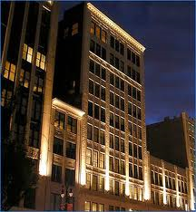
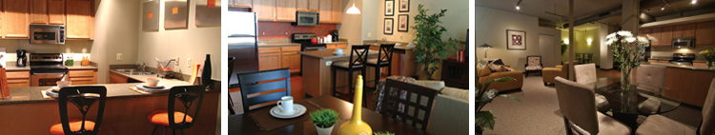
Highest and Best Use: Residential Apartment Rentals
Residential potentially offers the highest and best use
Detroit is full, very little vacancy, and there is the desire to live downtown by young, working professionals
These young professionals who favor loft type living. Simple finishes and open spaces are the appropriate design and can be more affordable to build
All of the housing currently available are older renovated buildings. Nothing currently offers the choice of a new space with more modern features designed for today’s lifestyle
80,000 people work in downtown Detroit so there are potential future tenants. Currently only 6000 people live in downtown Detroit
Despite the economy the occupancy rate has continued to grow until full

Slide 10
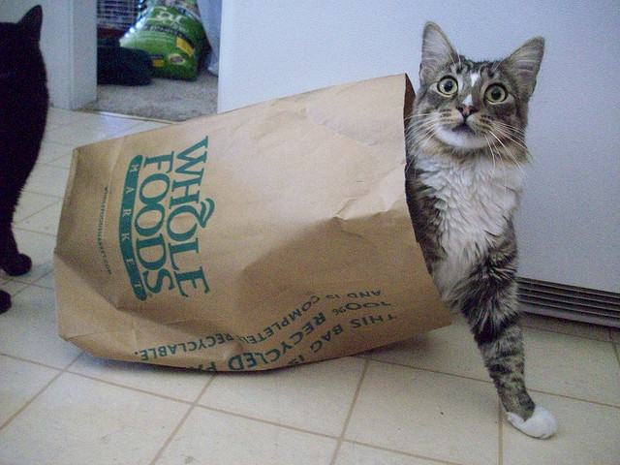
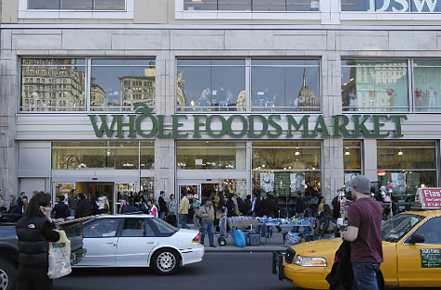
Highest and Best Use: Retail - Grocery
Grocery potentially offers the highest and best use
Downtown Detroit is highly underserved and demand is high.
This use works well in conjunction with the surrounding residential and commercial yet can function independently in this location, by also drawing users who are downtown oriented.
The demand of 125,000 sqft translates to roughly $38,000,000 in sales
Major chain can add vitality to the site and increase site value
The cost of developing a grocery store is substantially less than a luxury tower.
http://farm5.static.flickr.com/4074/4765979423_9d9cb314ac.jpg
http://farm4.static.flickr.com/3502/3730424763_836a8ba0fb_z.jpg

Slide 11
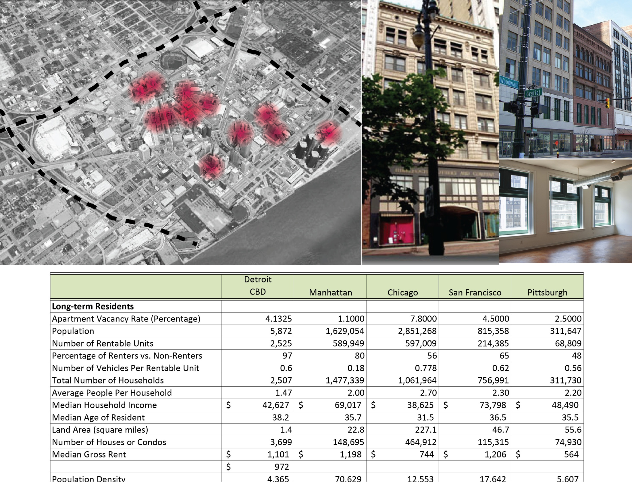
Housing - Rentals

Slide 12
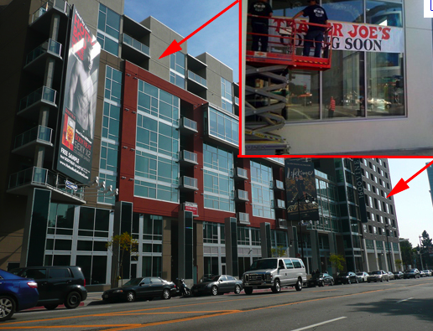
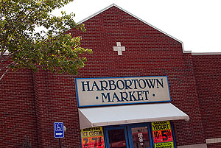
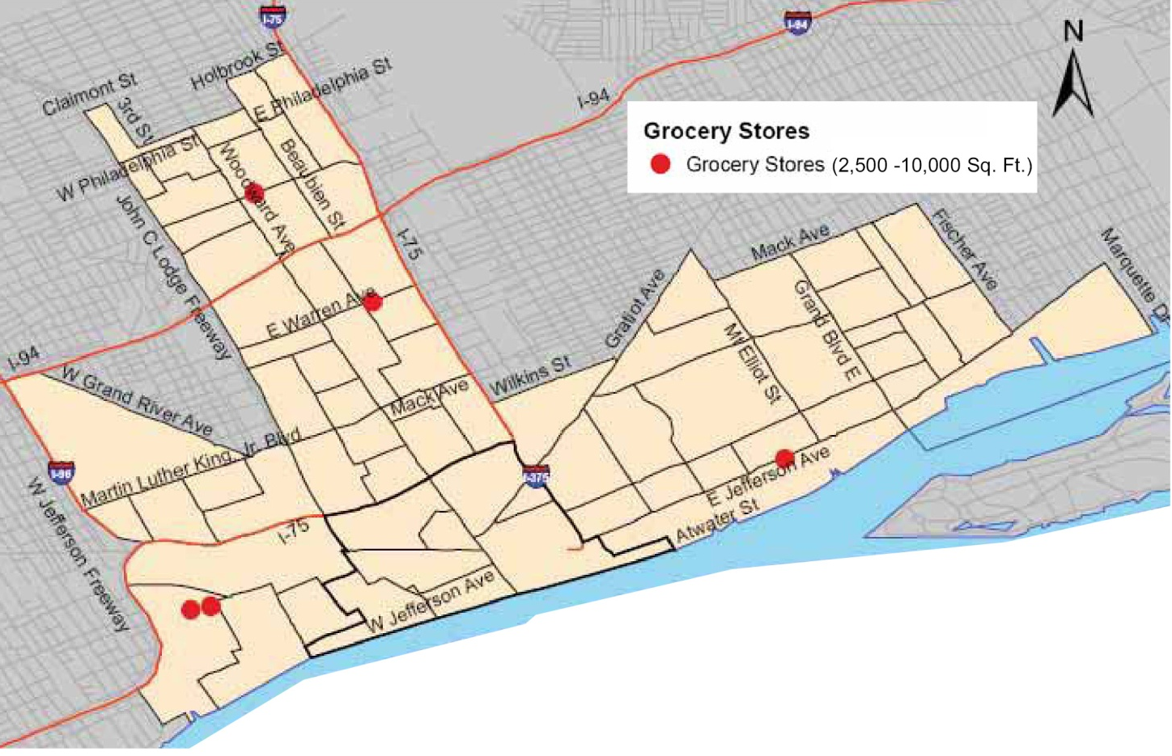
Right: Integrate Hipster friendly chain grocers to re-establish main-stream shopping into the City.
Economic Development Benefits of Supermarkets
The introduction of new neighborhood grocery stores increases property values, expands the city’s tax base and creates jobs
Full-line food stores are high-value magnets that attract complementary stores and services, creating opportunities for additional private sector investment.
New stores contribute to the physical revitalization of communities
In addition, could support Detroit’s Fresh Food Access Initiative
Above: Closest Grocery Store to Site: Harbortown Market
http://www.nyc.gov/html/dcp/html/supermarket/index.shtml
Retail - Grocery

