Slide 1
Flesh and Stone
Chapters 7 – 8 – 9
Christian Bell, Kimberly DeRoo, Ryan Grabow
7: Fear of Touching – Venice (1500-1636)
8: Moving Bodies – Paris (1628-1789)
9: The Body Set Free – Paris (1789-1793)
1500
1600
1700
1800

Slide 2
Chapter 7: Fear of Touching
The Jewish Ghetto in Renaissance Venice 1500-1636
Key Points:
Venetian Trade Market
Venetian Courtesan
Jewish Ghettos

Slide 3
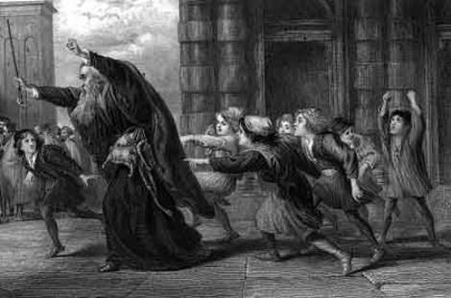
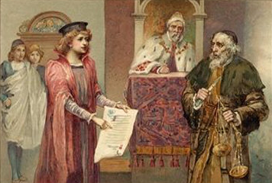
Merchant of Venice -
Shakespeare
Pound of flesh as collateral
Shylock wants to collect
Won case but couldn’t collect
  Exactly 1 pound
  No blood
Honor vs. dishonorable.

Slide 4
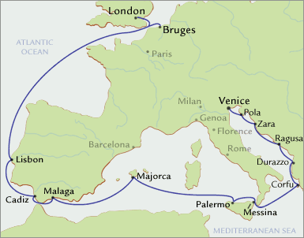
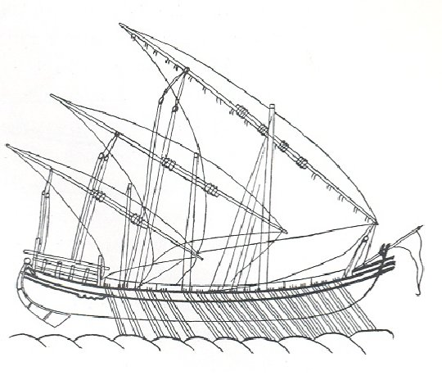
Venice Trade Market
“His word is his bond”
Most international city of Renaissance
Foreigners came and went
Spice trade:
-salt at first
-others later
Muda
Muda: Special merchant gallery ship that combined using sails when at sea and 200 men rowing, when nearing shore. City owned and then rented to merchants.

Slide 5
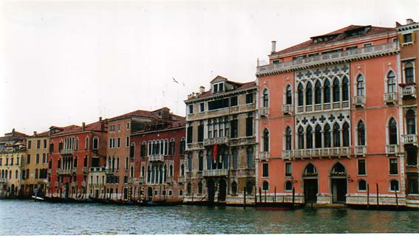
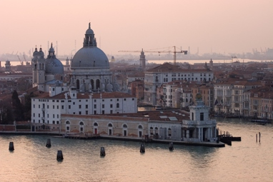
Venice Sensuality
7 / 5
Sensual
  -Europe
  -Themselves
Palaces along Grand Canal
Homosexual Subculture
Spice Trade

Slide 6
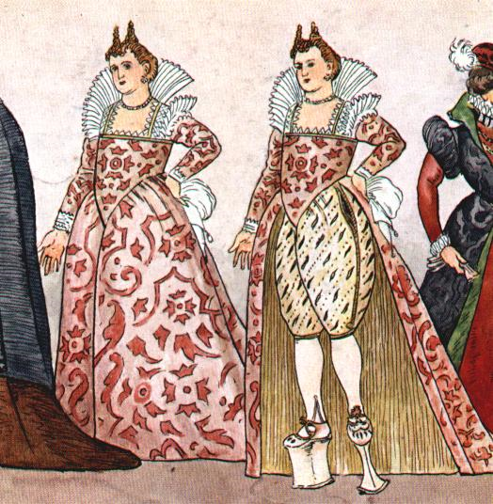
Venetian Courtesan
7 / 6
Special threat
  -fit into society
Part of society
Restrictions:
  clothing
  Jewelry
  living spaces
Fought forced isolation
Courtesan:
A prostitute with a courtly, wealthy, or upper-class clientele (Merriam-Webster Dictionary)

Slide 7
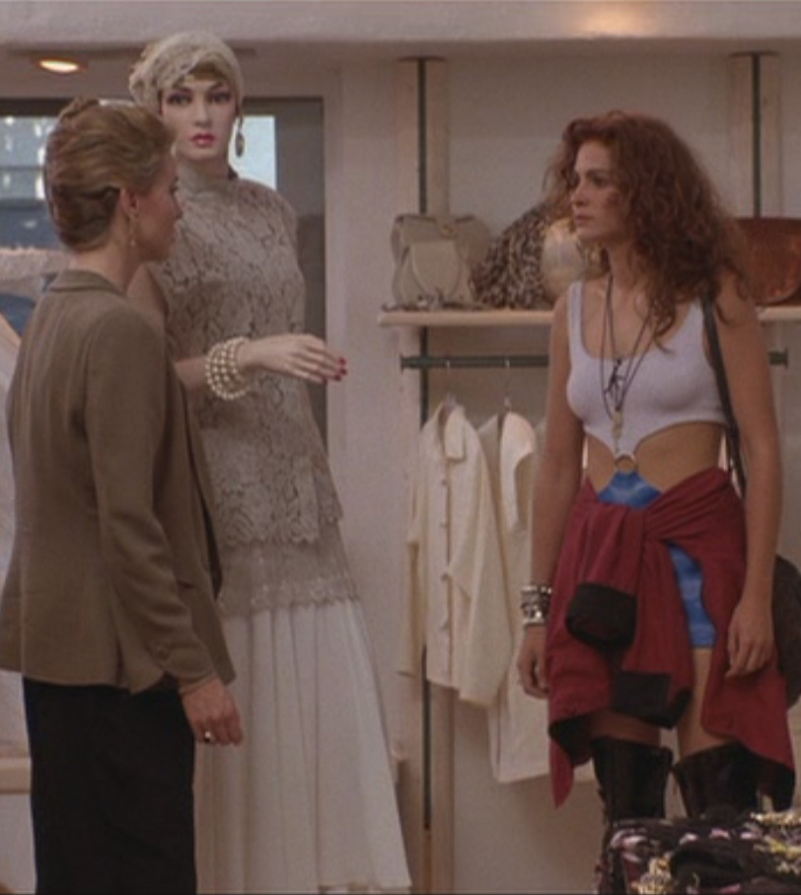
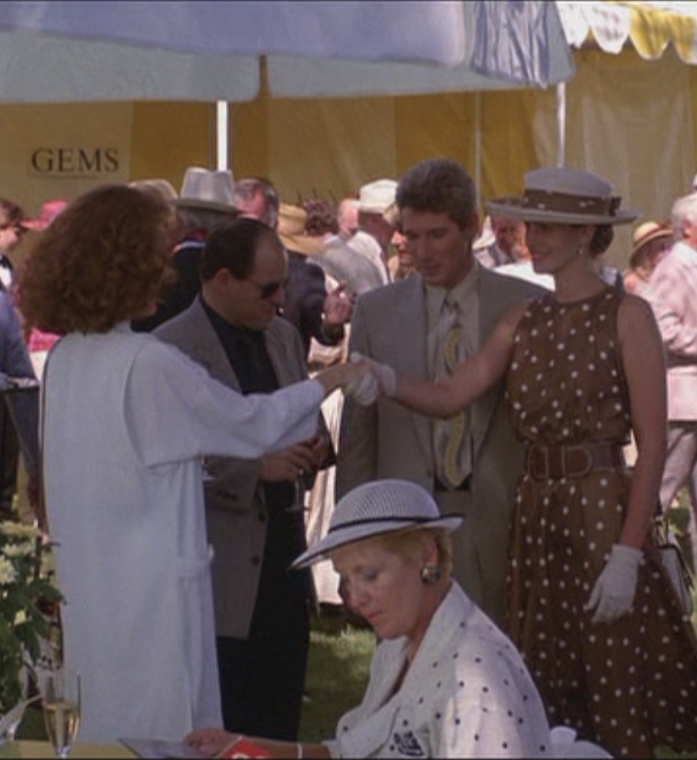
Segregative Identity
7 / 7
Prostitute vs. courtesan
Appearance based exclusion
Yellow scarves
  Prostitutes & pimps
  1416

Slide 8
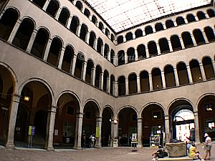
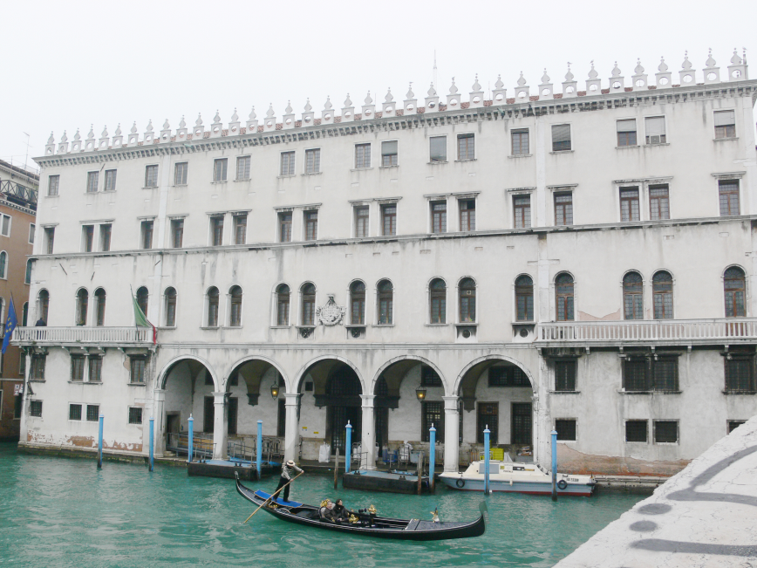
Fondaco dei Tedeschi
“Factory of the Germans”
1314 –Germans segregated
Under surveillance – economics
Reformation in Germany
1531 – All Germans in one place with spies

Slide 9
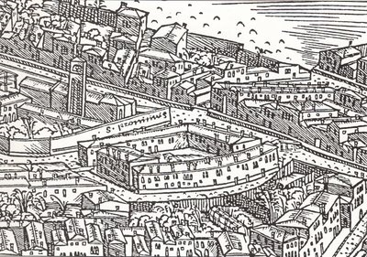
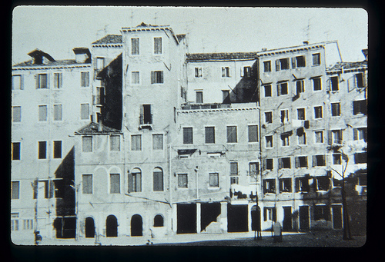
Jewish Ghetto
Disease concern
  -syphilis
  -leprosy
Money lenders
-usury
Call for segregation
  -April 6, 1515
Ghetto proposed
-1515
- Zacaria Dolfin
Ghetto:
‘foundry’ (from gettare, ‘to pour’)
Now: a quarter of a city in which Jews were formerly required to live
(Merriam-Webster dictionary)

Slide 10
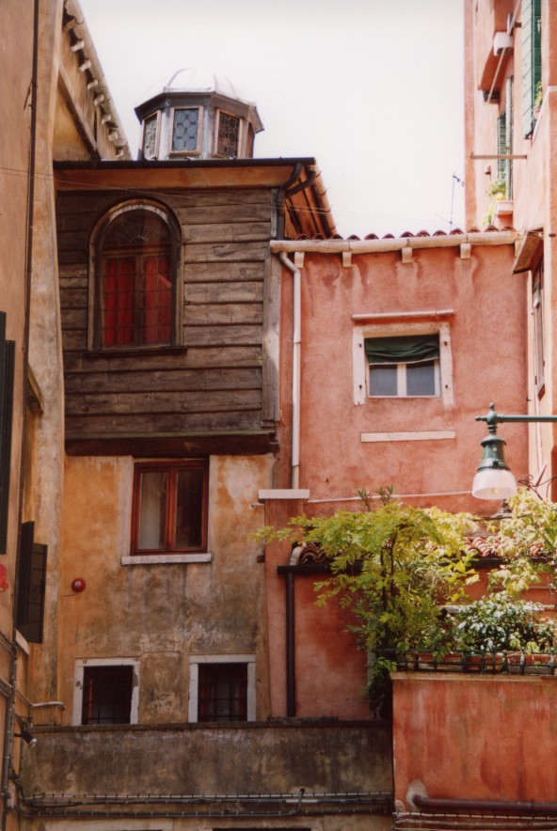
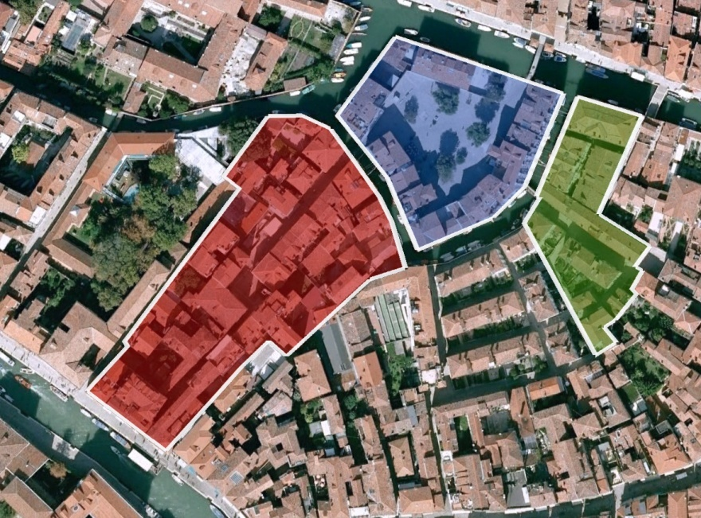
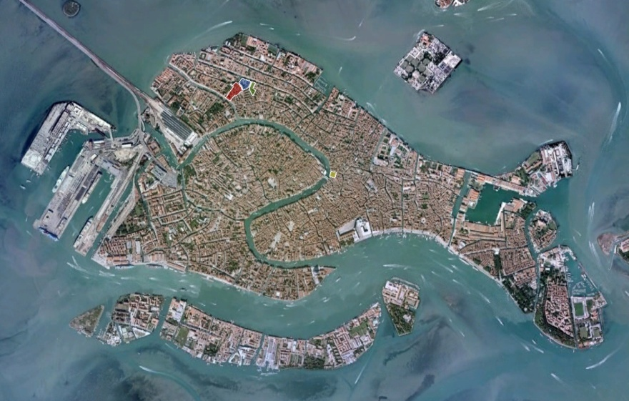
Jewish Ghetto
3 Ghettos :
1-Nuovo
2-Vecchio
3-Nuovissimo
Day – Open
Night - Locked
Christian view:
-crime
-self mutilation
Oppression a way of life
1
3
2

Slide 11
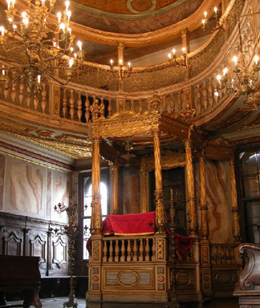
Synagogue
Allowed in Ghetto
Prohibited human imagery
Separate male and female bodies
Would have confirmed Christian stereotypes
Qadosh:
Biblical translation – separate or separated, more consequential meaning encompasses holiness

Slide 12
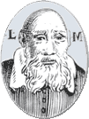
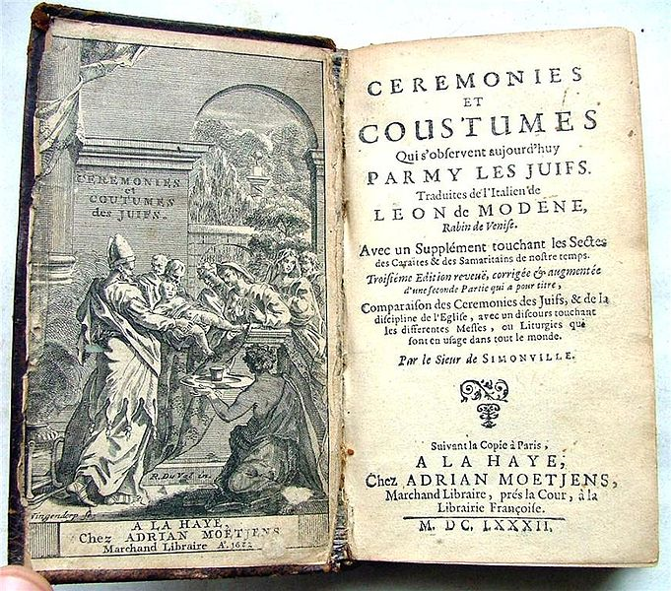
Leon Modena
Christians came to listen
 Protection
 Repression
Limits in value from Christians
 Religious profiling

Slide 13
Part Three
Arteries and Veins
Paris of the Enlightenment

Slide 14
Chapter Eight: Moving Bodies
Introduction
Key Points:
William Harvey’s Revolution
  Blood pulses and the nervous system
  City breathes like the body
  Circulatory city
The Mobile Individual
  The Great Transformation
  The Wealth of Nations
  Goethe flees south
The Crowd Moves
  Galeries du Palais-Royal
  The Great Bread Riot
  Urban crowd movement

Slide 15
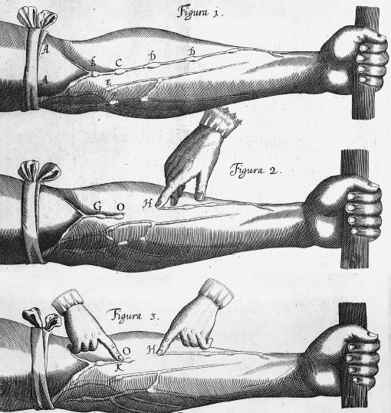
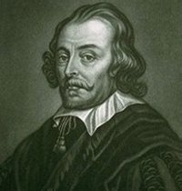
Moving Bodies
William Harvey
Process of blood and heart circulation.
Scientific understanding of the body;
  structure
  healthy state
  relation to the soul
Relates circulation to urban planning.
Circulation heats blood vs. Heat causing blood to circulate.

Slide 16
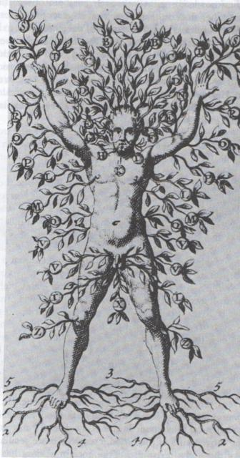
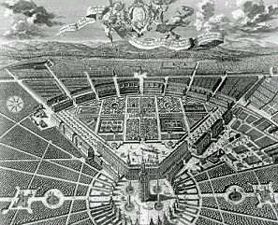
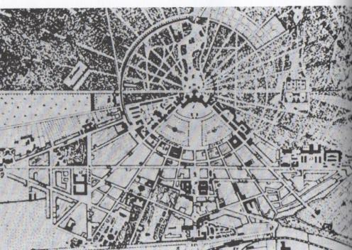
The City Breathes
8 / 16
Blood Circulation vs. Urban Cities
Streets as planned circulation
Artery’s and veins applied to streets
City breathes like a body

Slide 17
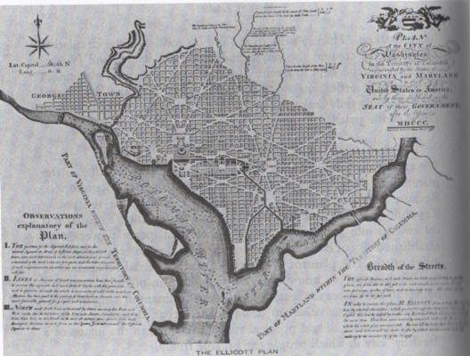
Moving Bodies
8 / 17
Washington D.C. L’Enfant’s Plan
Circulation applied to D.C
Avoid crisis of circulation
State of movement
  Air
  Water
  Waste

Slide 18
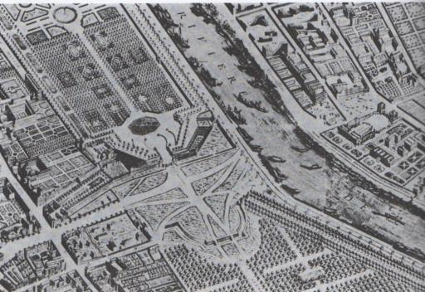
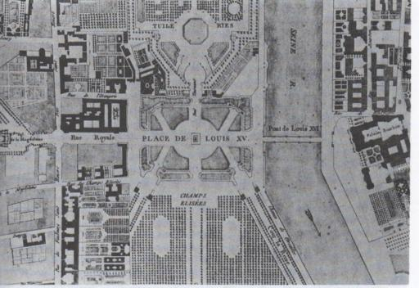
The City Breathes
8 / 18
Site Plan for Place Louis XV, Paris
Importance of
Central Lung
Boundless
Gardens

Slide 19
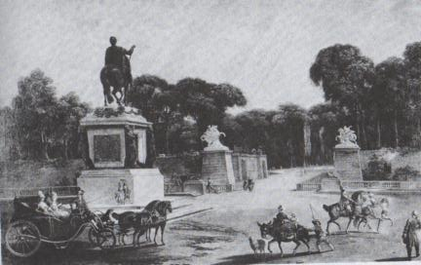
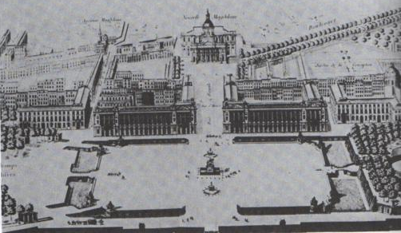
The City Breathes
8 / 19
Site Plan for Place Louis XV, Paris
Connect each part of the city
Citizens breathe free

Slide 20
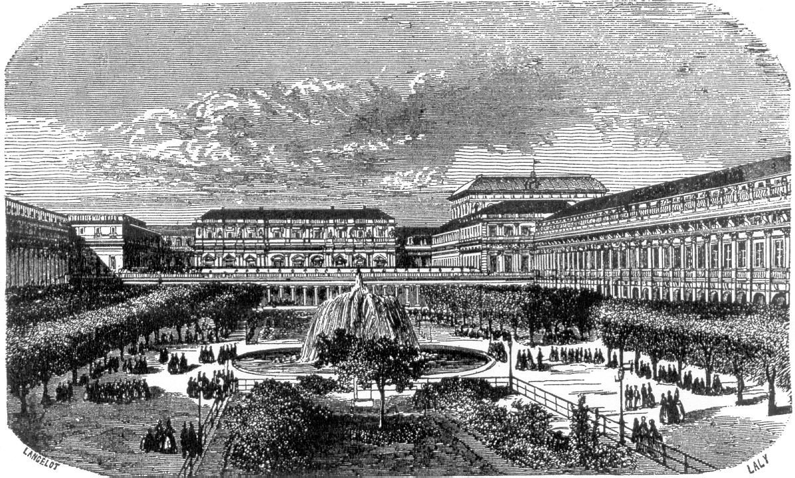
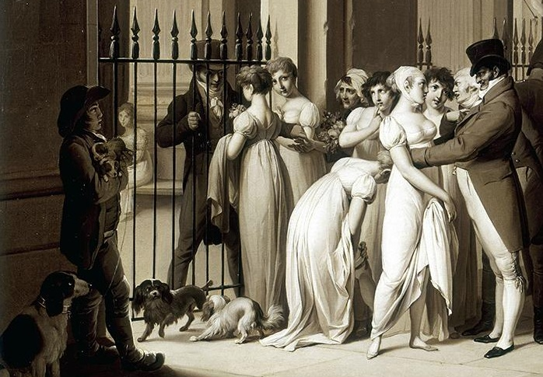
Moving Bodies
8 / 20
Galeries du Palais-Royal, Paris
Time Square of Paris
Urban economy
Market Place

Slide 21
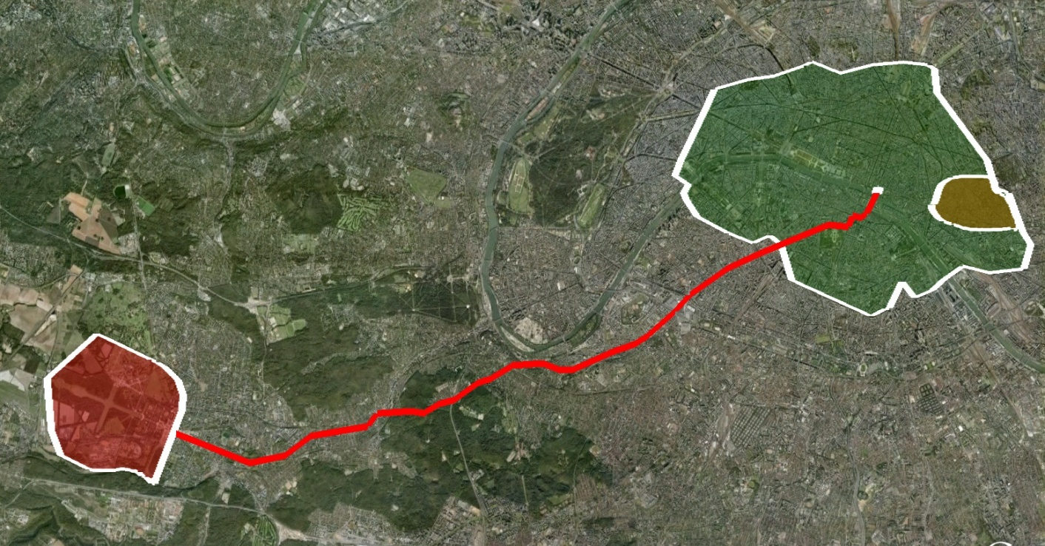
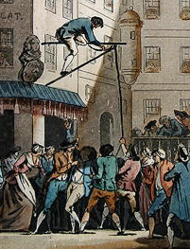
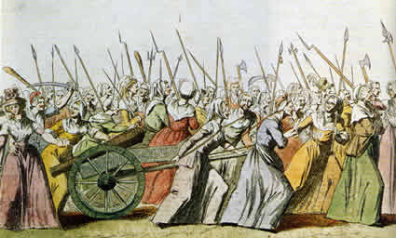
Great Bread Riot
October 5th, 1789
Begins:
  Saint-Antoine
  Food stalls
  High price of bread
Hotel de Ville
  Paris bankrupt
Versailles
  10,000-60,000
  Move King to Paris

Slide 22
Chapter Eight: Moving Bodies EXTRA SLIDE
Discovery in blood pulses and the nerve system
8 / 22
Circulation heats blood vs. Heat causing blood to circulate.
The Essence of the Soul
God is the Principle of the machine

Slide 23
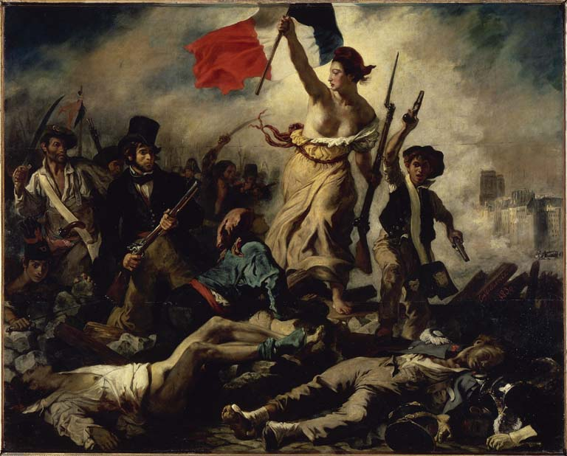
The Body Set Free
Revolutionary Paris, 1789 - 1793
Citizen Reborn
Boullee’s architecture
Dead Space
Festival Bodies
Crowd Psychology
  Gustave Le Bon
  Savagery vs. apathy

Slide 24
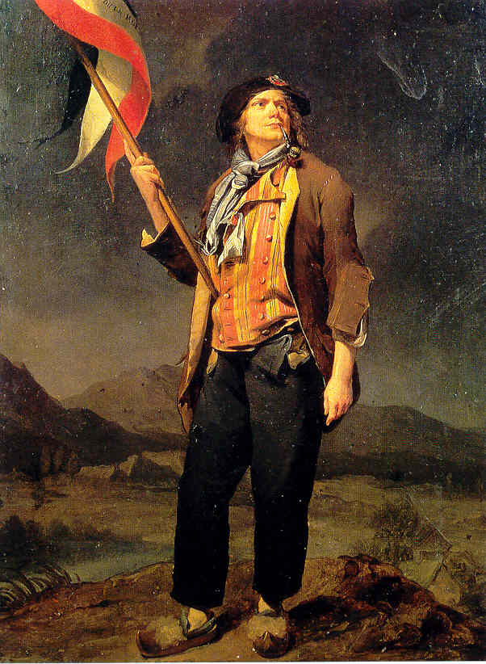
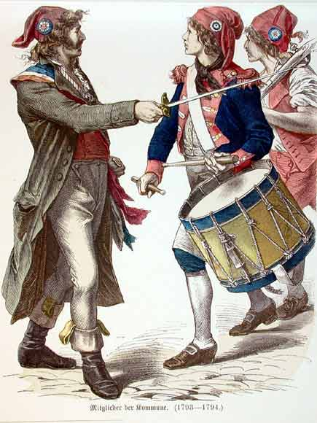
Sans-culottes
Revolutionary Parisians
Third Estate
  Working class
Trousers vs. Culottes

Slide 25
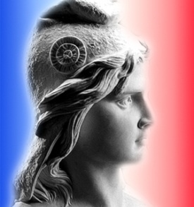
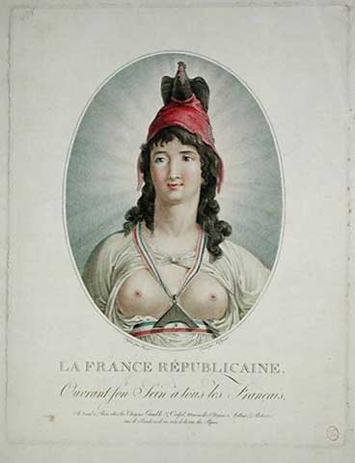
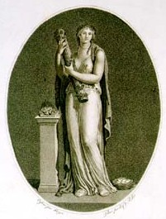
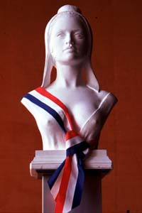
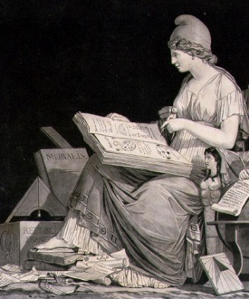
Marianne
The image of the Republic
Nurturing
Equal access
Phrygian cap
Breastfeeding: maternal affection
Liberty, Equality, Fraternity
Phrygian cap:
(a.k.a. Liberty cap)
-Given to freed roman slaves.
-Worn by Asian cultures from region called Phrygia.

Slide 26
Republic vs. Ancien Régime
Revolutionary Symbolism
Marianne
  Virtuous
  Full bosom ‘bursting with milk’
  Mature
Marie-Antoinette
  Immoral
  Sexually insatiable
  Flat-chested
  Immature, puerile, spoiled adolescent
Ancien:
Adjective similar to ex-
(e.g. ex-regime)

Slide 27
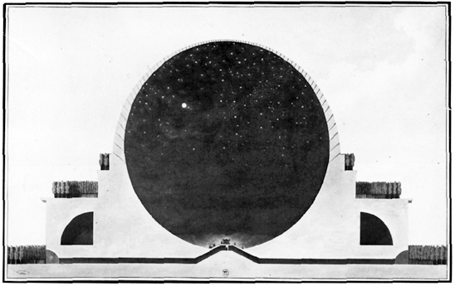
The Volume of Liberty
9 / 27
Etienne-Louis Boullee, 1728-1799
Newton’s Cenotaph
Cenotaph: empty tomb; a tomb or a monument erected in honor of a person or group of persons whose remains are elsewhere
Clear open space
Power & Idealism
Unheimlich: undomestic
  Not suited for Marianne
Temple to Nature and Reason

Slide 28
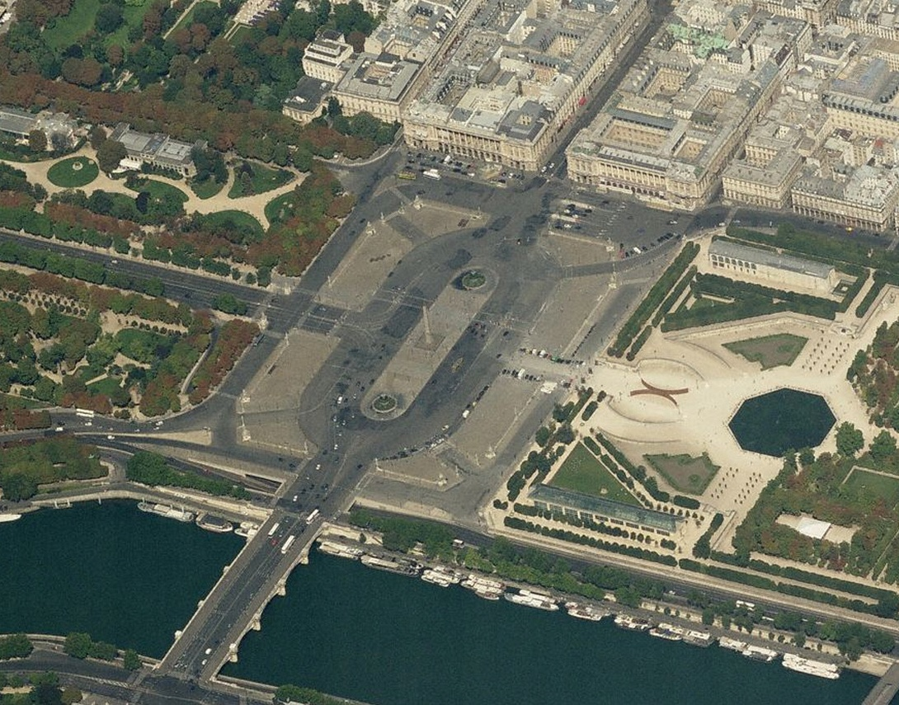
The Volume of Liberty
9 / 28
Place Louis XV : Place de la Republic : Place de la Concorde
Gardens cleared
  1971
Transparent
“Nothing hidden”

Slide 29
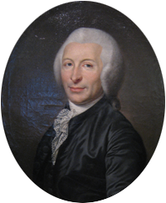
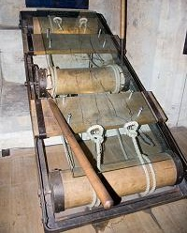
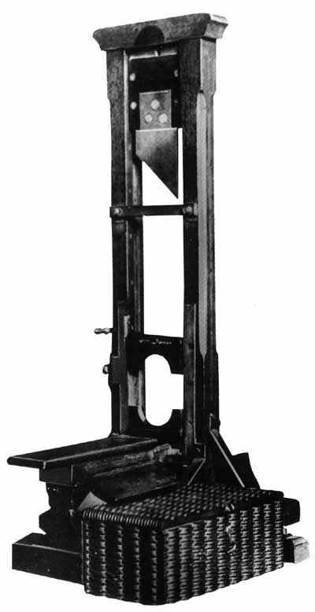
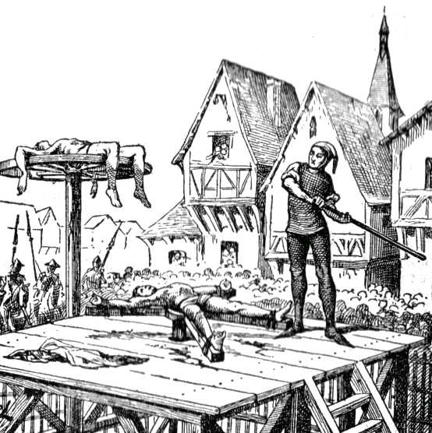
Guillotine
Joseph-Ignace Guillotin, physician (1738-1814)
Christian death
  Delayed
  Repentance
Guillotin, 1798
  Enlightened ritual-free death
  Humanitarian
  Painless death
  Respect for body
  Moral superiority
‘National razor’
Death invisible
  Loss of empathy

Slide 30
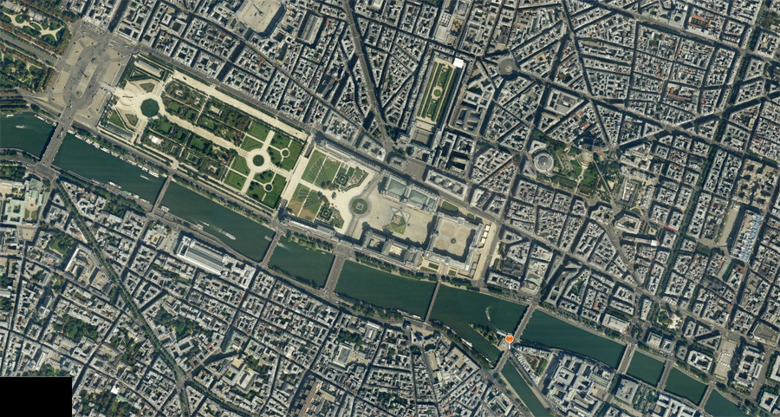
Dead Space
Locations of Guillotine
Ouside of City
1-Place de Grève
  2,000 – 3,000
2-Place du Carrousel
  12,000 – 20,000
  Political executions
3-Place Louis XV
  Louis Capet

Slide 31
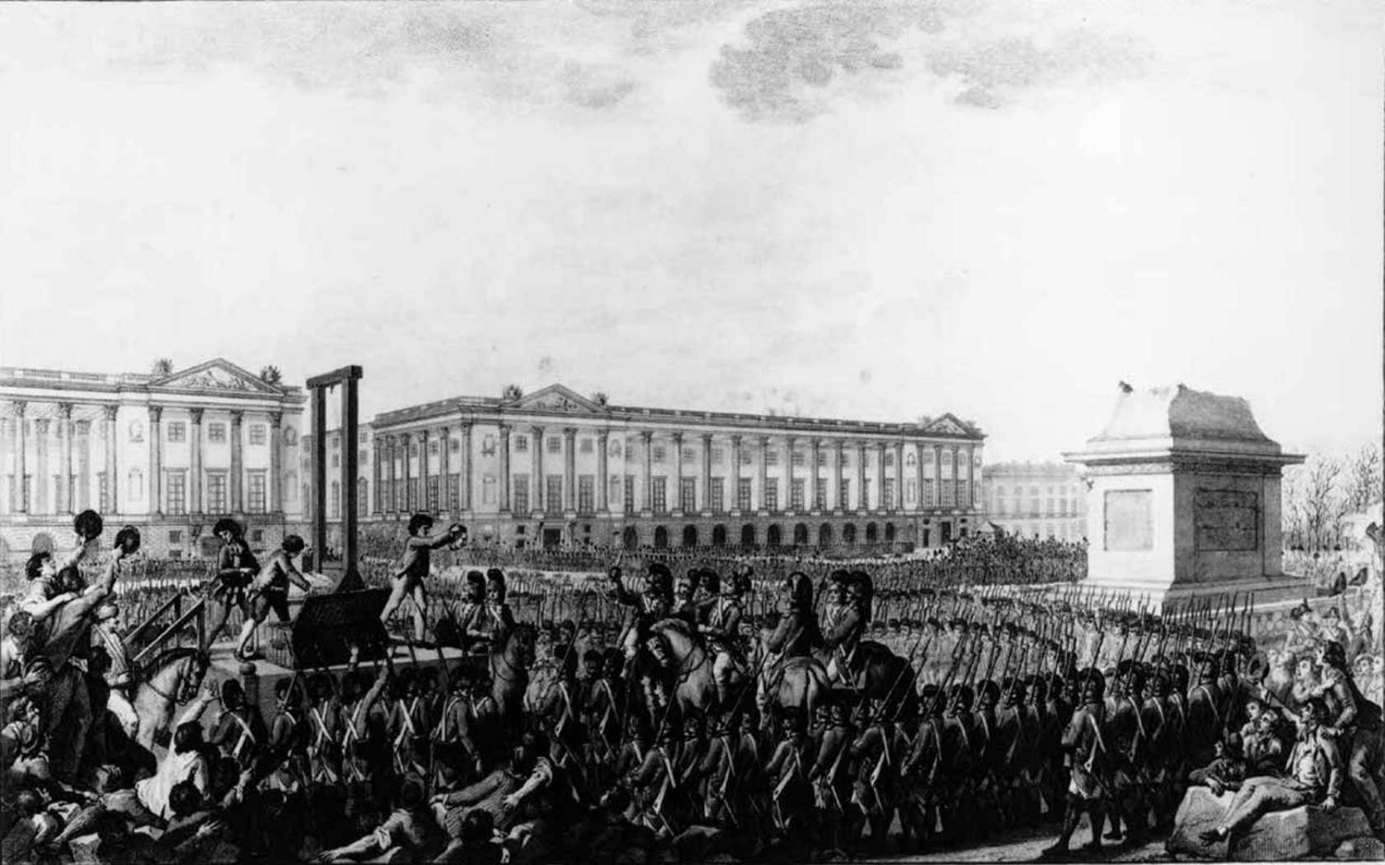
Execution of Louis XVI
January 21, 1793 : Place de la Revolution
No speeches
Insulated by rows of guards
Equal in death
Death as a non-event.
Crowd apathy
  Passive bodies

Slide 32
Festival Space
Defining the new citizen
Festival of Chateauvieux
  15 April 1792
  Glorification of riot
Festival of Simonneau
  3 June 1792
  Honor victim of riot

Slide 33


Social Touching
Festival of the Unity and Indivisibly of the Republic, August 10, 1973
Fountain of Regeneration
  Bastille prison ruins
  Papier-mâché
Herakles image
  Change attempted
  Failed
Marianne
  Desire to touch
  Inaccessible in revolutionary space

Slide 34




Stillness and Emptyness
Compassion expressed through body, not place
The Death of Marat
  July 13, 1793
The Death of Bara
  1793
Stillness
Coldness
Emptiness
Focus on body
Bara
  Innocence
  Unselfishness
  Reflection of Marianne

Slide 35
Ch. 9 - Summary
The Body Set Free
Citizen Reborn
  Marianne: Nurturing
  Liberty, Equality, Fraternity
Volume of Liberty
  Boullée: Rational and idealized
  Plazas: Nothing hidden
Dead Space: Executions
  Respect for the body
  Cut away the old - Ancien Régime
  Apathy to decapitation
Festival Space
  Intent to develop republican character
  Idealization dulls the body, resistance arouses
  Compassion conveyed through body, not place

Slide 36
Chapter 7-8-9: Summary
The social body
  Syncope  Segregation  Circulation  Amputation
Social space
  Economic  Segregated  Circulatory  Idealized  Apathetic

Slide 37
Image Credits
Chapter 7
http://www.greenwichlibrary.org/blog/library_news/2009/09/bob-smith-returns-to-recount-merchant-of-venice.html (slide 3)
http://wapedia.mobi/en/John_Gilbert_%28painter%29 (slide 3)
http://www.syropoulos.co.uk/ships.htm (slide 4)
http://flemishamerican.blogspot.com/ (slide 4)
http://www.cedarseed.com/pearl/myitaly2.html (slide 5)
http://www.venice-sights.co.uk/customs_house.htm (slide 5)
http://realmofvenus.renaissanceitaly.net/library/drawers.htm (slide 6)
Pretty Women, 1990. Walt Disney Studios
http://reference.canadaspace.com/search/Giovanni%20Giocondo/ (slide 8)
http://www.visit-venice-italy.com/art-painters/albrecht_durer_venice_italy.htm (slide 8)
http://www.flickr.com/photos/richardsennett/3965221695/ (slide 9)
http://samgrubersjewishartmonuments.blogspot.com/2009/04/lecture-isjm-president-samuel-gruber-to.html (slide 9)
http://www.sacred-destinations.com/italy/venice-jewish-museum.htm (slide 10)
Google Earth, Aerial Image underlay (Slide 10)
http://www.kiddushinvenice.com/Sinagoga%20Tedesca.htm (slide 11)
http://jhom.com/topics/choir/modena.htm (slide 12)
http://de.wikipedia.org/wiki/Leone_da_Modena (slide 12)
Chapter 8
Sennet, R, Flesh and Stone, Norton and Company, New York: Norton, 1994 (slides 15-20, and 22)
???? (slide 20)
Google Earth, Aerial Image underlay (Slide 21)
http://www.executedtoday.com/2009/10/22/1789-baker-boulanger-francois-denis-lafayette (Slide 21)
http://en.wikipedia.org/wiki/File:Women's_March_on_Versailles.jpg (slide 22)

Slide 38
Image Credits
Chapter 9
http://www.rjgeib.com/thoughts/french/french.html (slide 23)
http://en.wikipedia.org/wiki/Sans-culottes (slide 24)
http://www.kunst-fuer-alle.de/english/art/artist/image/simon-louis-nach-boizot/11315/2/75499/the-french-republican,-engraved-by-a--clement/index.htm (slide 25, 26)
http://a32.idata.over-blog.com/300x332/1/15/47/48/STOCK-PLUS/marianne.jpg (slide 25)
http://chnm.gmu.edu/revolution/d/2/ (slide 25)
http://www.elysee.fr/elysee/root/bank/les_symboles_de_la_republique/maria2gd.jpg (slide 25)
http://chnm.gmu.edu/revolution/d/37/# (slide 25)
Sennet, R, Flesh and Stone, Norton and Company, New York: Norton, 1994 (slides 26,27,32)
http://hanser.ceat.okstate.edu/4073%20pages/boullee3.htm (slide 27)
http://www.bing.com/maps (slide 28)
http://www.medievality.com/the-rack-torture.html (slide 29)
http://www.ipmart-forum.com/showthread.php?t=388768 (slide 29)
http://astrologieklassisch.wordpress.com/2009/10/22/seriose-zeitung-fragt-wen-wurden-sie-zuerst-erschiesen-banker-oder-politiker/ (slide 29)
http://www.blastmilk.com/decollete/gallery/guillotine/guillotine19.jpg (slide 29)
Google Earth, Aerial Image underlay (Slide 30)
http://architecture.desktopnexus.com/get/193979 (slide 31)
http://www.georgeglazer.com/prints/law/monnetfontfede.html (slide 33)
http://www.vidarholen.net/contents/junk/marat.html (slide 34)
http://www.paintingall.com/jacques-louis-david-the-death-of-bara.html (slide 34)
http://www.still-life-art.org/The-Death-of-Joseph-Bara-(1779-93)-30th-November-1793,-1883-large.html (slide 34)
http://en.wikipedia.org/wiki/File:Jacques-Louis_David,_Le_Serment_des_Horaces.jpg (slide 34)

