Slide 1
Save Homes
Settle Detroit
Ryan Grabow | Massive Change Studio | Lawrence Technological University | Spring 2010

Slide 2
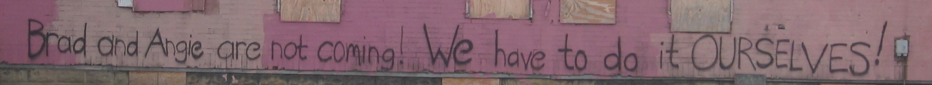
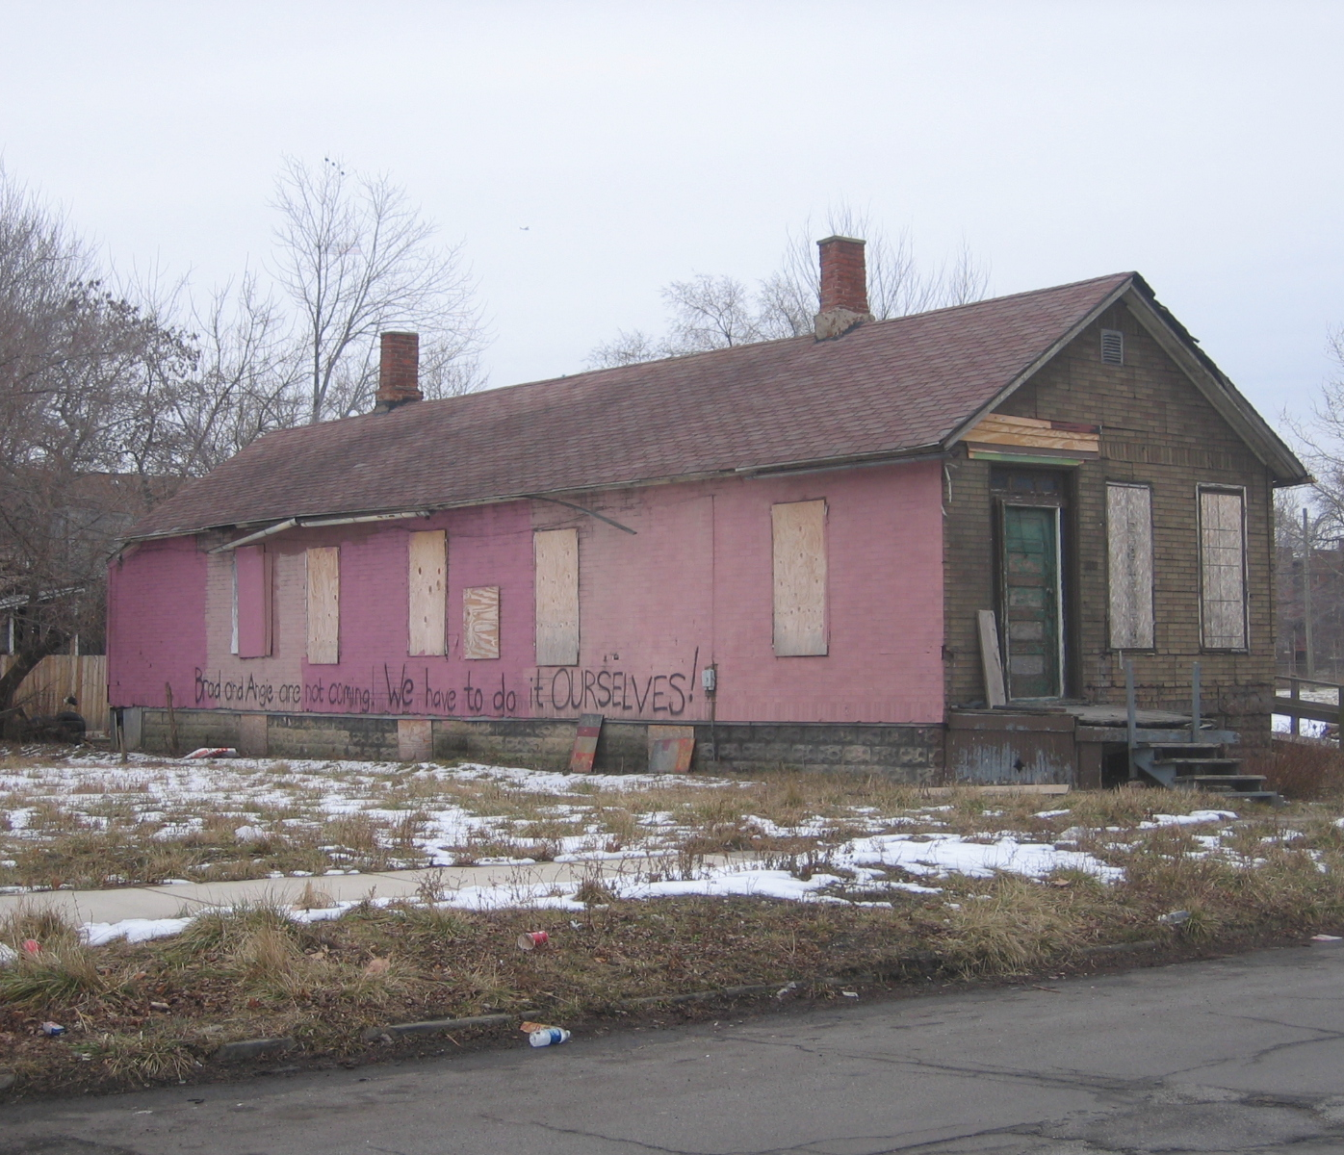
Blighted Buildings
Problem
2
Detroit has an international identity of abandonment and blight. Demolishing over 150,000 homes over the past four decades has not eliminated the existence of a substantial stock of dilapidated structures.
Many of these structures are in a state of disrepair resulting in continued deterioration of the building. Such structures encourage crime and further deterioration of the area.
Intervention before deterioration renders the structure beyond a salvageable could provide a economic incentive and help draw people to reside in the city.

Slide 3
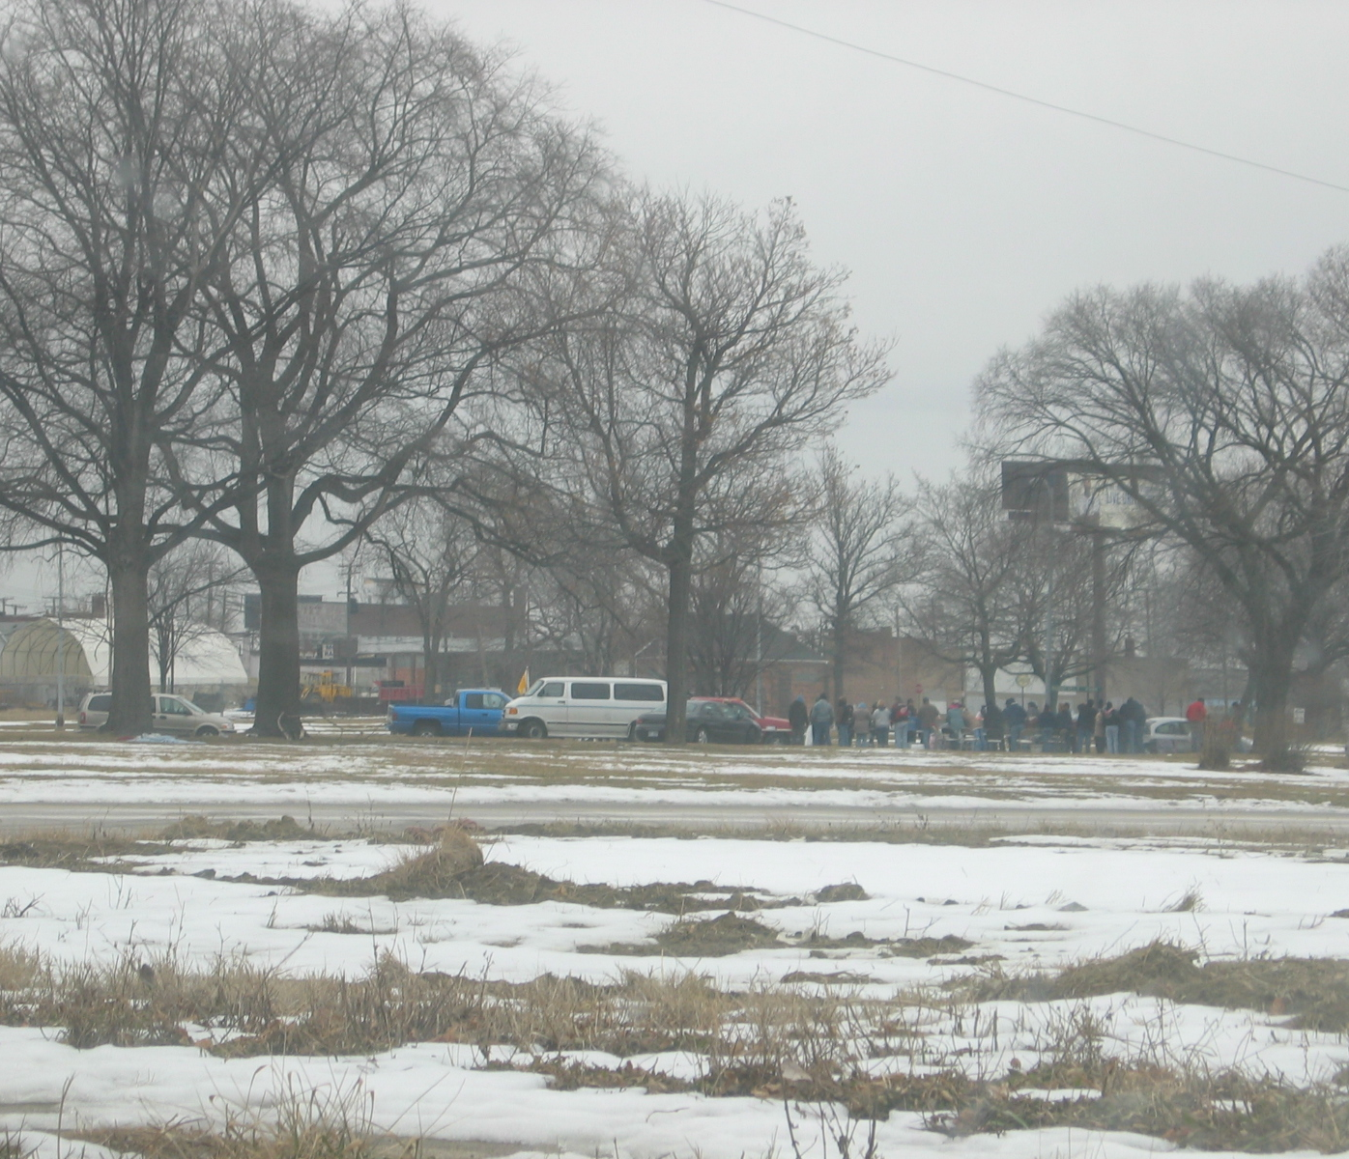
Blighted Buildings
+
Productive Homeless
Problem
3
Various shades of homeless are present in any major city. Ideally you could use the abandoned building stock to help address homeless issues within the city. Placing homeless in truly inadequate building presents a danger to the inhabitant unless the inhabitant is able to remediate the structure to habitable standards. This restricts the potential population to what this report refers to as Productive Homeless.
Specifically people willing and able to inhabit and improve the structure. This can be a long term residence or for sale of the property and the economic ability to profit.

Slide 4
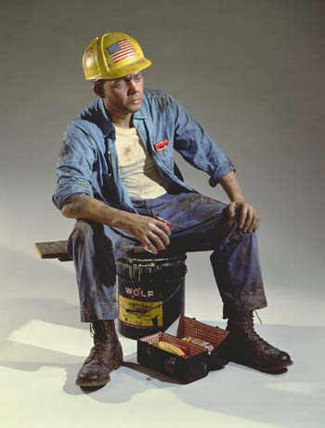
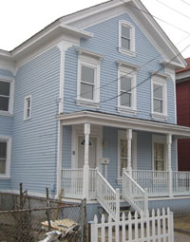
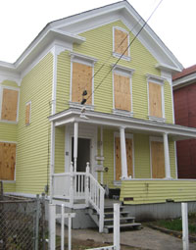
Vision
Strategy
4
Enable displaced individuals with the ability to salvage at risk dwellings to take possession and residence of the building and return the structure to a productive building.
+

Slide 5
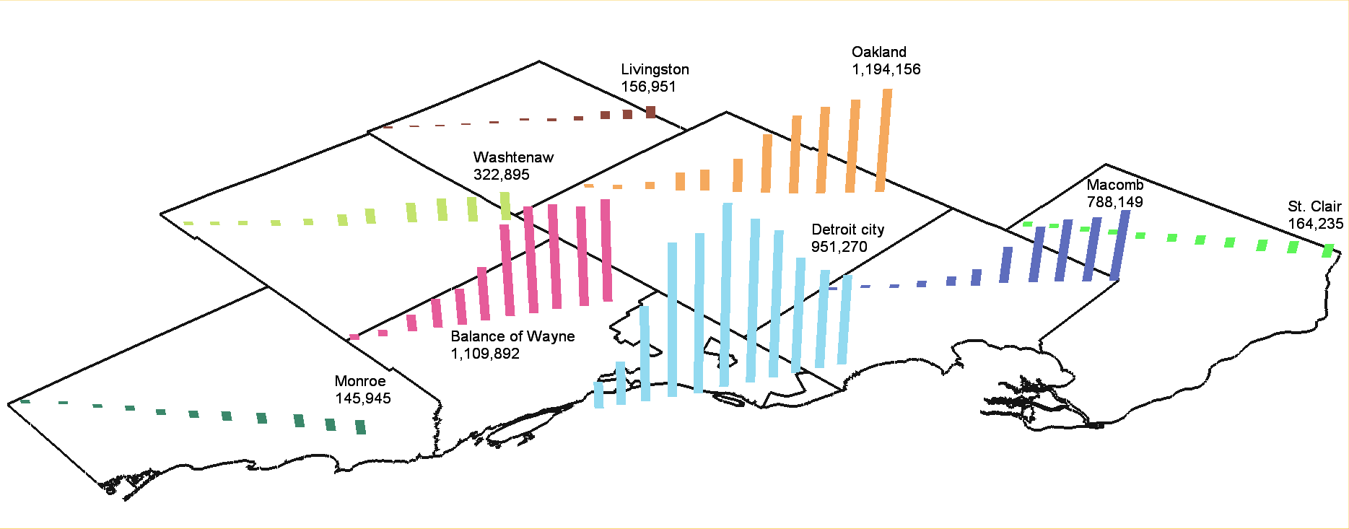
Exodus
Why
5
Population declines since the 1950s, nearing half of the peak population, contributes signifi-cantly to housing abandonment. Losses continue to increase due to reductions in the local automotive workforce.

Slide 6
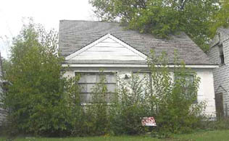
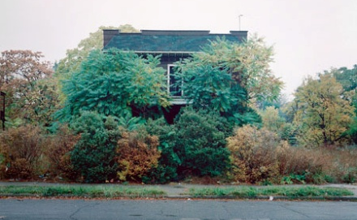
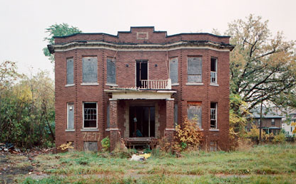
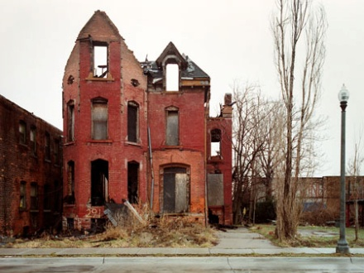
Property Conditions
Where
6
Definitions of Property Conditions:
*Good: The building looks structurally sound and well maintained. It needs no more than two minor repairs. It is not leaning or tilted and the foundation is in good shape. The building may need some general maintenance, such as the replacement of window frames or painting.
*Fair: The building is structurally sound, and may need three or more minor repairs, but no more than one major repair. The building could be rehabilitated fairly inexpensively to improve its rating.
*Poor: The building may not be structurally sound, and needs two or more major repairs. The building may have broken windows or the porch may look like it is falling off the structure. Major repairs need to be made for this building to be safe, adequate housing.
*Should be demolished: This building is not structurally sound and should not be lived in. It may have fire damage or it may be leaning.
-Vacant Properties Toolbox, LISC Detroit
The target structures would not qualify for a certificate of occupancy, but would not require a crane for repair.
Marketable
Salvageable
Dangerous

Slide 7
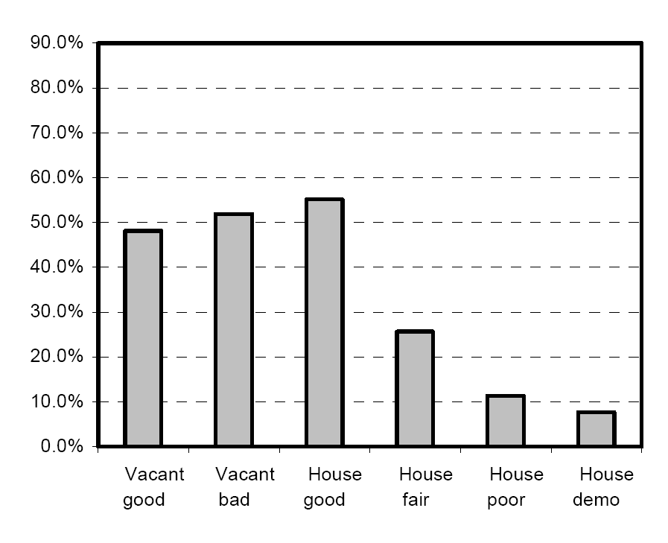
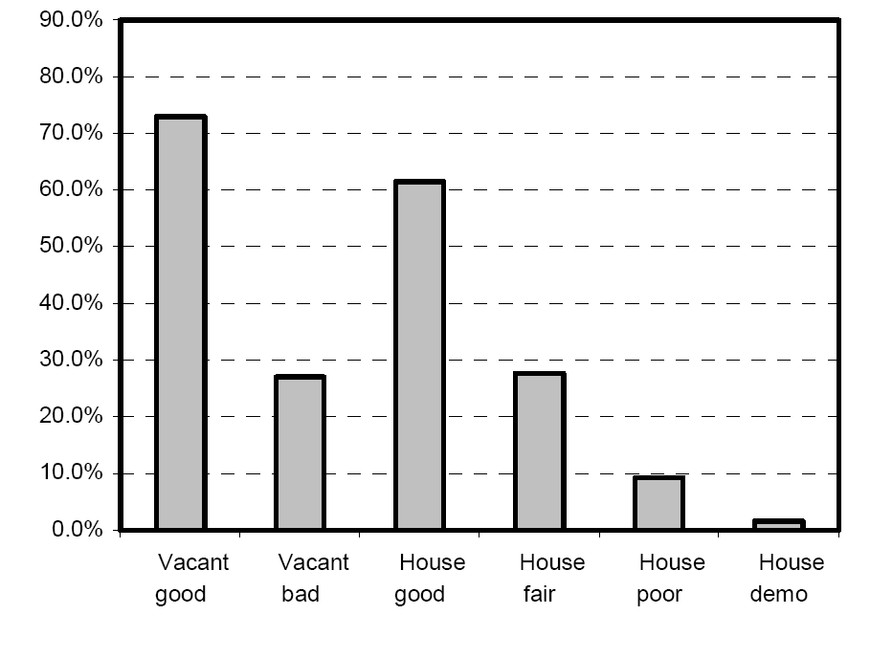
Quantification
Where
7
Foreclosure Auction Sales
City Owned Foreclosure Sales
The selected condition represents approximately 10% of foreclosure sales in 2005 and 2006.
In October of 2009, Detroit’s city government auctioned about 9,000 tax foreclosures with minimum bids of $500;
four-fifths were not sold.
Assuming half of the properties had structures, approximately 500 properties fit the selection at the auction.
Detroit has an estimated 78,000 homes, with 100,000 to be reached by the end of the year. Assuming 10%, nearly 10,000 homes would meet the selection criteria this year.

Slide 8
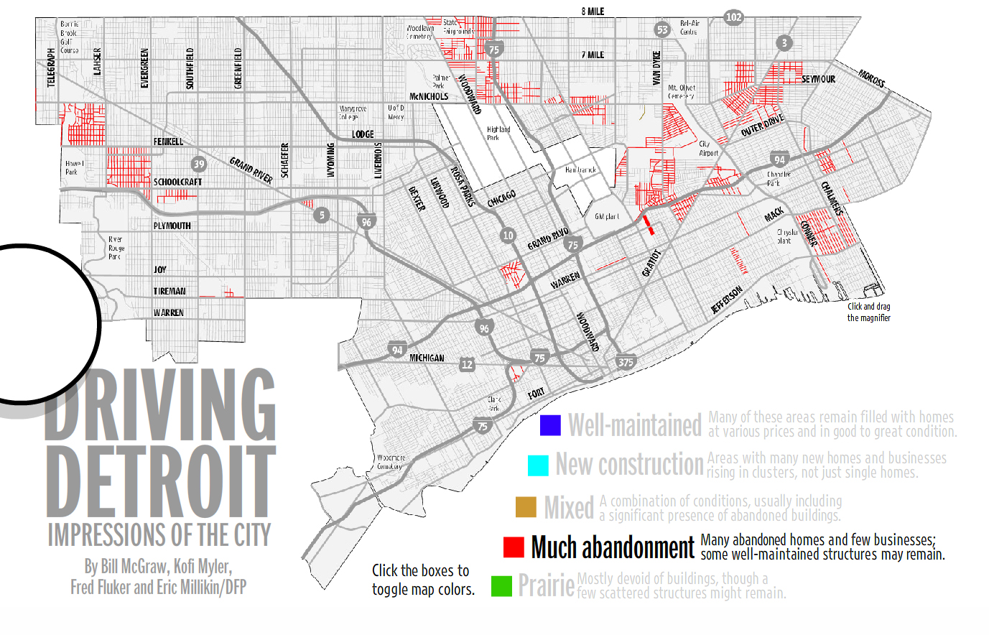
Abandonment Areas
Where
8

Slide 9
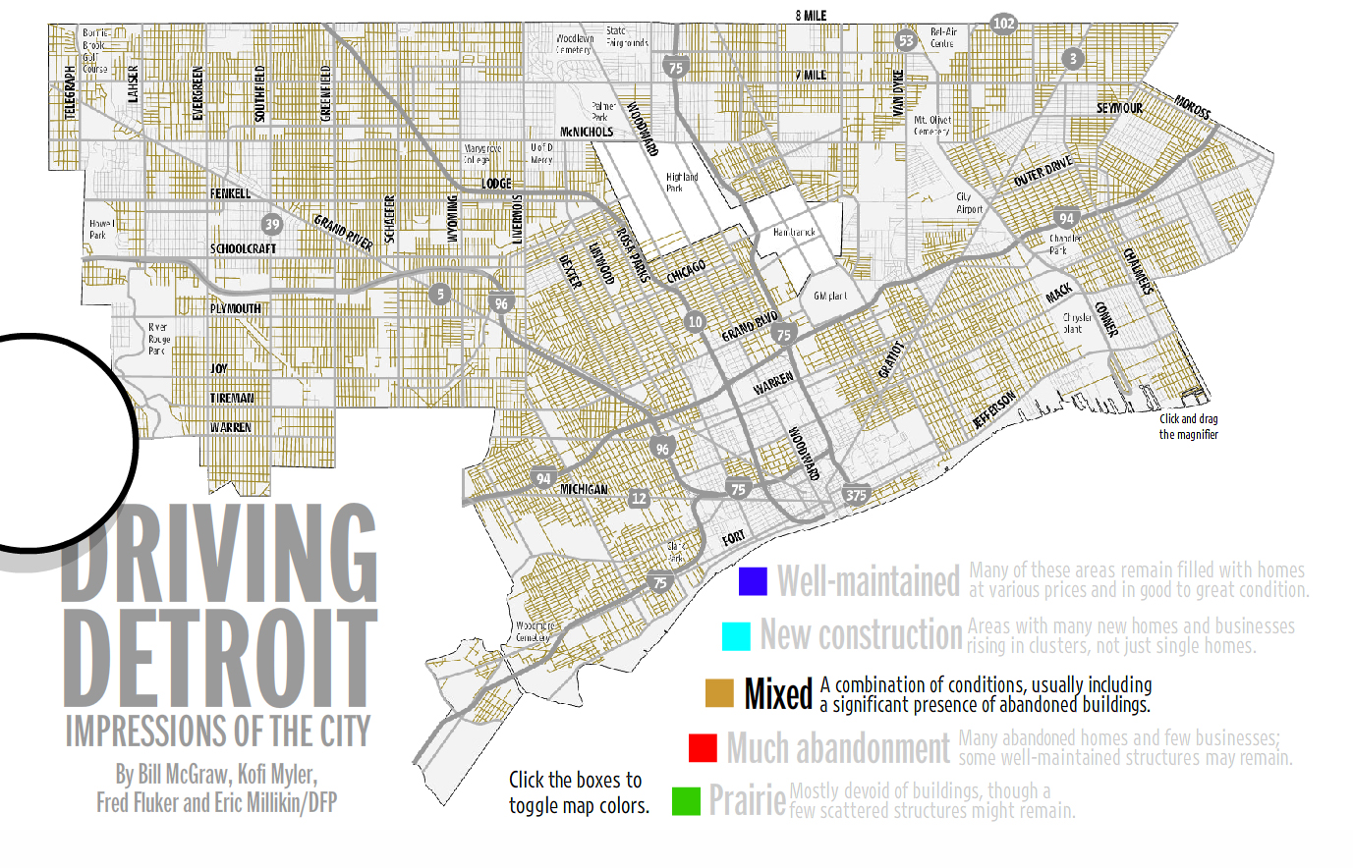
Mixed Areas
Where
9

Slide 10
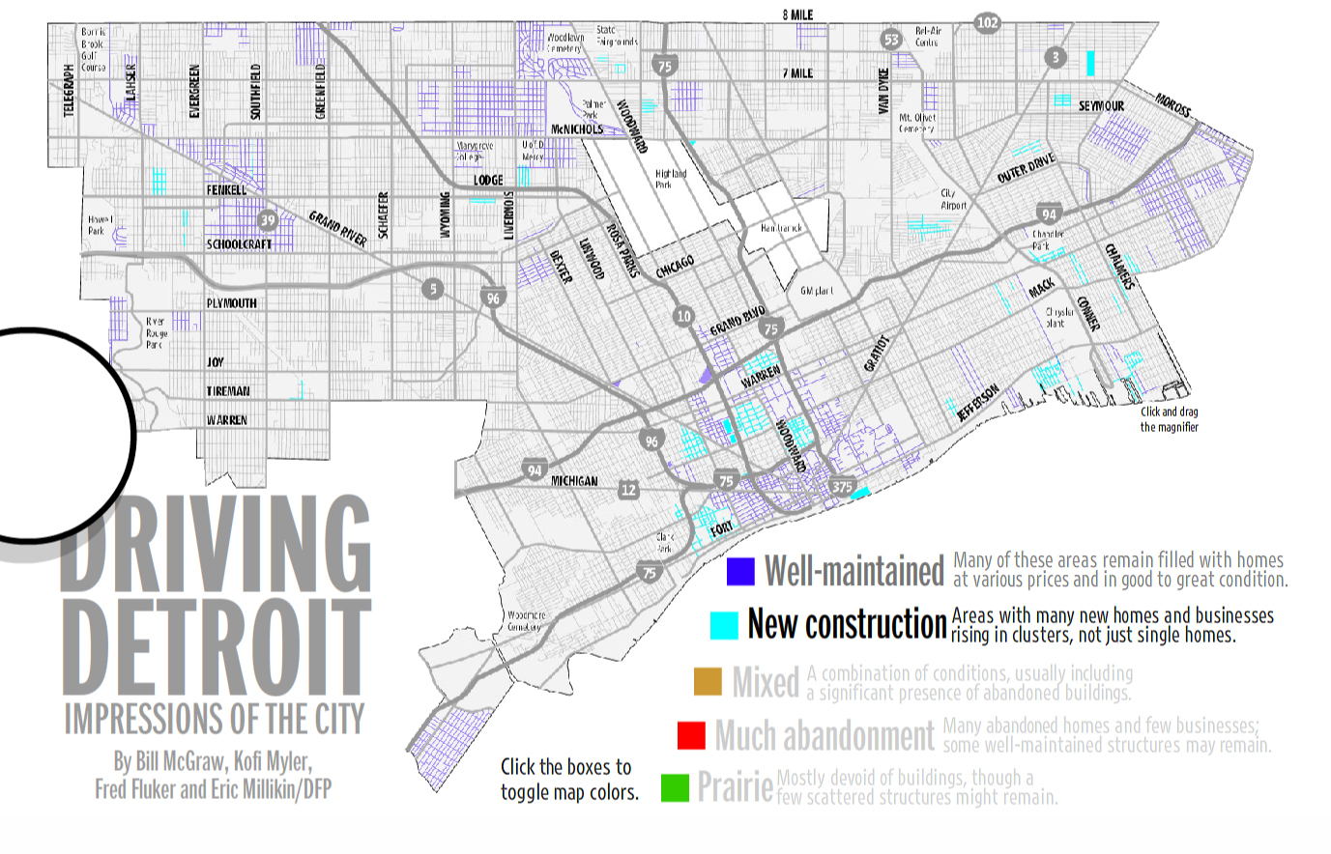
New or Maintained
Where
10

Slide 11
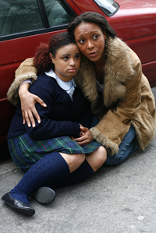
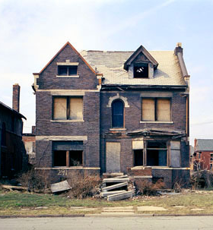
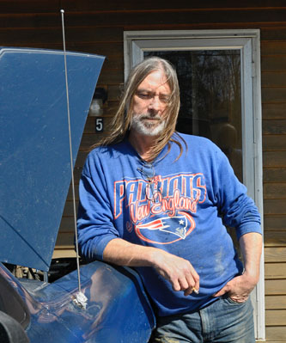
Constructor Selection
Who
11
People and structures would need to be appropriately matched between ability and need.
Steep increases in construction unemployment provides a stock of skilled trade workers that can successfully provide the labor for the structure’s rehabilitation.
“You’re in the construction trade and there ain’t no construction, what do you do? …I’ve done carpentry for 35 years. That’s all I know. … Just I ain’t got nowhere to go. I got my truck right outside, I’ll be sleeping in that soon.” -Matt Springer, Valley News
Skill
Skill
Needs





Slide 12
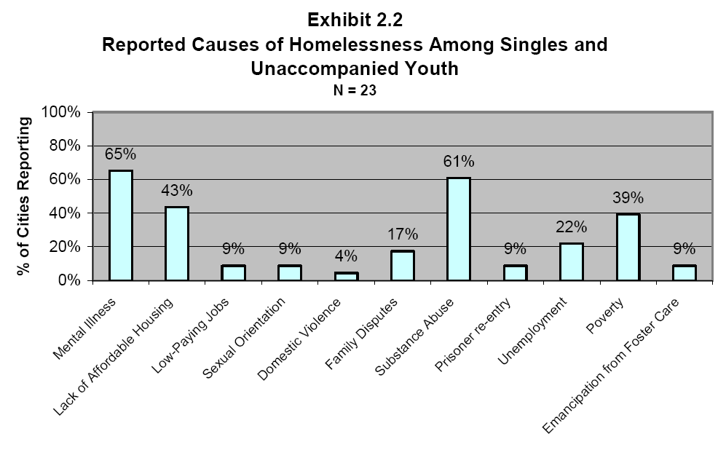
Constructor Selection
Who
12
Ideally persons who have a background in construction that are homeless or at risk of being homeless due to unemployment or underemployment.

Slide 13
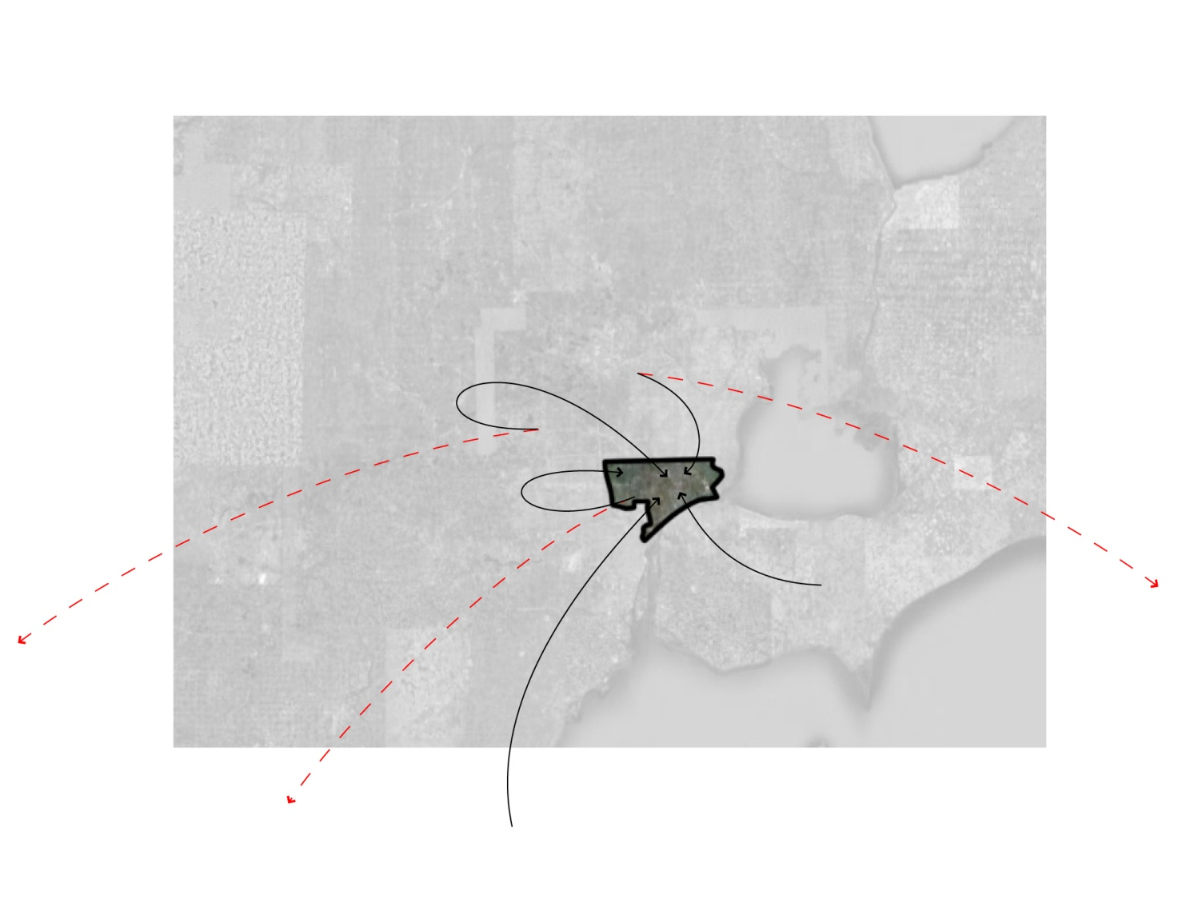
Regional Benefits
Stakeholders
13
Opportunities keeping or attracting displaced productive workers to Detroit benefits the regional economy.
Stabilizing the deterioration of Detroit makes attracting development investments more feasible.
Keeping extended families together in south east Michigan keeps their internal support systems intact.
Keep displaced Detroiters
Attract displaced from region
Attract national / international displaced workers

Slide 14
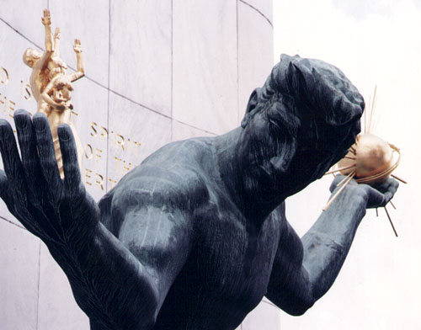
Beneficiaries
Stakeholders
14
City of Detroit
Liability turned to asset
Avoid demolition costs
Short term tax loss for long term gain
Neighborhoods
Liability turned to asset
Add population to neighborhood
Deter crime
Constructors
Ability to build asset
Free to low cost housing
Future tenants/ owners
Preserved buildings offer opportunities for affordable housing

Slide 15
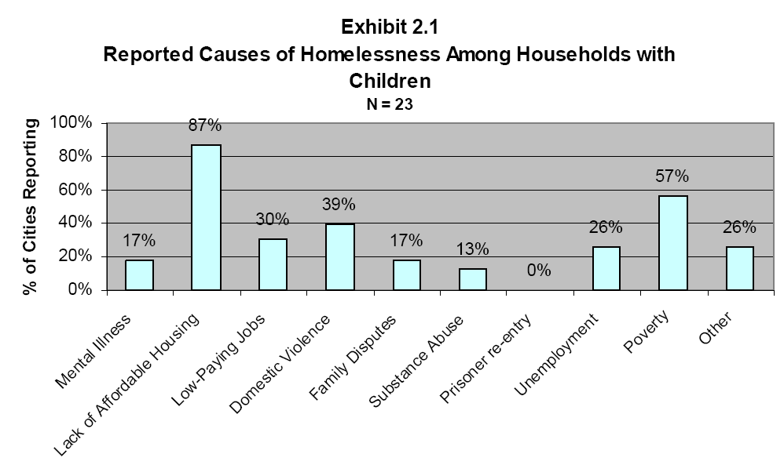
Beneficiaries
Stakeholders
15
A segment of the homeless population with children can be served by the creation of more affordable housing in the city. A habitat for humanity loan could be set up to provide funding or sale opportunities for the constructors.

Slide 16
Challenges
Challenges
16
Legal
Ownership, certificate of occupancy, liability, insurance, OHSA construction requirement, plans and permitting
Political
Tax forgiveness, population attracted, and conflicts with clearing land for large developments.
Living
Economic support, safety, transportation, flexibility, climate, and utilities.
Construction
Materials, costs, equipment, manpower, transportation.
Employment
Income, time, availability and accessibility.
Psychological
Self values, community values
Legal
Political
Living
Construction
Employment
Psychological

Slide 17
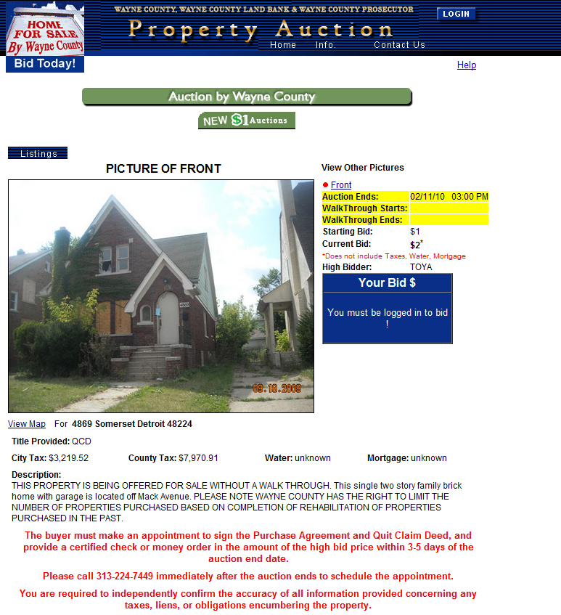
Legal
Challenges
Wayne County $1 Auctions
  Current bid: $2
  Cost: Over $11,192.43
  No walk through
  Potential other obligations encumbering the property.
  Independent verification of information
Potential for squatters
Leave for construction work

Slide 18
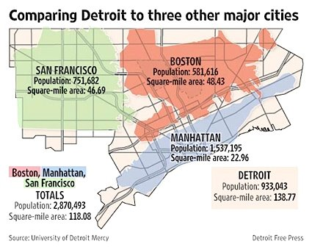
Political
Challenges
Challenges
18
Potential conflicts with long term development goals.
  Shrinking the city
  Clearing land for large developments
  Objections to inhabitants
  Immigration status
  Viewed as squatters
  Viewed as adding to homeless population
  Criminal background
  Legal when crime occurs

Slide 19
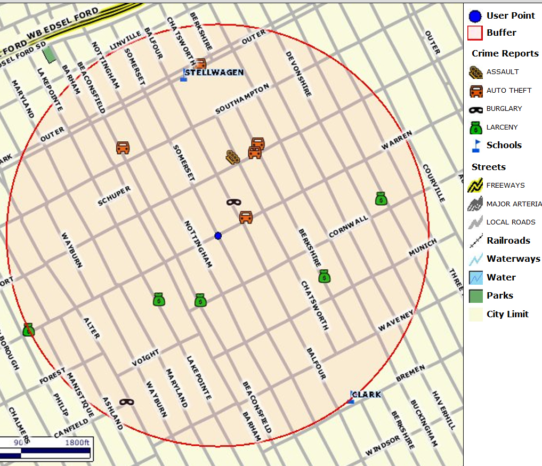
Living
Challenges
Challenges
19
Crime
  For the $2 bid property
  ½ mile radius, past 30 days
  1 Assault
  5 Auto thefts
  2 Burglaries
  5 Larcenies
Distressed areas have increased crime rates.
  Potential strategies:
  Organized teams can help reduce criminal opportunity.
  Neighborhood awareness to reduce the risks of being victimized.
  Increased police and oversight activities may help reduce risk, but funding is unlikely.
  Gratis safety deposit boxes.
  C.B. / Walkie talkie network

Slide 20
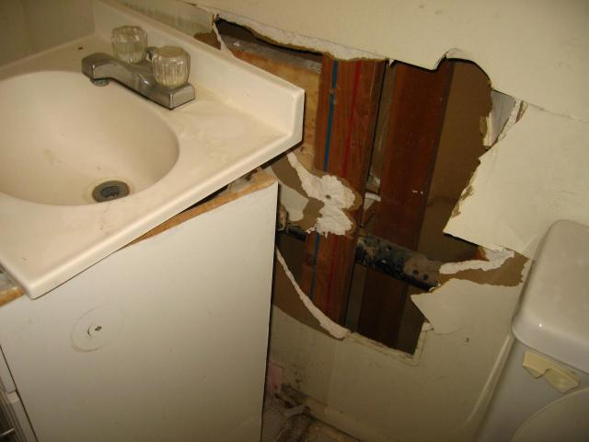
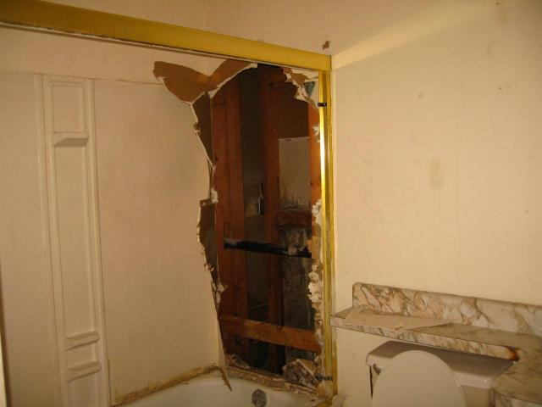
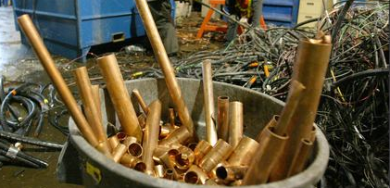
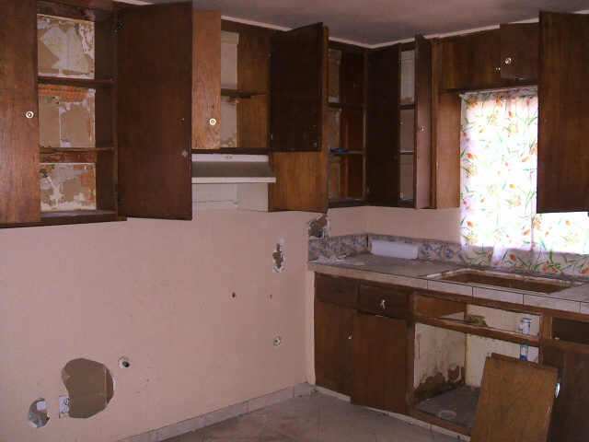
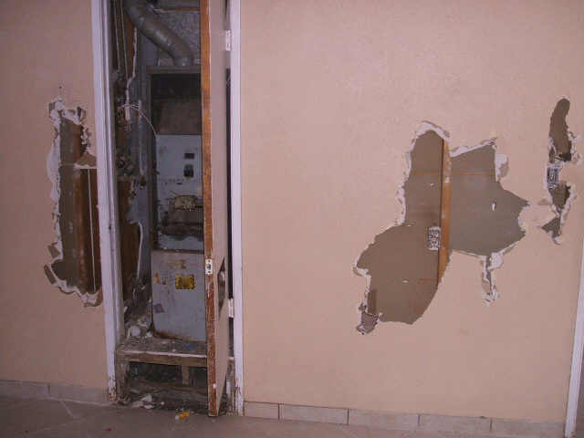
Living
Challenges
Challenges
20
Stripped buildings
  Stolen pipes
  Stolen wires
  Significant construction required before utilities can function.
Potential strategies:
  Starter core
  Downsizing or dividing the building.
  Community kitchens / baths.
  Old tech – out house /composing
  Rainwater catchment
  Community battery charging

Slide 21
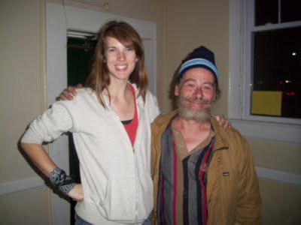
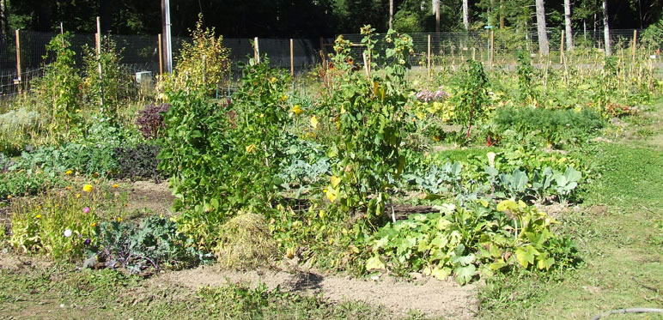
Living
Challenges
Challenges
21
Food
  Acquisition
  Storage
  Transportation
Potential strategies:
  Vehicle sharing
  Food bank drop offs
  Community & private gardens
  Coolers with ice from neighbor
  Broken fridge coolers.
  Sponsoring neighbors

Slide 22
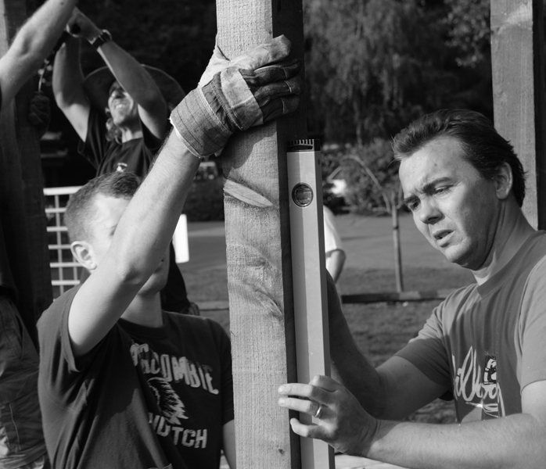
Construction
Challenges
Challenges
22
Materials
  Ultra low budgets
  Material purchase
  Transportation
No plans
  Engineering judgments
  Code compliance
  Teamwork
  Other displaced builders
  Habitat for Humanity, Blight Busters
  Supportive neighbors

Slide 23
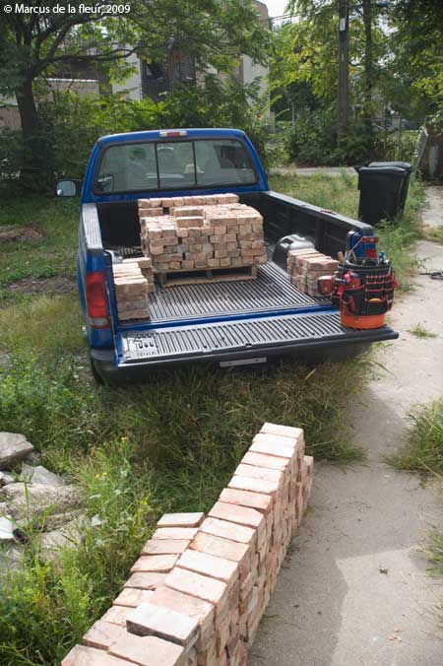
Employment
Challenges
Challenges
23
Living / construction expenses
Local employments
  Local labor tasks
  Availability for day labor
  Preferred labor network
City demolition contracts
  Require disassembly and material salvage
  Prefer manual to mechanical labor
  Divert demolition funds to reconstruction.
Union / Non-Union conflicts
Home or sale profit, not paycheck

Slide 24
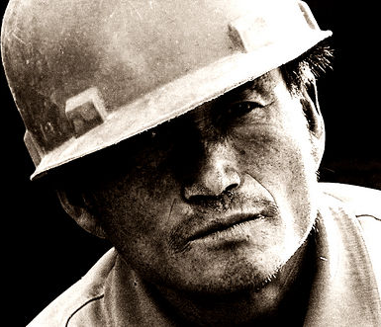
Psychological
Challenges
Challenges
24
Self Image
  Protect identity as productive part of society
  Urban pioneers
  Encourage entrepreneurial skills
Community Image
  Positive force
  Community developers, not squatters
  Neighborhood renaissance

Slide 25
Vision
Summary
25
Enable displaced individuals with the ability to salvage at risk dwellings to take possession and residence of the building and return the structure to a productive building.
+

Slide 26
Credits
Slide 4 – Photo http://www.vmfa.state.va.us/collections/85_401.html
Slide 4 – Photos http://www.foreclosure.com/education/before_and_after/woosley.html
Slide 5 – Image http://www.somacon.com/p479.php
Slide 5 – Data http://www.swivel.com/workbooks/26335-Detroit-Population
Slide 6 – Image http://www.waynecounty.com/wcauctions
Slide 6 – Images http://www.kevinbauman.com/100abandonedhouses
Slide 7 – Graphs http://closup.umich.edu/publications/workingpapers/papers/closup-wp-2-tax-foreclosure.pdf
Slide 7 – Data http://www.reuters.com/article/idUSTRE59O17F20091026
Slide 8-10 http://media.freep.com/drivingdetroit/mcgrawsmap.html
Slide 11 – Image http://www.kevinbauman.com/100abandonedhouses
Slide 11 – Image http://www.vnews.com/zipcodes/05088-wilder.html
Slide 11 – Image http://www.broadwayworld.com/article/New_Musical_Shelter_to_Play_to_Over_100_ Homeless_Families_20070112
Slide 11 – Data http://www.theconcreteproducer.com/industry-news.asp?sectionID=1419&articleID=944695
Slide 11- Quote http://www.vnews.com/zipcodes/05088-wilder.html
Slide 12 – Image http://www.vnews.com/zipcodes/05088-wilder.html
Slide 12 – Graph Hunger and Homelessness Survey: A Status Report on Hunger and Homelessness in America’s Cities, The United States Conference of Mayors, December 2007
Slide 14 – Image http://sun2.science.wayne.edu/~gk12/Spirit1.jpg

Slide 27
Credits
Slide 15 – Image http://www.broadwayworld.com/article/New_Musical_Shelter_to_Play_to_Over_ 100_Homeless_Families_20070112
Slide 15 – Graph Hunger and Homelessness Survey: A Status Report on Hunger and Homelessness in America’s Cities, The United States Conference of Mayors, December 2007
Slide 17 – Image http://www.waynecounty.com/WCAuctions/
Slide 17 – Image http://cartophilia.com/blog/2009_06_01_archive.html
Slide 19 – Image http://detroit.mi.crimeviewcommunity.com/
Slide 20 – Images http://uglyhousephotos.com/wordpress/?p=7429
Slide 20 – Images http://uglyhousephotos.com/wordpress/?p=3520
Slide 20 – Image http://www.seattlepi.com/dayart/20070125/450metaltheft_copper.jpg
Slide 21 – Image http://www.evergreen.edu/cell/images/CommunityGardens.jpg
Slide 21 – Image http://homelessontuesday.blogspot.com/
Slide 22 – Image http://csrprojects.files.wordpress.com/2008/12/wwwcsrprojectscom-176.jpg
Slide 23 – Image http://delafleur.com/blog/wp-content/uploads/2009/11/common-brick-01.jpg
Slide 24 – Image http://www.flickr.com/photos/saad/1968774/
Slide 25 – Images See Slide 4

