Slide 1
Solar-Thermal Heating Group
High Performance Building Investigation
Upland Hills Ecological Awareness Center
Oxford, Michigan
Ryan Grabow, Cheryl Smith, Jessica Turner, & Brent Wozniak
Professor Janice Means, P.E.
Lawrence Technological University

Slide 2
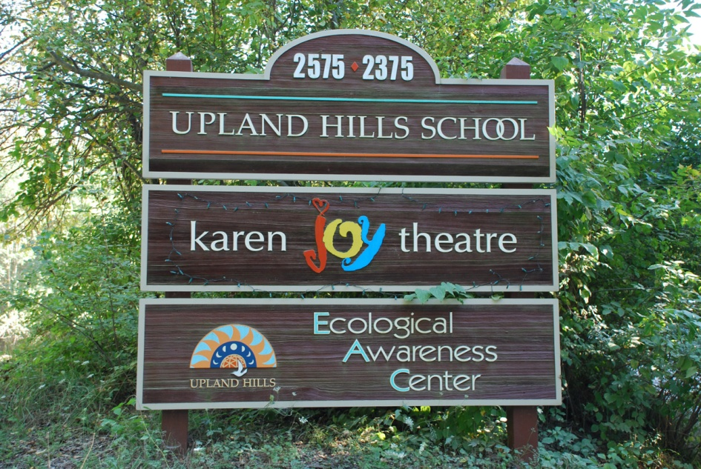
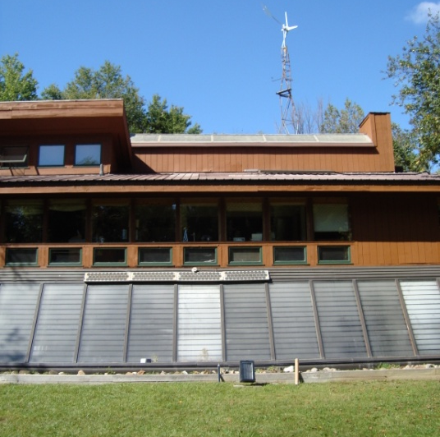
Overview
Air Collector
Ductwork
Rock Storage
Building needs
Photos by Craig Necci

Slide 3
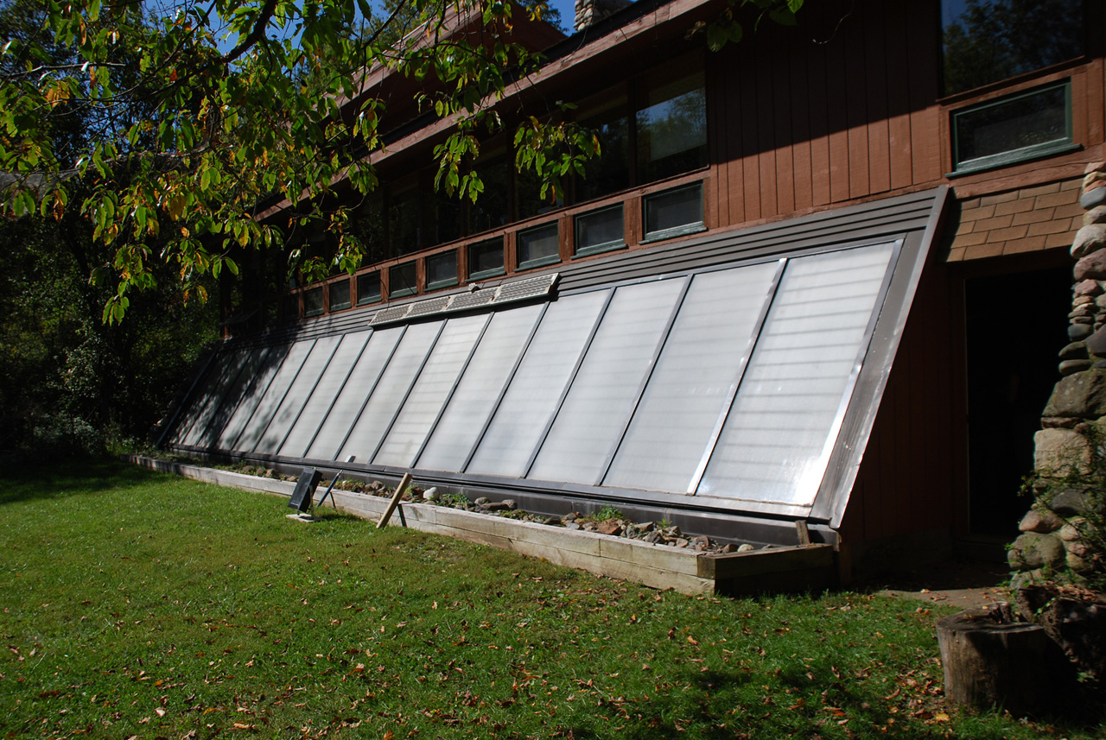
Air Collector –
Solar Thermal Air Based Collector Panels
Photo by Craig Necci

Slide 4
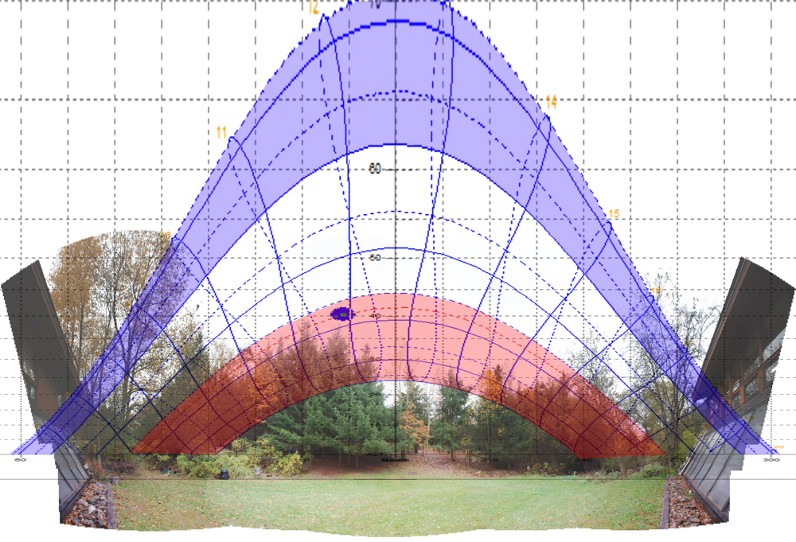
Solar Exposure
Summer
Trees obstruct the sun from reaching the panels in the winter when heat is needed.
In December, a point on the panels will receive less than two hours of direct sunlight.
East
(Morning)
Winter
West
(Evening)

Slide 5
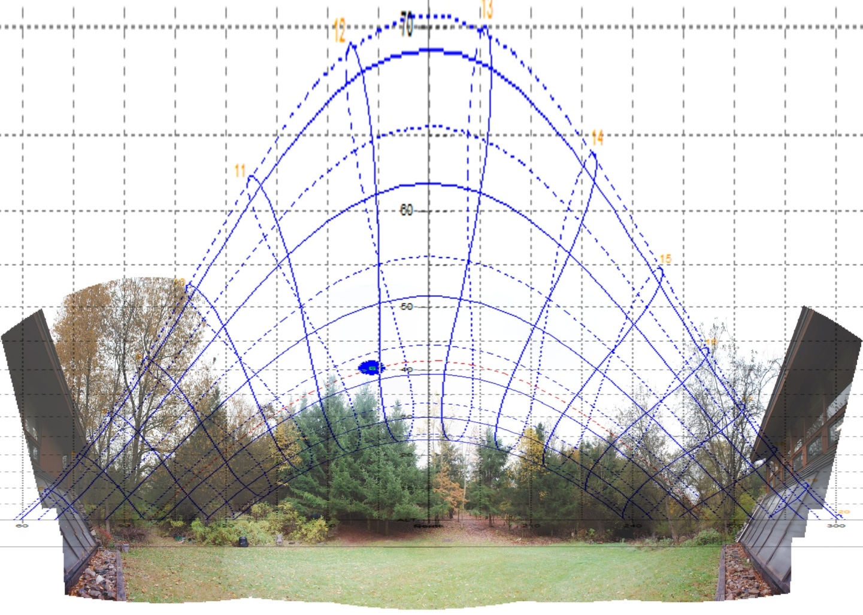
Collector Tilt
58 degree slope aims the panels to maximize exposure to the winter sun.
Rule of thumb
Latitude + 15 ° to 20°

Slide 6
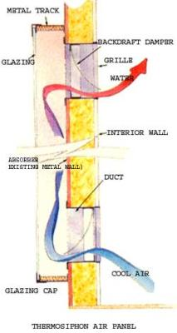
Termosiphoning
How it should work
10 square feet of solar collecting panels for every 100 square feet of floor space.
UHEAC is about 1800 square feet = 180 square feet of collecting panels or about 7 panels
Currently has 15 panels totaling 430 square feet of solar collecting area
www.motherearthnews.com/renewable-energy

Slide 7
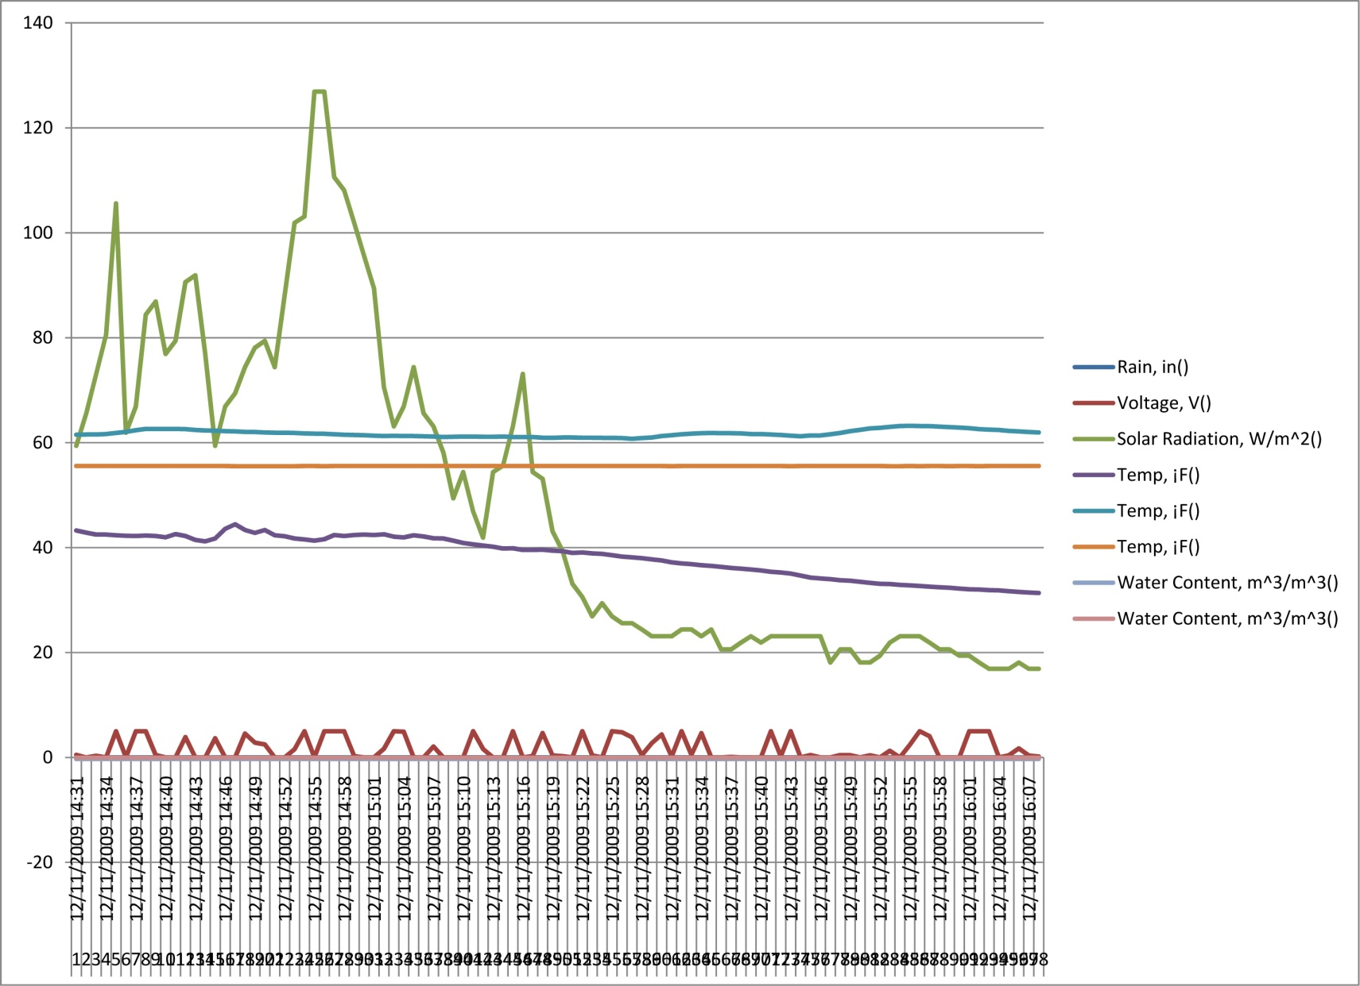
Is it working?

Slide 8
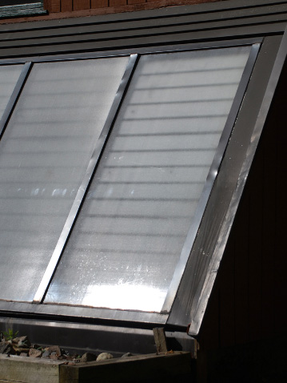
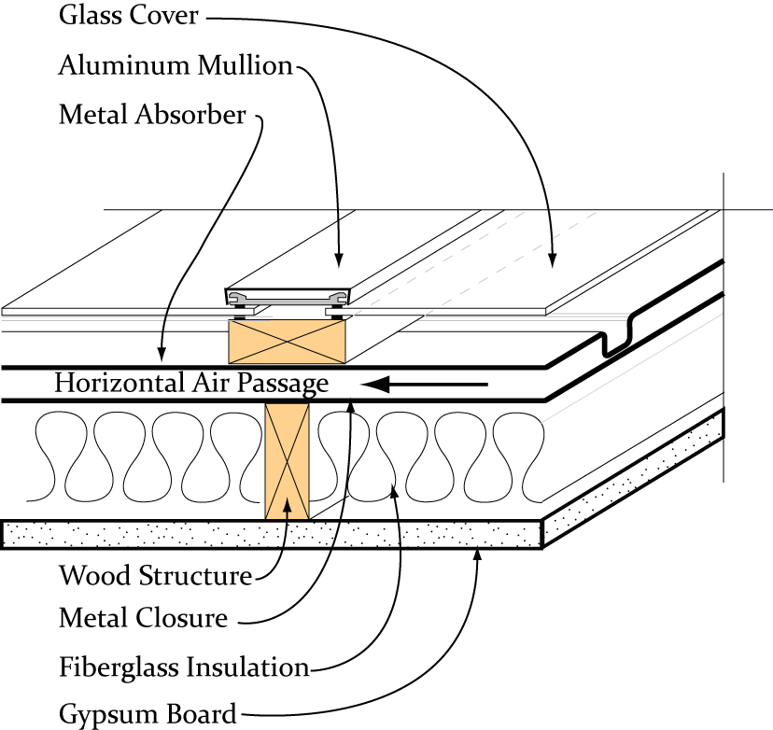
Panel Construction

Slide 9
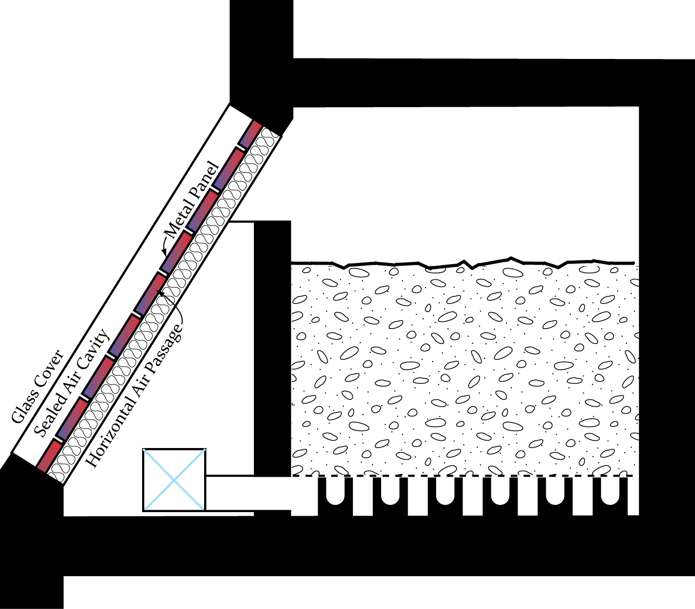
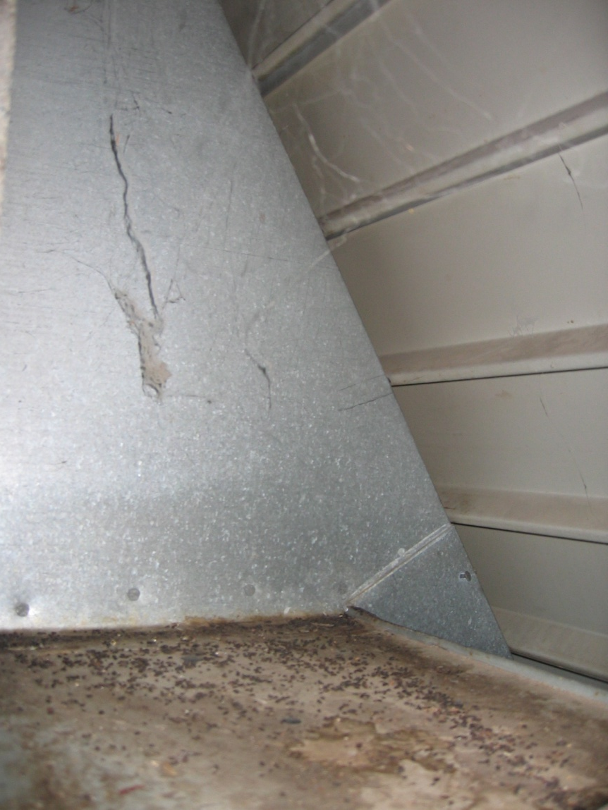
Collector to Rock Storage

Slide 10
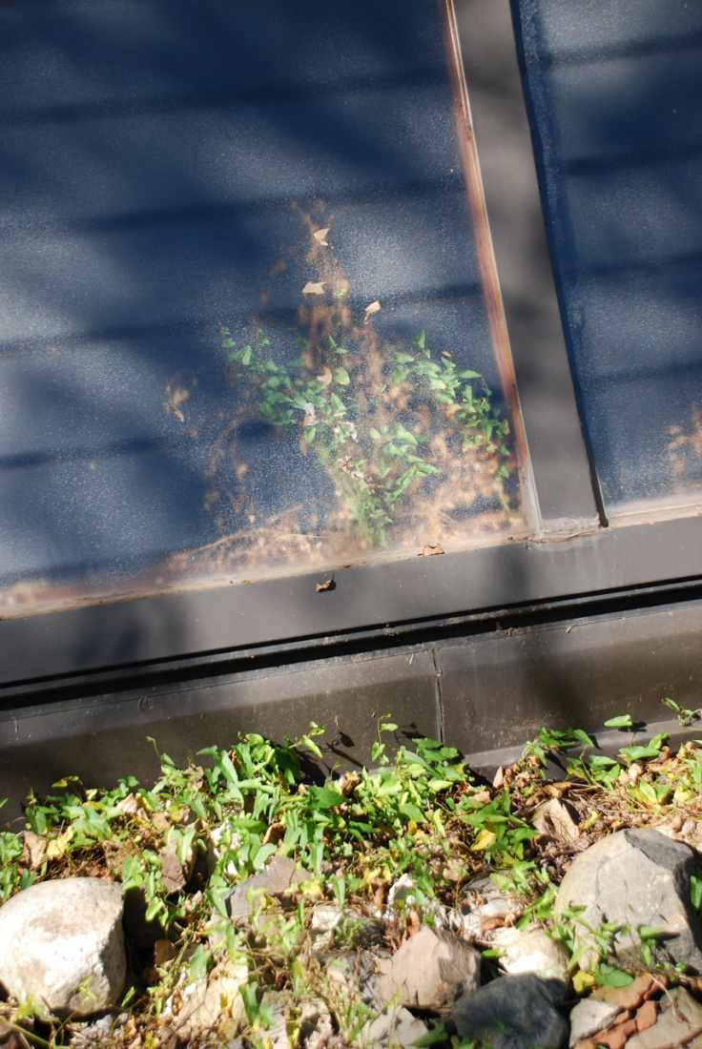
Current problems
Aging system
Weeds between glass panes
Air flows from sides instead
of bottom
Duct work not properly sealed
Photo by Craig Necci

Slide 11
What can be changed
Properly install collecting panels so that cold air flows in from bottom
  Reduce # of panels needed from 15 to 7
    If rock storage is not made effective
  Increase efficiency and effectiveness
Reseal all panels and incoming duct work
Replace any damaged panels and recoat real panels

Slide 12
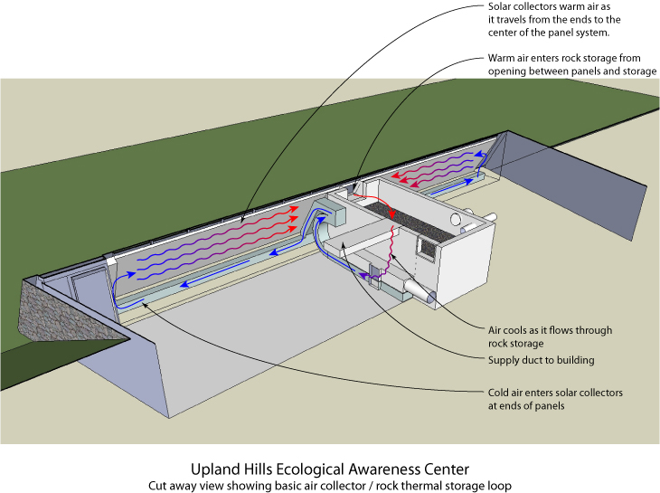
Ductwork

Slide 13
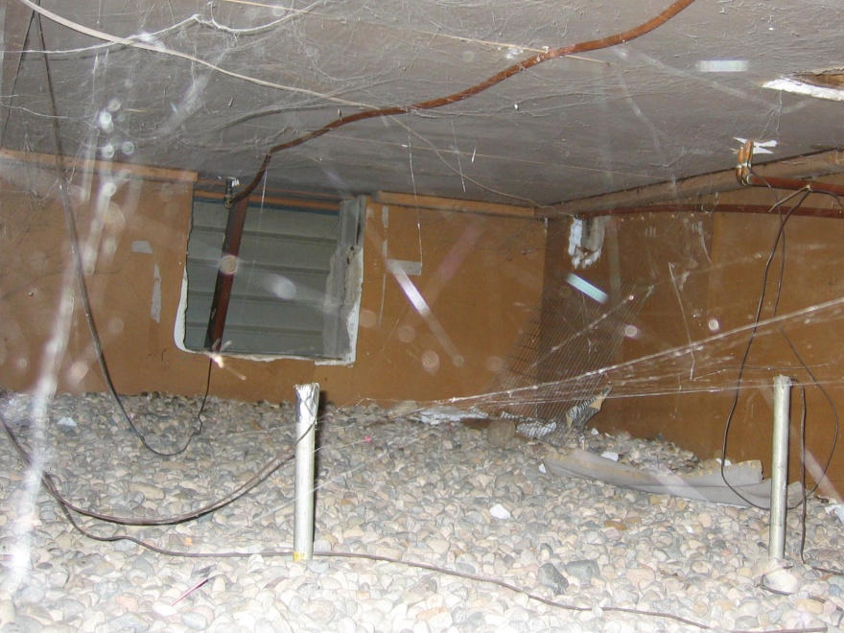
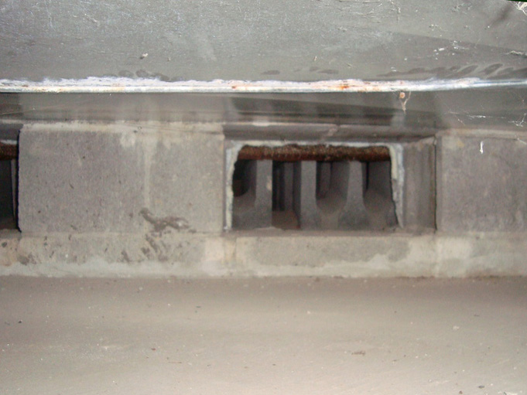
Duct to Rock
Storage Connection
(Drawing from Howell)

Slide 14
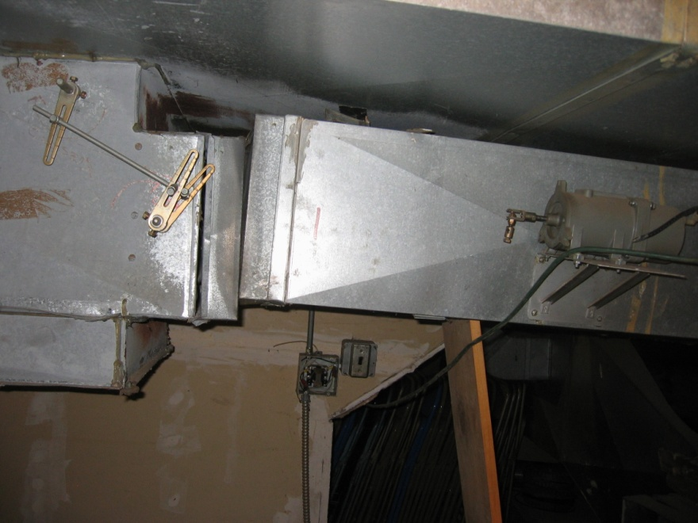
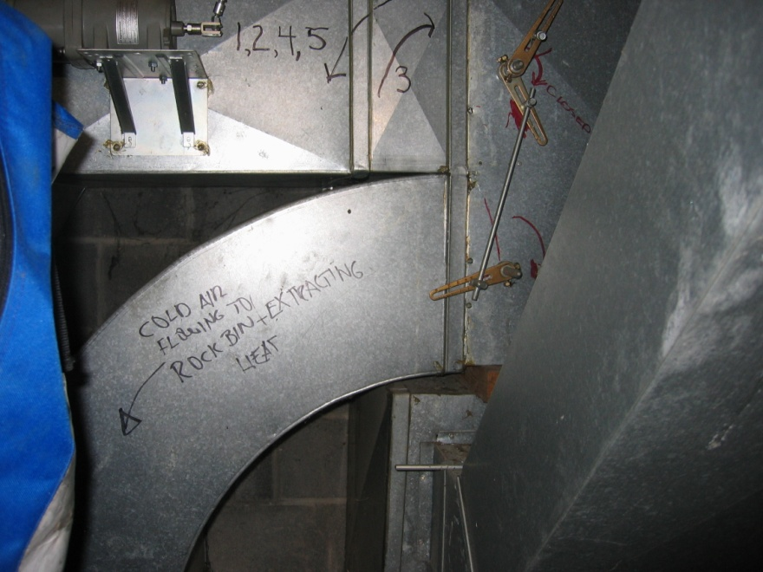
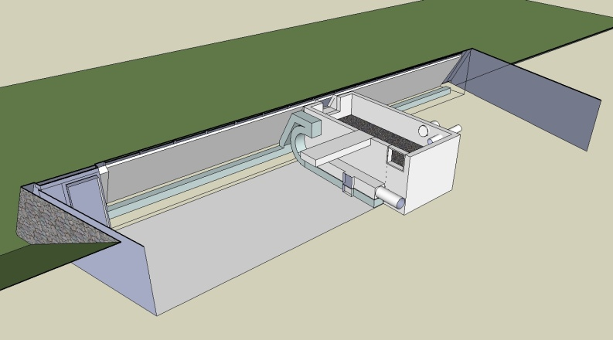
Disconnected Controls
Disconnected furnace results in large openings within the duct system.
Control equipment is disconnected from dampers and thermostats.

Slide 15
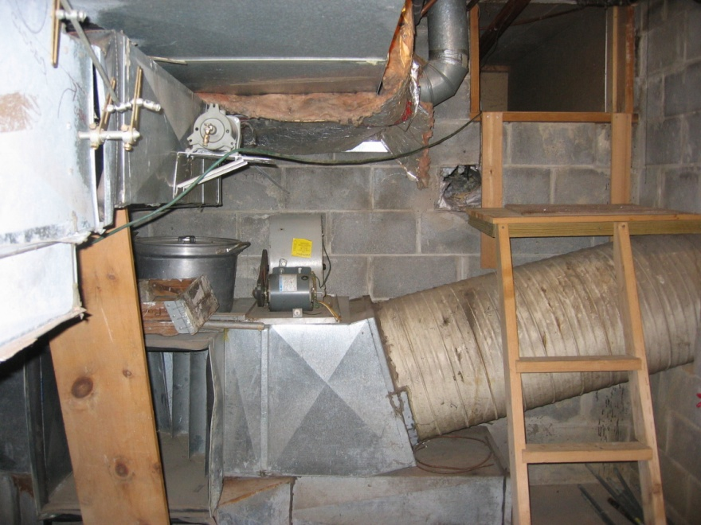
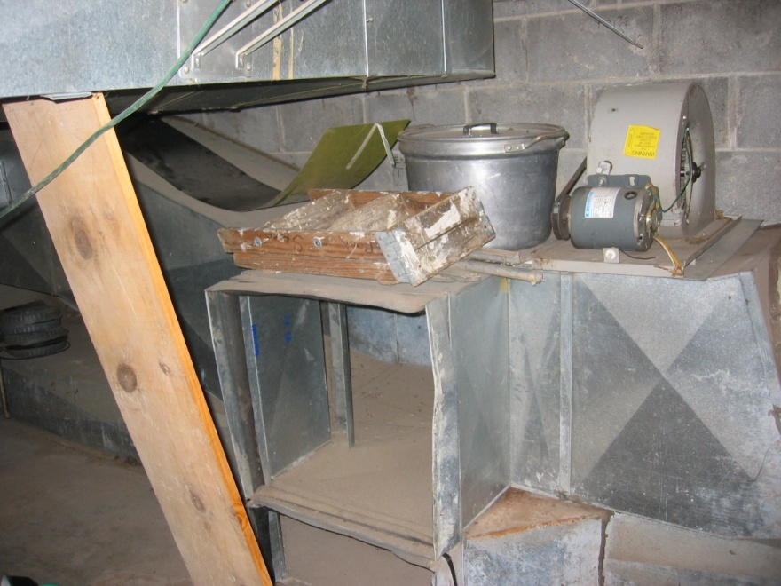
Disconnected Components
Control equipment is disconnected from dampers and thermostats.
Blower fan disconnected from the system.
Unintended openings in the rock storage

Slide 16
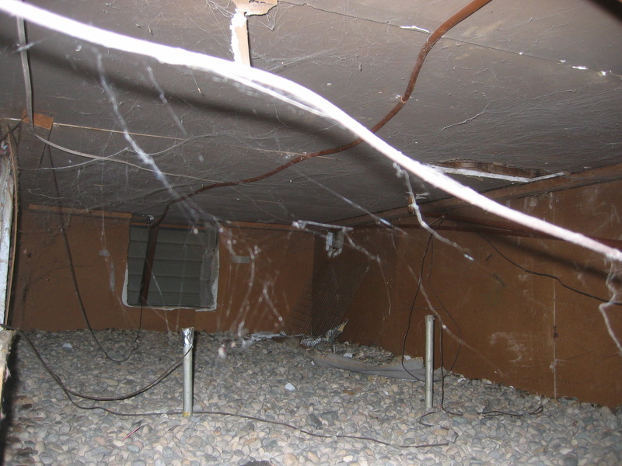
Rock Storage
What is it
How should it work
Does it work
What can be changed

Slide 17
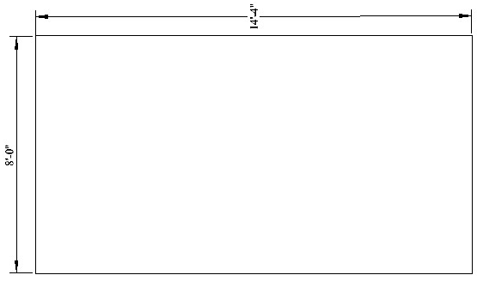
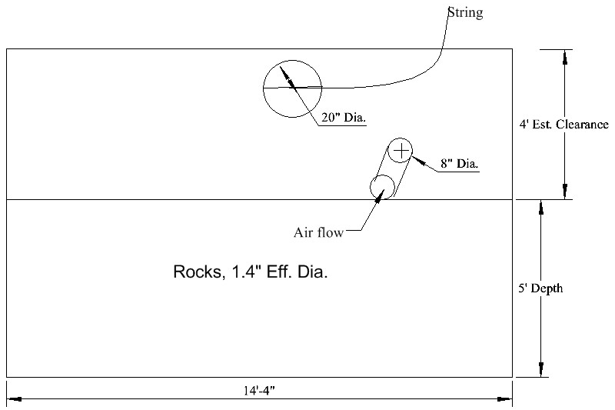
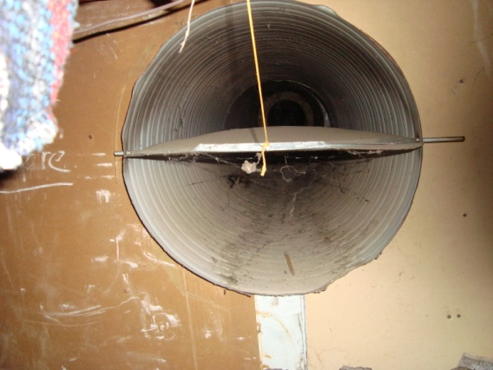
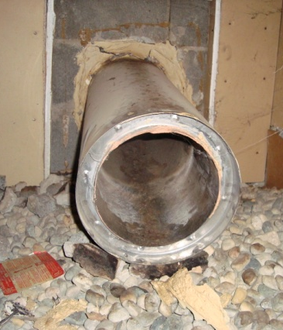
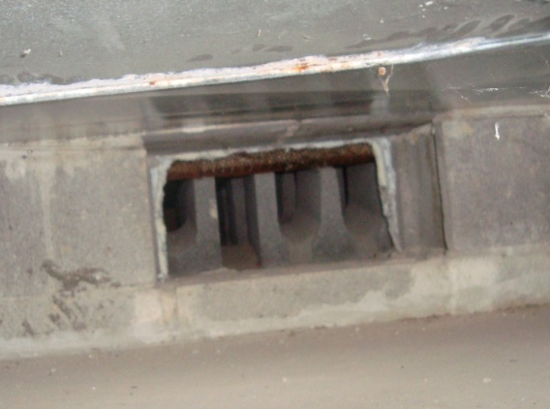
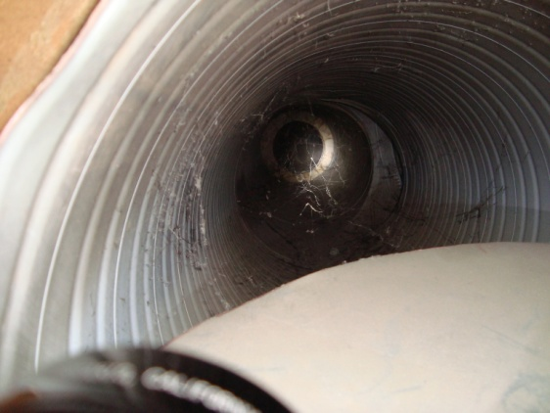
Rock Storage
Drawings & Pictures
1
2
3
Plan View
West Elevation
1
2
3

Slide 18
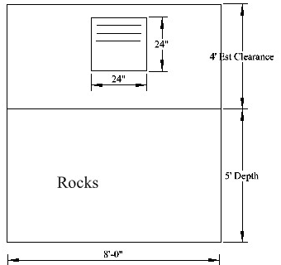
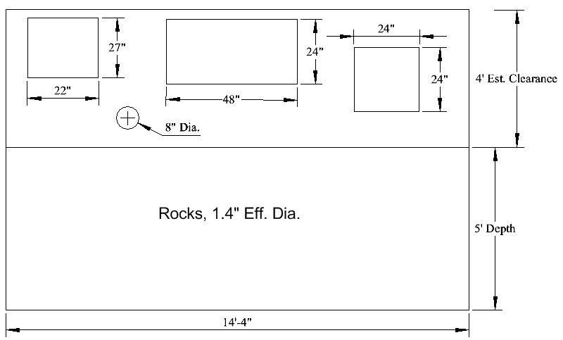
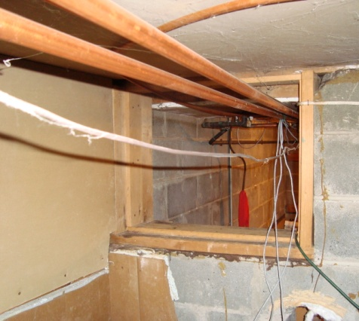
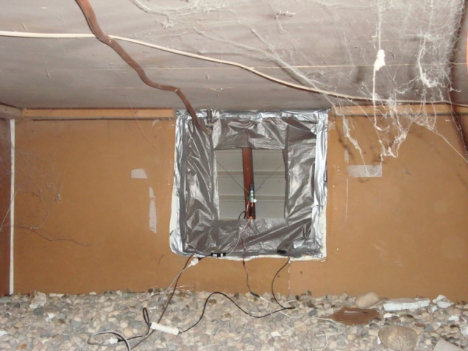
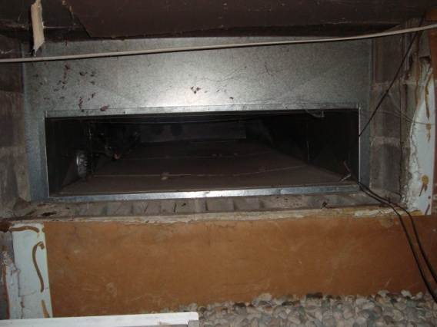
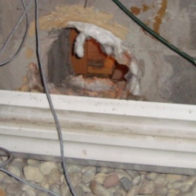
Rock Storage
Drawings & Pictures
2
4
1
3
South Elevation
East Elevation
2
1
4
3

Slide 19
Installed Sensors
Pyranometer
Air Velocity Sensor
Temperature behind collector panels
Temperature within rock storage
5. Temperature within occupied space
5
1
2
3
4

Slide 20
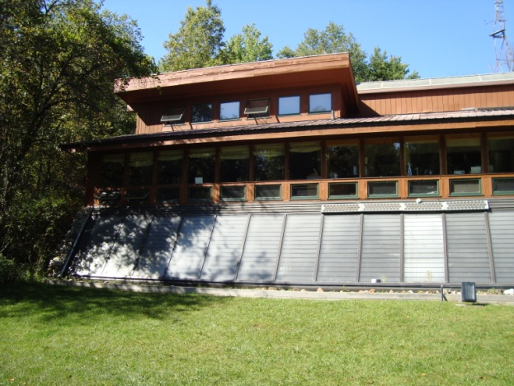
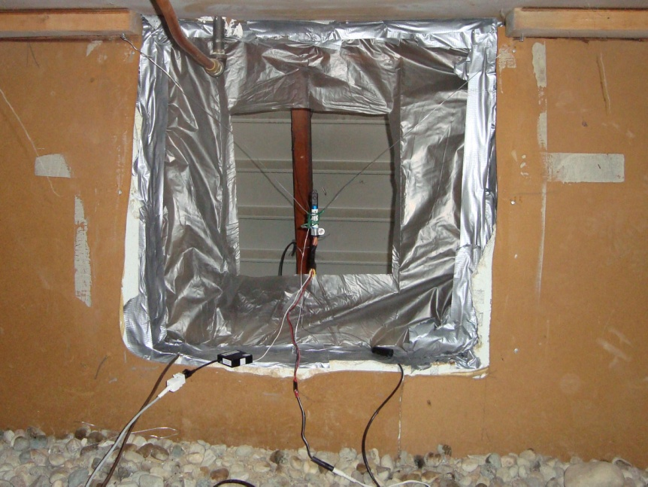
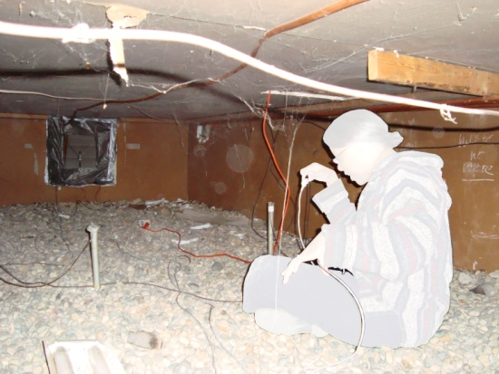
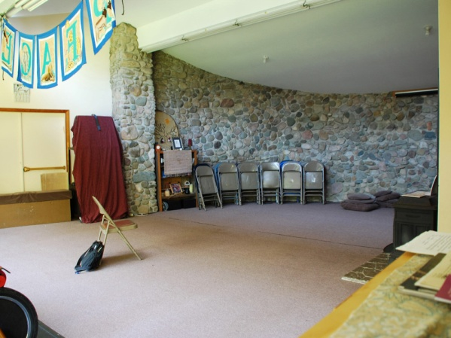
Sensor Locations
1.) Pyranometer
The Solar Radiation
light sensor measures
average light intensity
5
1
3
2
4
2.) Air Velocity Sensor
4. & 5.)
Temperature Sensors
3.) Temperature Sensor

Slide 21
Collected Data December 12th, 2009

Slide 22
Collected Data December 12th, 2009
Sunlight affecting temperature from collector; however, it is insufficient.

Slide 23
Air Velocity Data
Erratic data largely falls outside the calibrated range. Increase opening size and check logger for averaging capability.

Slide 24

Recommendations
Restore duct system to an operable state.
  Close unintended openings.
  Reinstall blower fan.
  Revaluate system via manual operation of dampers.
  Replace supplemental heat system.
  Salvage / replace automated control system.
Replace coniferous trees south of the building with short deciduous tress.
Revaluate prior to modifying air collector panels.

Slide 25
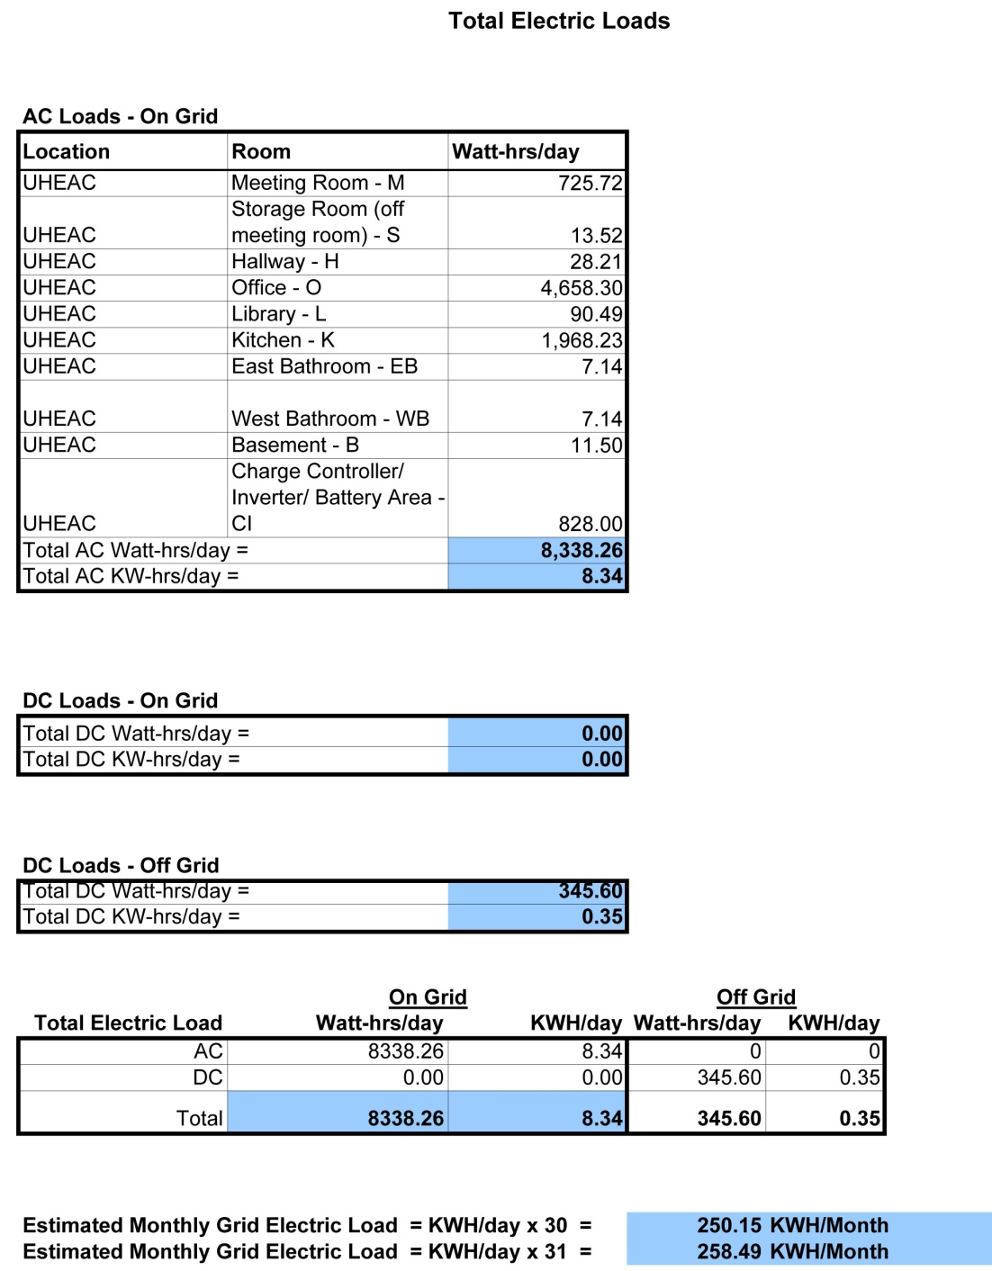
UHEAC
Energy Audit
Note: Highest Usage
*Highest power usage is
the desktop computer
September UHEAC Energy Usage
244 KW-hrs/month
HPBI Energy Audit
8.34 KW-hrs/day
8.34 x 31 (days) = 259 KW-hours/month
[(244-259) / 244] x 100 = 6% difference
8.34 KW-hrs/day

Slide 26
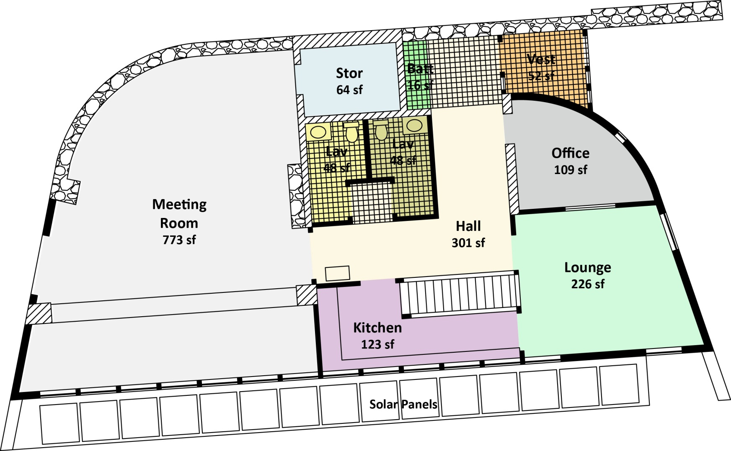
UHEAC : Floor Plans
Device : Energy Ratios : per room basis
3 : 14
2 :414
2 : 50
7 : 725
1 : 7
1 : 7
10 : 4,658
2 : 28
8 : 90
5 : 1968
# Devices : Energy Usage (Watt-hrs/day)
Rounded up

Slide 27
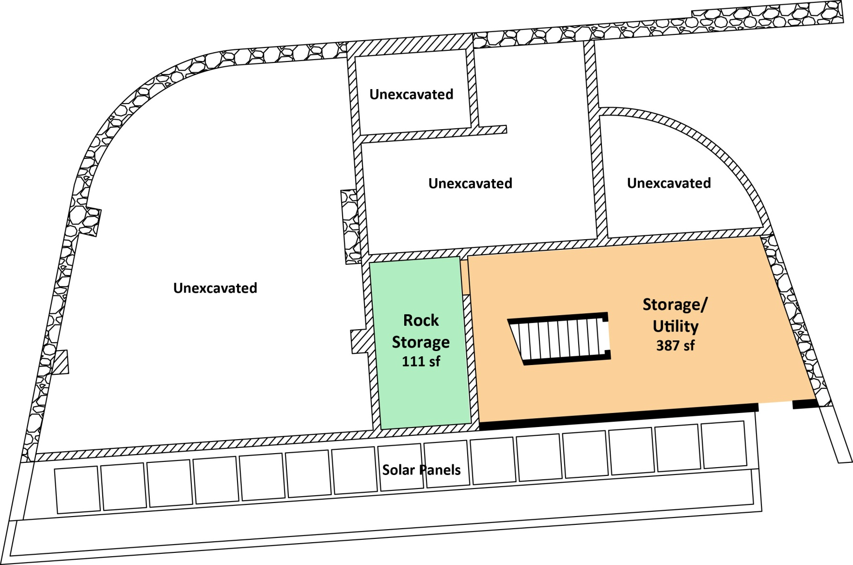
UHEAC : Floor Plans
Device : Energy Ratios : per room basis
2 : 12
# Devices : Energy Usage (Watt-hrs/day)
Rounded up

Slide 28
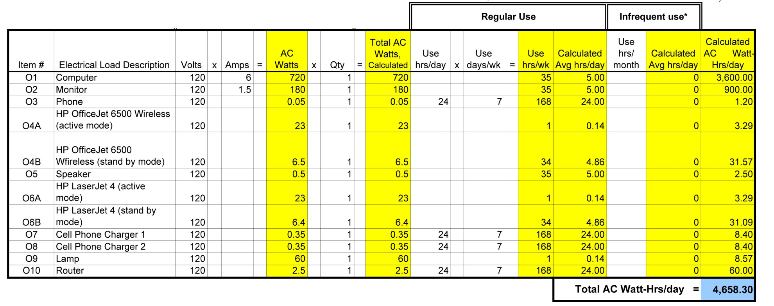
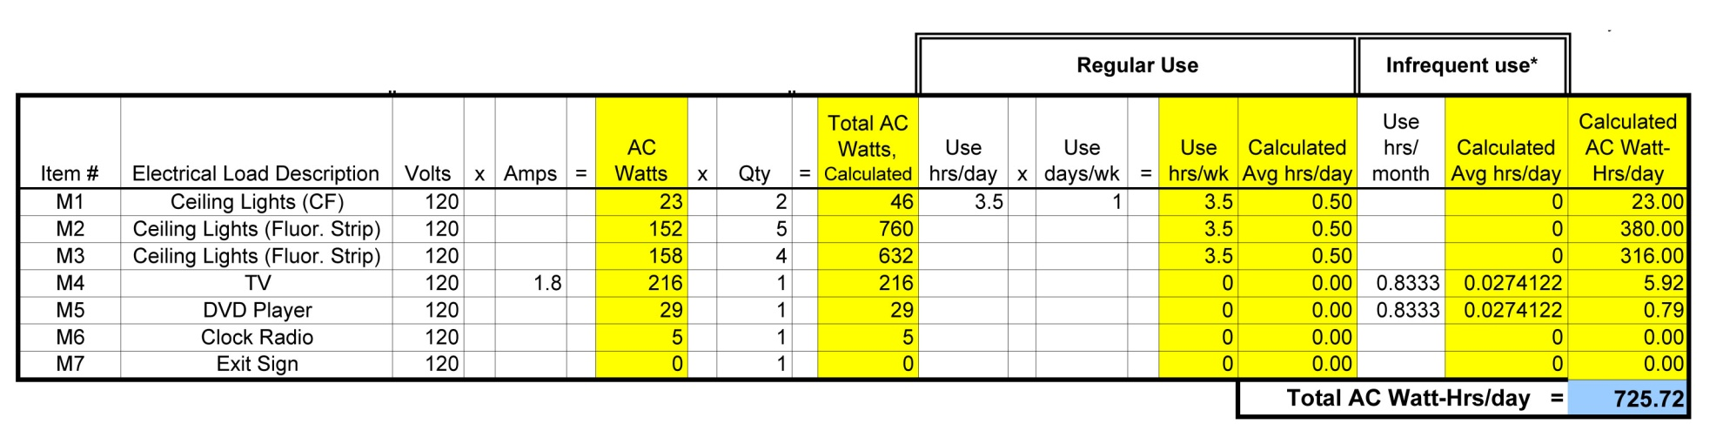
Energy Audit Breakdown
Office
Meeting Room

Slide 29
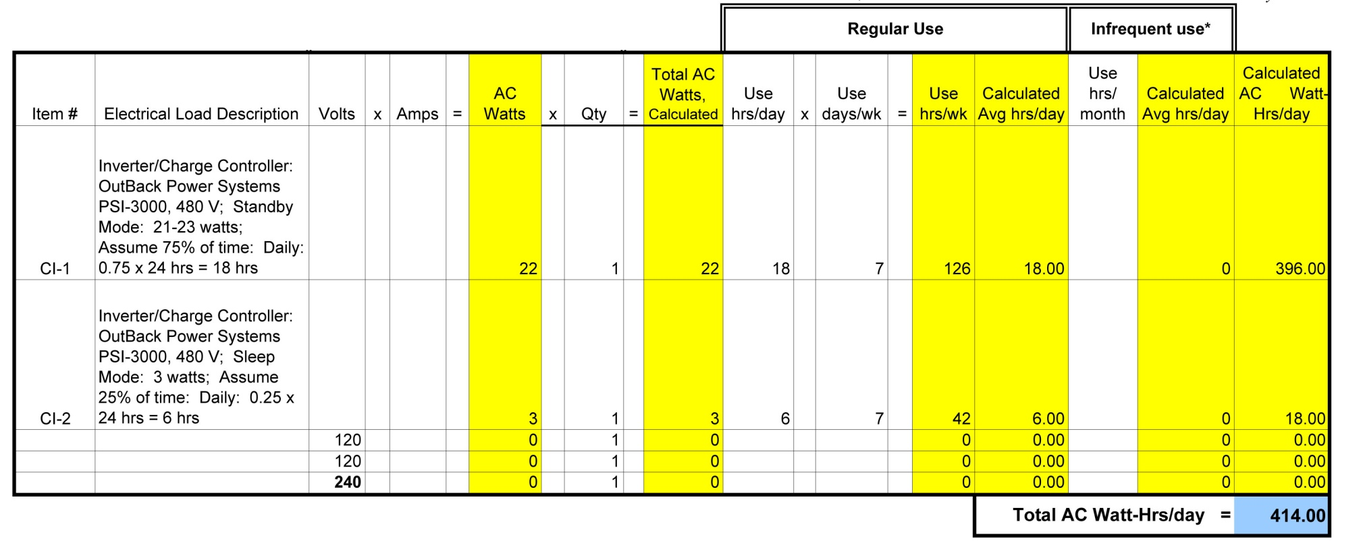
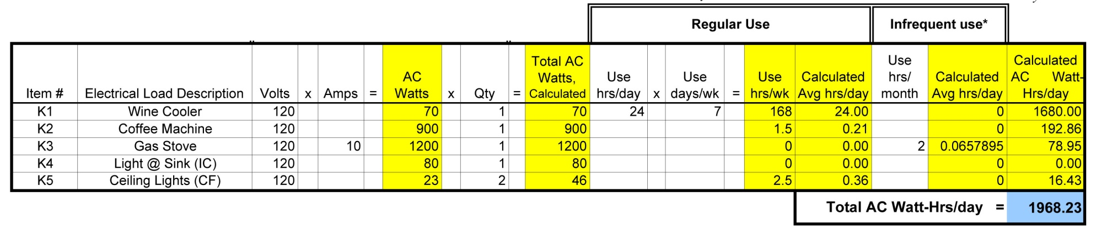
Energy Audit Breakdown
Battery Closet
Kitchen

Slide 30
Software Evaluation
Software | Website | Comments | Cost
ESP-r | apps1.eere.energy.gov/buildings/tools_directory/software.cfm/ID=39/pagename_submenu=load_calculation/pagename_menu=whole_building_analysis/pagename=subjects | Whole building analysis. An EnergyPlus Interface. Compatible with AutoCAD and Ecotect. | Free
ECOTECT | www.squ1.com/ | Whole building analysis. An EnergyPlus Interface. Extensive program. Learning curve involved. Compatible with AutoCAD. | Student License $75
Energy Plus | apps1.eere.energy.gov/buildings/energyplus/ | Whole building analysis. Most comprehensive, state of the art, energy software available from the Dept of Energy. | Free
EP-Launch, IDF Editor, & Open Studio | apps1.eere.energy.gov/buildings/energyplus/ep_utilities.cfm#idfeditor | An EnergyPlus Utility. Helps create input files and run simulations. | Free-Part of Energy Plus
Energy Plugged & EP-Quick | apps1.eere.energy.gov/buildings/energyplus/ep_utilities.cfm#idfeditor | Data interface for EnergyPlus. This is a plugin for AutoDesk AutoCAD to allow for easy input of data to EnergyPlus. | Free

Slide 31
Supplementary Resources
Electrical Energy Usage Survey and Analysis
Energy Modeling Software Evaluation
Weather Data Sources Documentation
Sunlight and Sneezing Literature Search
Assistance to Greenroof Group:
Provided assistance on how to measure greenroof performance
Conducted search for greenroof modeling software
Solar Radiation Data

